Slide 1
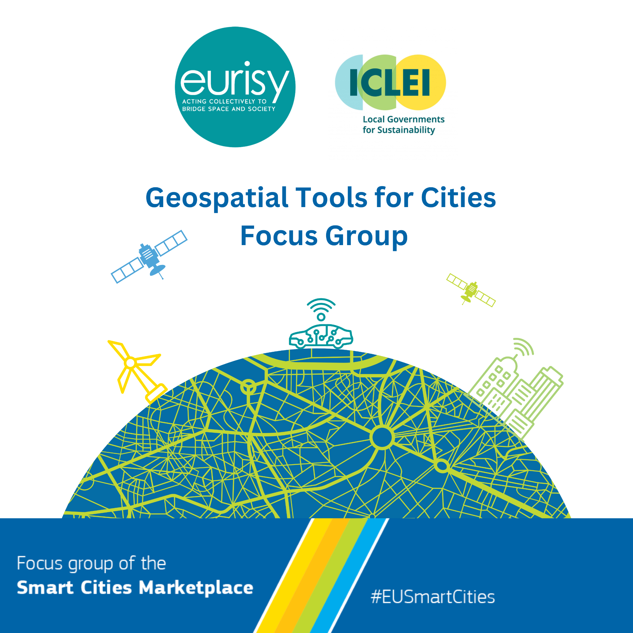
Background image by Aleksejs Bergmanis from Pexels

Slide 2
What is ICLEI?

Slide 3
A NETWORK OF LOCAL GOVERNMENTS
COMMITTED TO SUSTAINABLE URBAN DEVELOPMENT

Slide 4
OUR MEMBERS IN EUROPE
>200
LOCAL AND REGIONAL
AUTHORITIES
PROJECTS & FUNDING
PLATFORMS & CAMPAIGNS
EVENTS & CAPACITY BUILDING
CONSULTANCY & TRAININGS
ADVOCACY

Slide 5
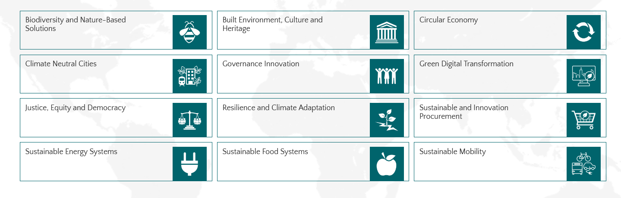
OUR THEMATIC AREAS
We look at how to bring about change in an INTEGRATED way. For example, how nature-based development contributes to resilience, or how to bring equity into low emission development.

Slide 6
What is the Smart Cities Marketplace?

Slide 7
Smart Cities Marketplace
The Smart Cities Marketplace helps cities and towns of all sizes to
deliver more sustainable urban environments, and offers all the information needed to explore, shape and set up successful smart city projects – in one place.
Notes:
Matchmaking: our approach

Slide 8
What we offer
A repository of EU climate-neutral and Smart City projects
A hub for those who look to bring climate-neutral and smart city solutions/projects to the market
A matchmaking process to create funding opportunities
A forum for knowledge exchange in dedicated Focus & Discussion groups
Notes:
A repository of EU climate-neutral and smart city projects;
A hub for those who look to bring climate-neutral and smart city solutions/projects to the market;
A matchmaking process to create funding opportunities;
A forum for knowledge exchange in dedicated Focus & Discussion groups

Slide 9
Our knowledge hub – the website
Use cases from European climate- neutral and Smart City projects
Data in the Self-Reporting Tool
Solution booklets
Policy papers
Fully integrated Wiki
Notes:
Our knowledge HUB – the website

Slide 10
Matchmaking – our approach
Receive help to make the match between your climate-neutral and smart city projects and potential investors.
Participation in matchmaking events where you can meet investors and project representatives face to face
Notes:
Matchmaking: our approach

Slide 11
The Geospatial Tools for Cities Focus Group

Slide 12
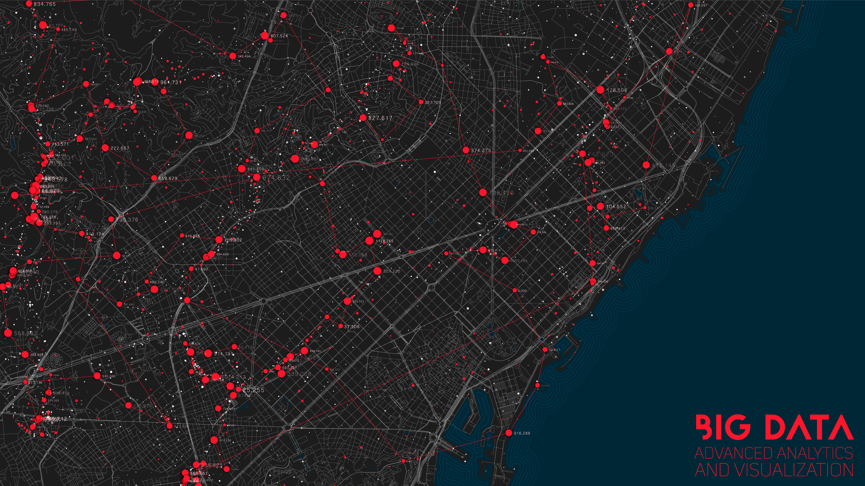
Why are geospatial tools important for cities?
Background image by Garry Killian (Freepik)

Slide 13
The Geospatial Tools for Cities Focus Group
Objectives:
Exchange best practices.
Support information-based decision-making.
Gather first-hand feedback.
Promote state-of-the-art geospatial solutions for Smart Cities.
Connect potential end-users to data providers.
Timeline: Launch in December 2024 - Final event in June 2026.
Survey distribution from December 2024 to February 2026
February 2025: Workshop 1
July 2025: Workshop 2
February 2026: Workshop 3
Activities:
2-4 meetings a year
Survey distribution to gather feedback
3 webinars
Development of a booklet
Foster the creation of pilots/projects
Targeted Participants:
Local public authorities with and without experience in geospatial tools;
Local decision-makers;
Services providers;
Industry representatives (space and non-space);
Researchers;
Interested Smart Cities actors.
Geospatial Tools for Cities Focus Group

Slide 14
The Geospatial Tools for Cities Focus Group - webinars
 | Workshop 1: Climate Change Adaptation and Mitigation in Urban Environments | Workshop 2: Disaster Risk Management and Infrastructures | Workshop 3: Procurement of Innovative Geospatial Solutions
Proposed Topics | Assessing needs for green areas (soil cover and use). Improvement of traffic conditions. Air quality management. Satellite data for 15 minutes cities. Analysing traffic to assess cycling lanes needs (European Declaration on Cycling, adopted in April 2024). Insulation of housing buildings | Information-based urban development and urban expansion (including identification of illegal buildings and cadastral maps). Mapping of gas and electric lines. Monitoring housing and public infrastructures. Retrofitting of public infrastructures to prevent disasters. Ground motion monitoring. Water (sea and inland) monitoring. | Tools currently available for urban planners and future innovations. Smart cities at the forefront of the uptake of innovative solutions: use of AI, IoT, etc. Call opportunities
Geospatial Tools for Cities Focus Group

Slide 15
Join us!
The Geospatial Tools for Cities Focus Group
Contact us
Gabriella Quattropanetti, Eurisy Communication Officer gabriella.quattropanetti@eurisy.eu
Xavier Casanova, Expert Green&Digital Transformation, Smart Cities Marketplace xavier.casanova@iclei.org
We are looking for:
Space agencies
Solution providers
City representatives
Universities/research centres
Interested in exchanging on geospatial tools.

