Slide 1
National Agency for Cadaster and Land Registration
NATIONAL CENTER FOR CARTOGRAPHY’S
CONTRIBUTION TO ROMANIAN NATIONAL SPATIAL DATA INFRASTRUCTURE
July 6th 2022
Nov. 2024

Slide 2
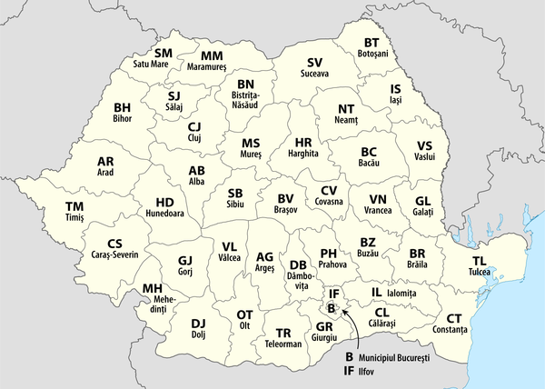
ABOUT US
The National Center for Cartography is a public institution with legal personality subordinated to the National Agency for Cadastre and Land Registration
The National Center for Cartography has a history of more than 50 years - was founded in 1958 – period over which it has undergone several changes of name and has constantly enriched its field of activity
National Agency for Cadastre and Land Registration
National Center for Cartography
42 Cadastre and Land Registration Offices

Slide 3
TIMELINE

Slide 4
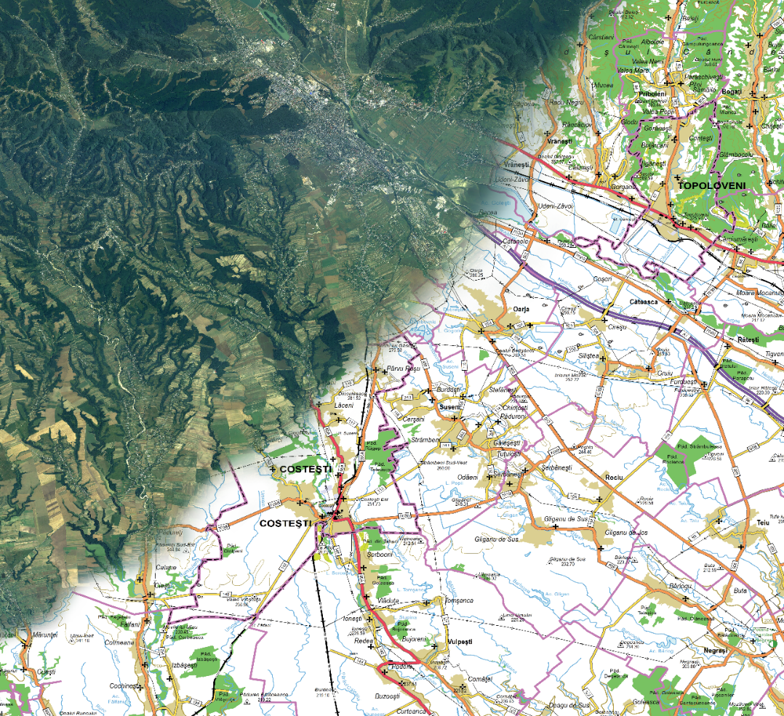
MISSION
The main activity of the institution is to provide specialized technical support to develop and update national geodetic and cartographic databases to fulfill the tasks of The National Agency for Cadastre and Land Registration and of its territorial offices

Slide 5
262 days
211 days
180 days
523 days
151 days
109 days
36 days
66 days
108 days
2018
ROMANIAN POSITIONING SYSTEM
86 GNSS reference stations
GPS
GLONASS
Galileo
BeiDou

Slide 6
WHAT WE DO
Producing and updating of the official map of Romania in analog and digital format TOPRO5 (1:5.000), as well as the digital terrain model
Participates in creating and updating of the methodologies, technical specifications, norms, models and structures of geodetic and cartographic data

Slide 7
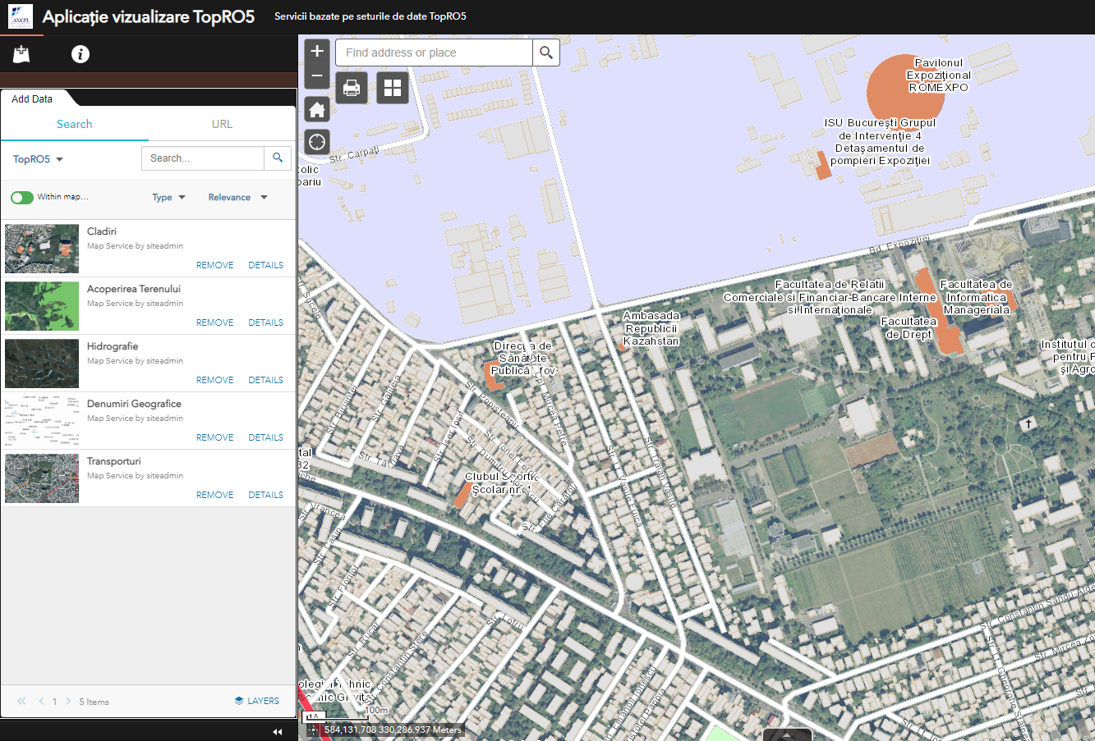
WHAT WE DO
Permanent provision of geodetic and cartographic data for ensuring the geo-spatial data infrastructure within the INSPIRE Directive
Provides technical support to any central or local public authority of public administration
Provides and performs on request, domain-specific works and products derived from existing data in its databases

Slide 8
PROJECTS IN PROGRESS
Support for implementing the National Cadastre and Land Book Program (PNCCF)
TOPRO5 Romania's Topographic Reference Plan in Digital Format
The Determination of a New Gravimetric Quasigeoid for Romania

Slide 9
NATIONAL PROJECT FOR HIGH RESOLUTION IMAGE ACQUISITION
DIM
DSM
True-ortho
Project objectives:
•acquiring aerial images and performing aerial triangulation;
•generating the dense point cloud and the digital surface model;
•generating the true-orthophotos.
Bucharest - oblique images and additional product: 3D mesh.

Slide 10
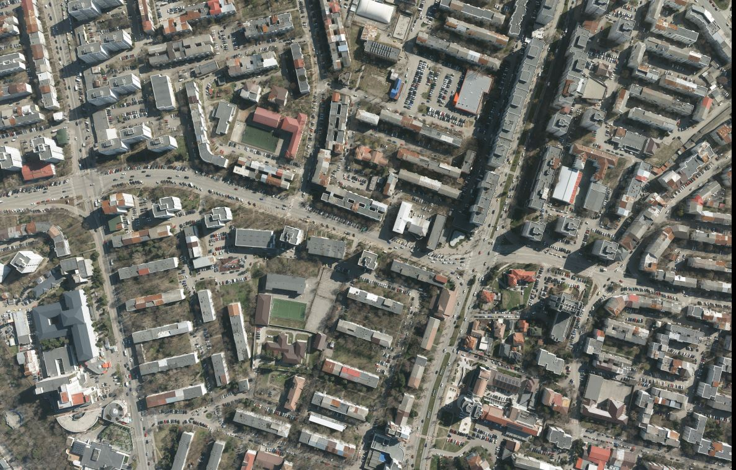
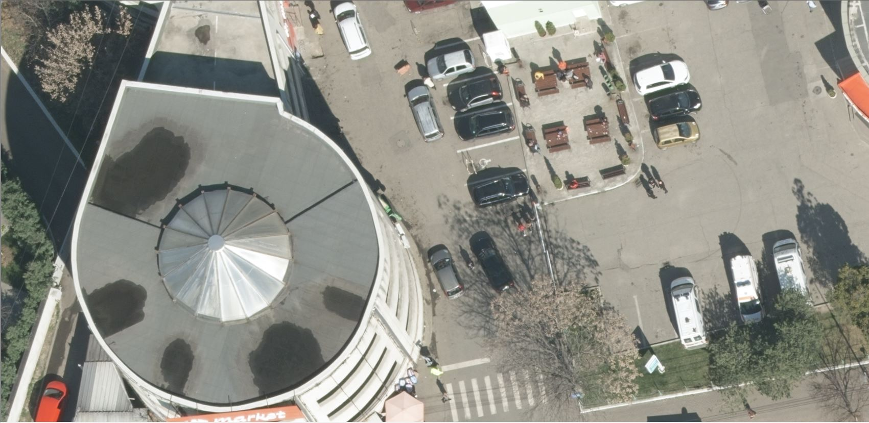
NATIONAL PROJECT FOR HIGH RESOLUTION IMAGE ACQUISITION
Slatina
GSD = 4cm

Slide 11
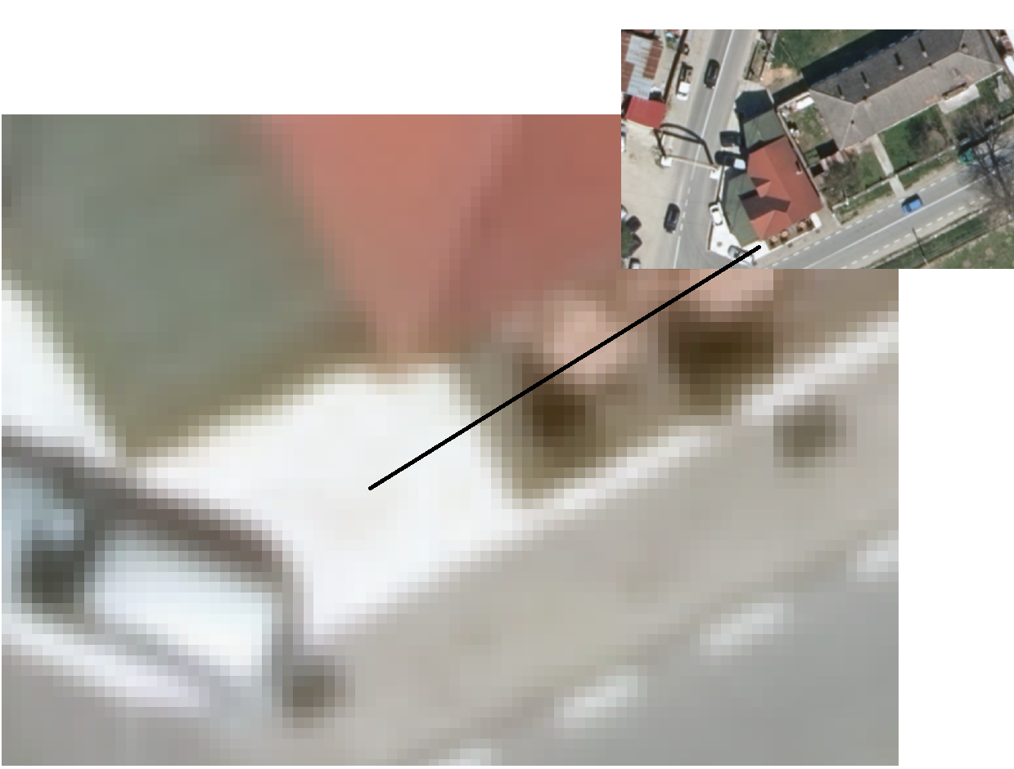
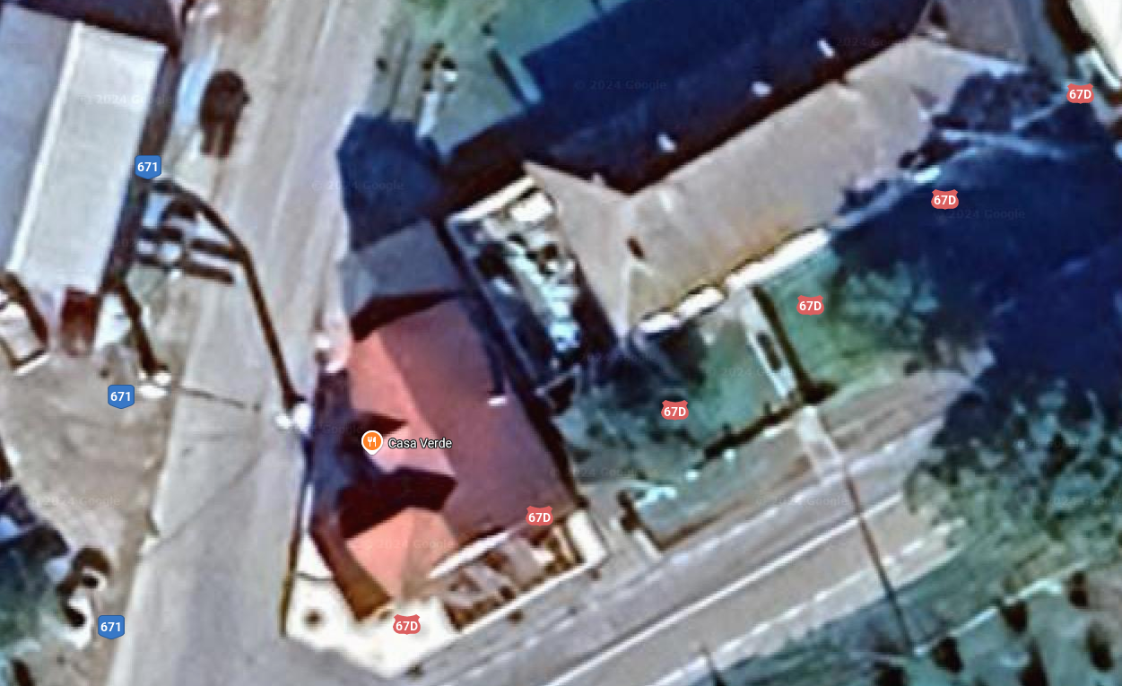
TRUE-ORTOFOTOPLAN ORASE – GSD 15 CM
BAIA DE ARAMĂ
Google Maps – zoom maxim posibil
Ortofoto CNC – zoom detaliu nivel pixel

Slide 12
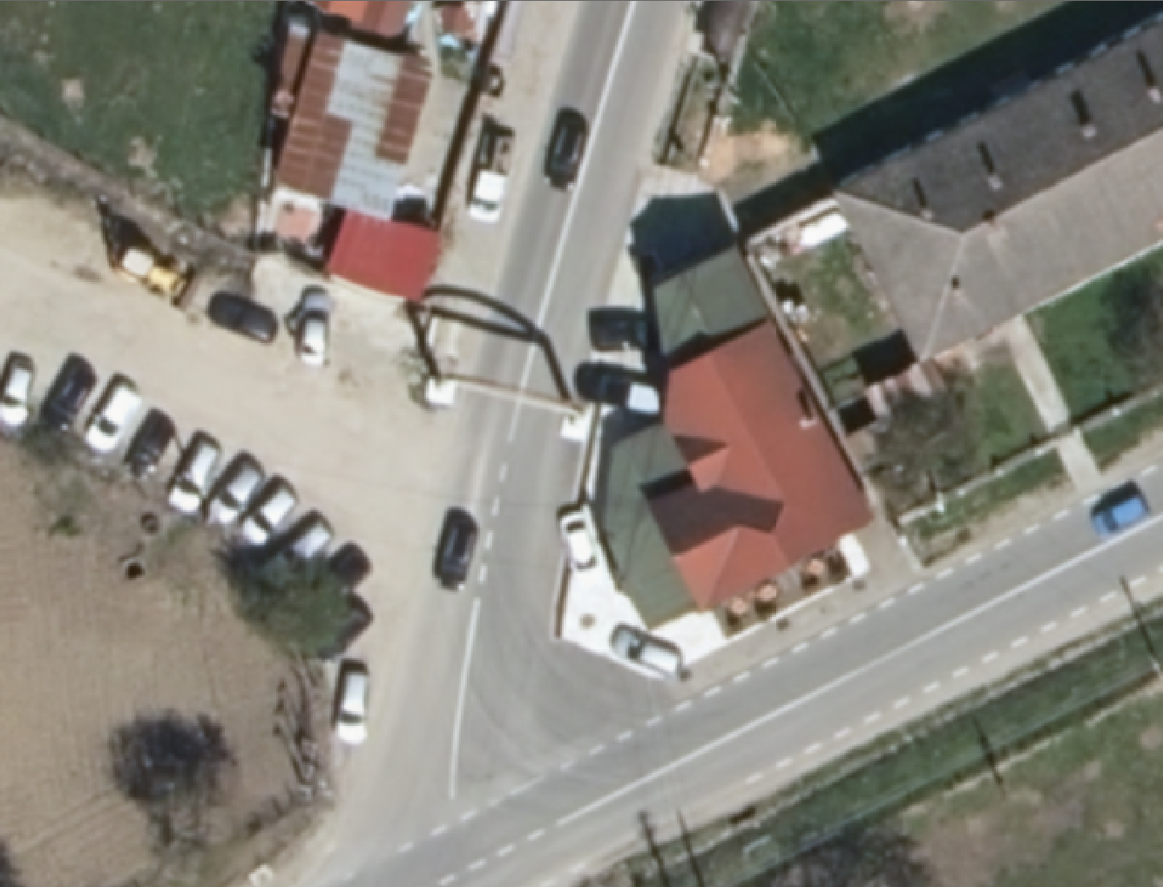
1:200
GSD 15 CM

Slide 13
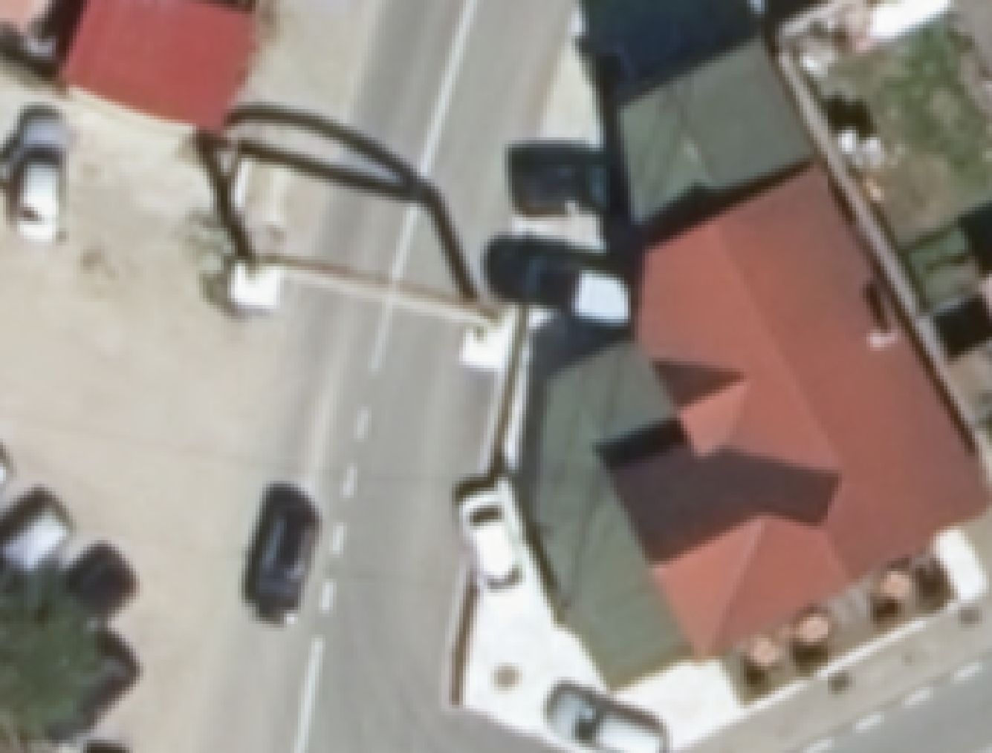
1:100
GSD 15 CM

Slide 14
1:50
GSD 15 CM

Slide 15
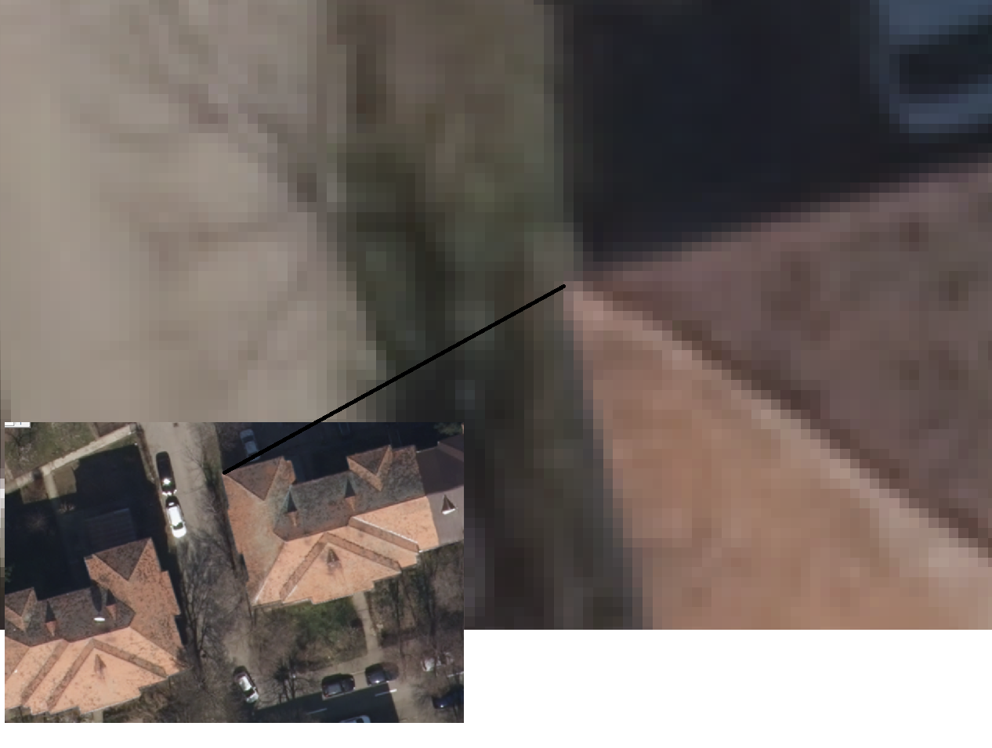
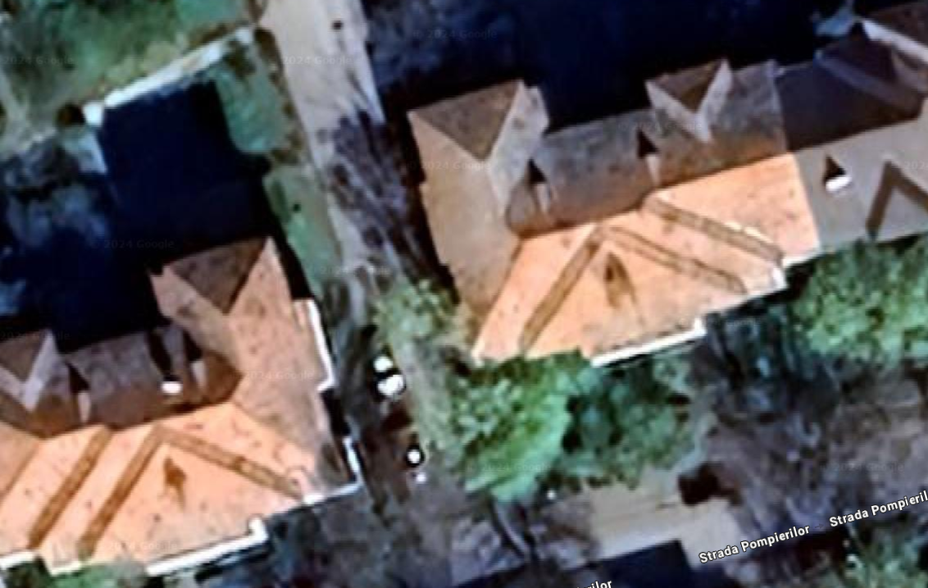
TRUE-ORTOFOTOPLAN MUNICIPII – 10 CM
TURNU MĂGURELE
Google Maps – zoom maxim posibil
Ortofoto CNC – zoom detaliu nivel pixel

Slide 16
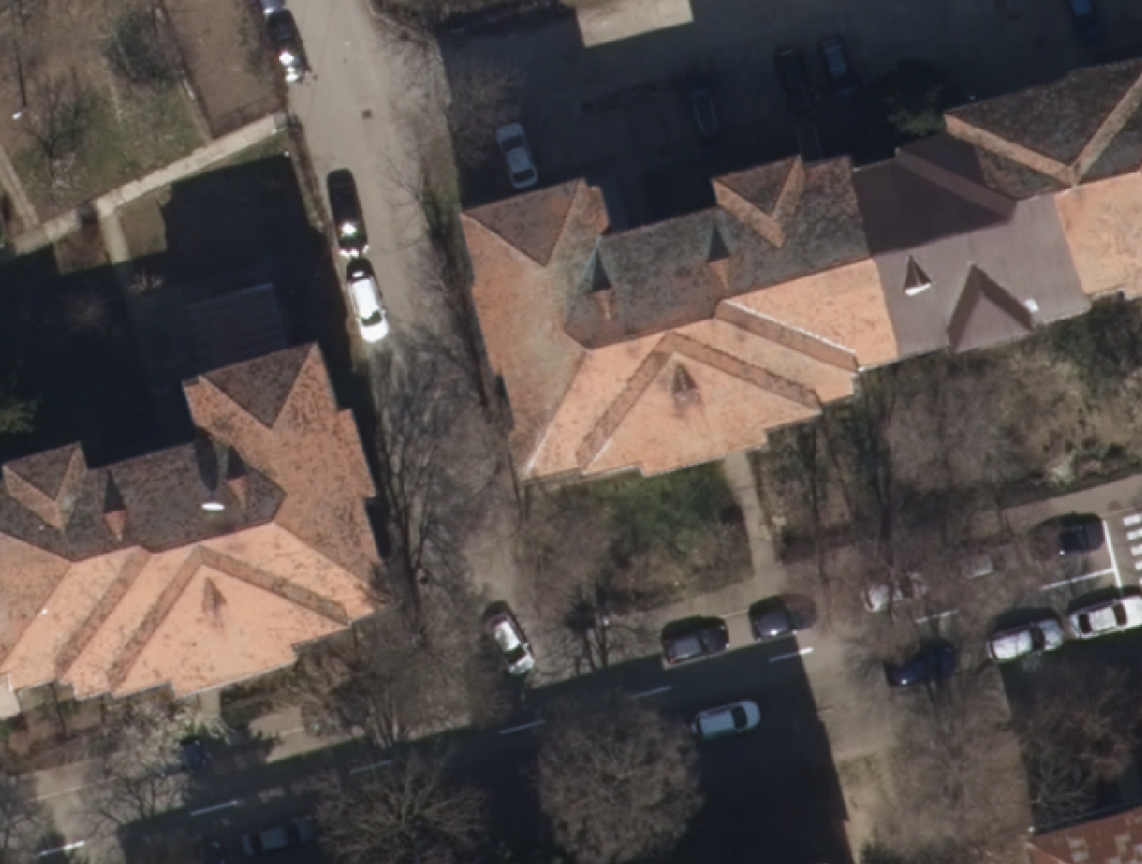
1:200
GSD 10 CM

Slide 17
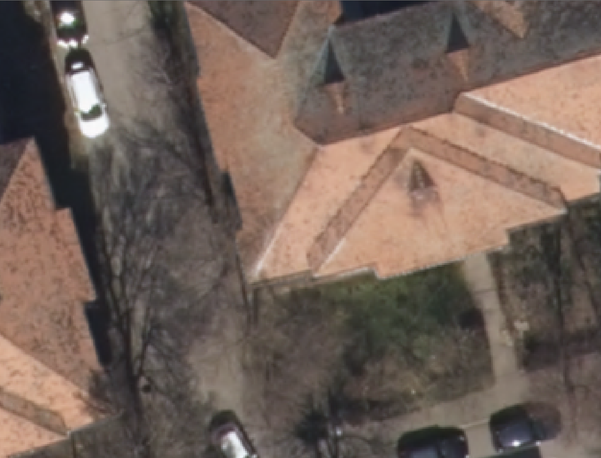
1:100
GSD 10 CM

Slide 18
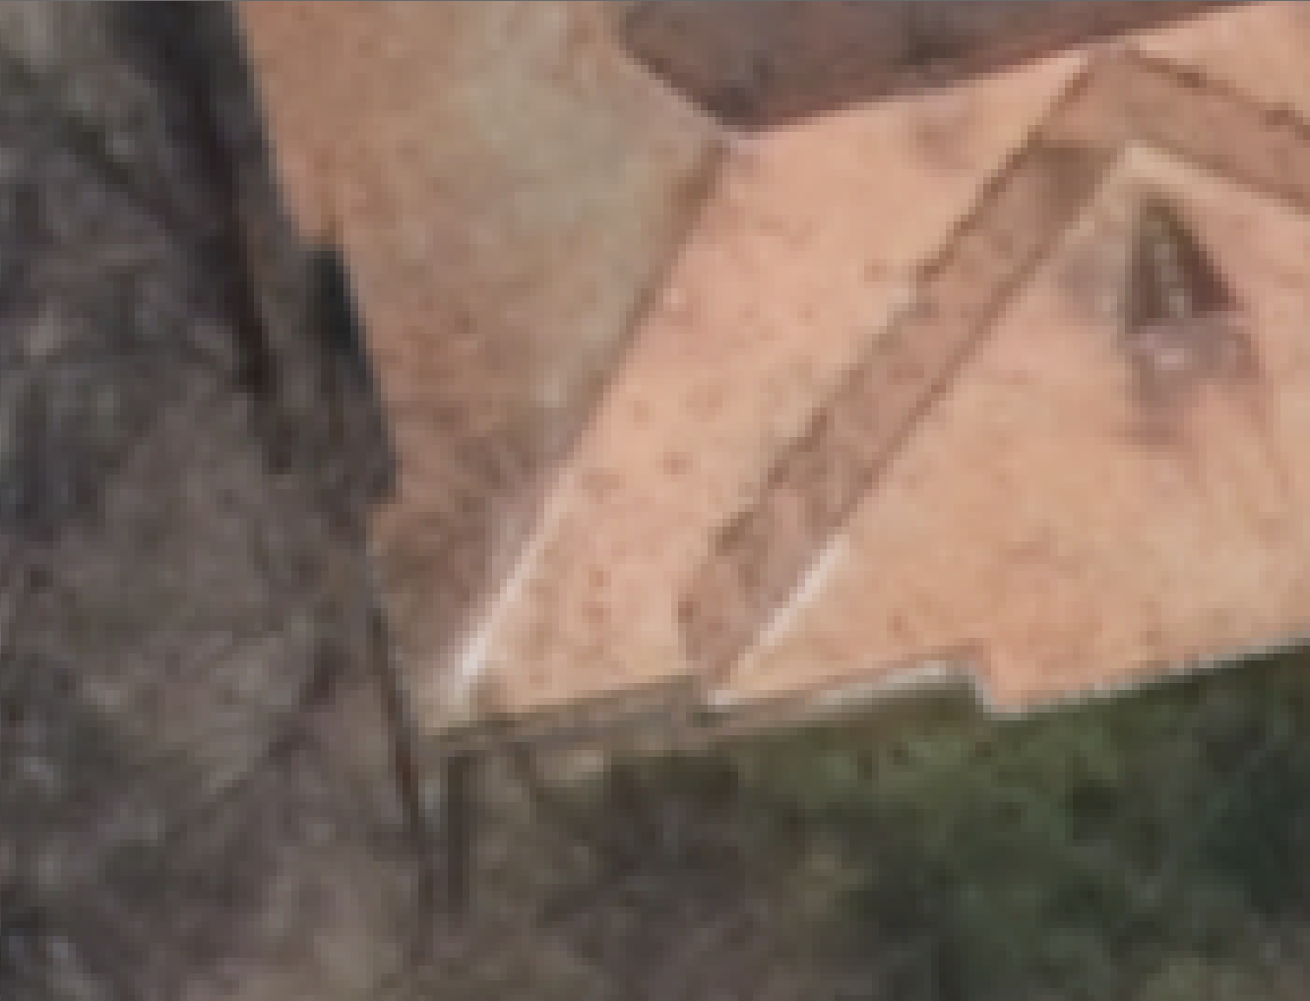
1:50
GSD 10 CM

Slide 19
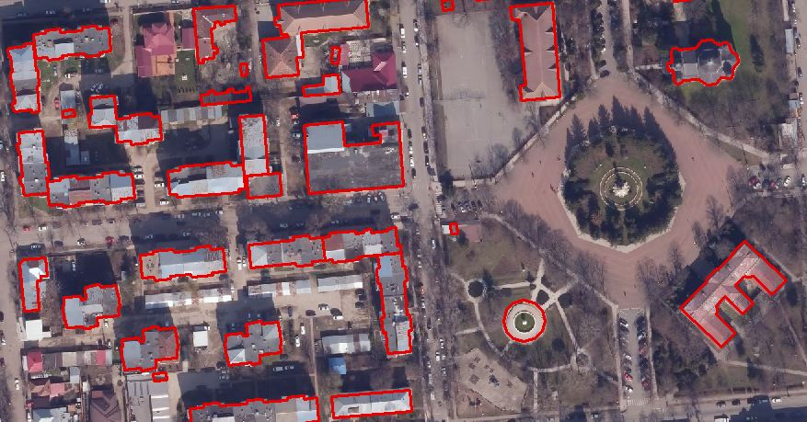
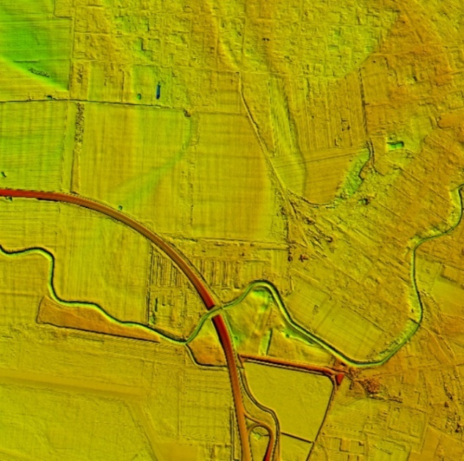
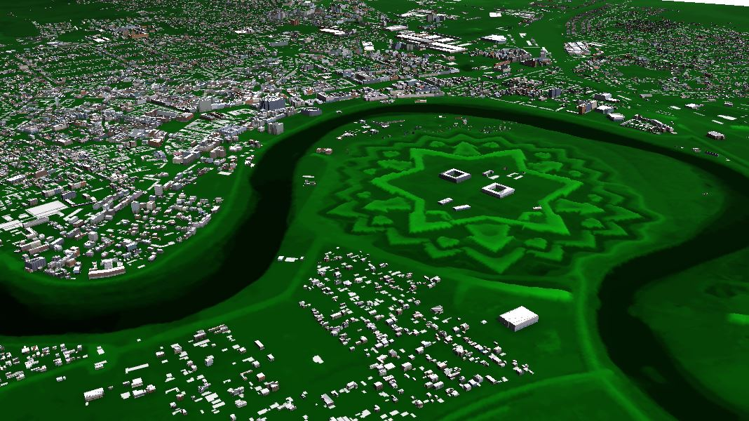
NATIONAL PROJECT FOR HIGH RESOLUTION IMAGE ACQUISITION
New products:
extracting objects, like building footprints by semi-automated process or by digitizing in 2D or 3D environment
generating digital terrain model based on the DIM products
generating 3D city models

Slide 20
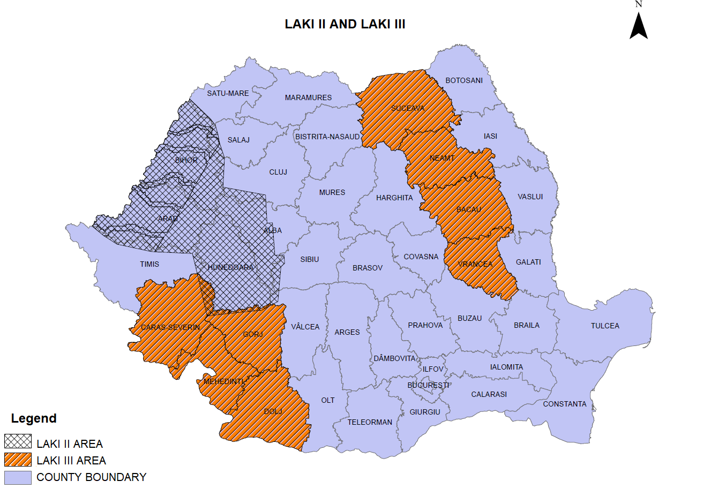
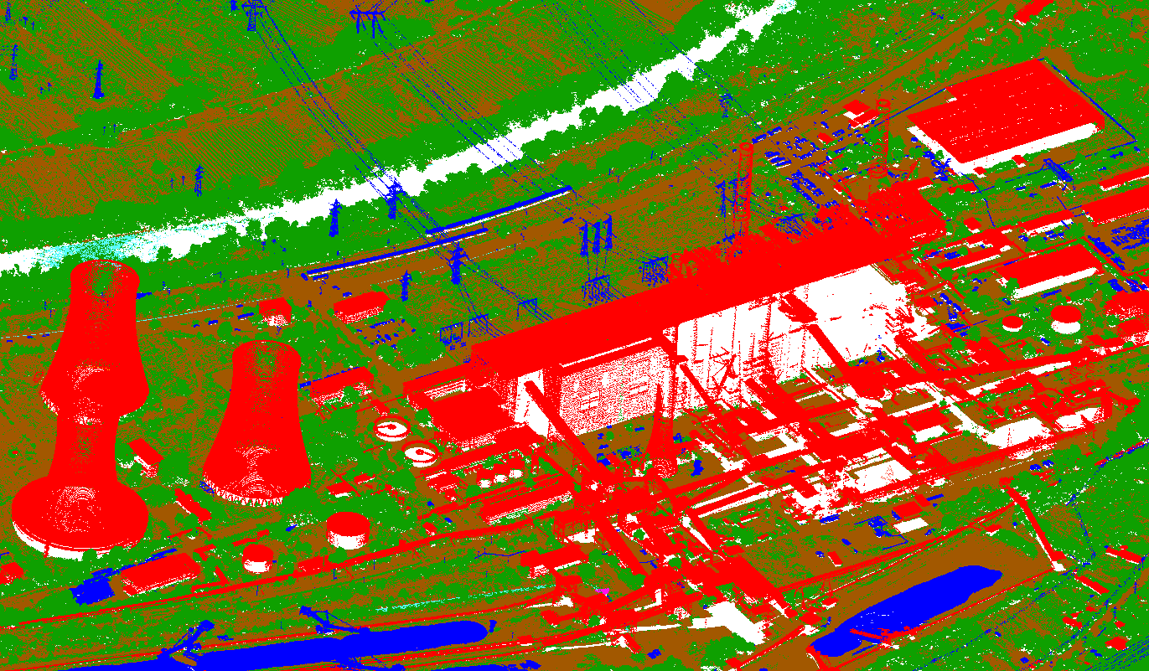
QUALITY CONTROL OF PHOTOGRAMMETRIC AND CARTOGRAPHIC PROJECTS
LAKI II and LAKI III
project area: 50.000 sqkm;
project duration: 2023 - ongoing;
activities: laser scanning flights for producing detailed digital terrain and surface models.
Area | Tiles delivered | Total no. of tiles
A | 3 | 13
B | 3 | 13

Slide 21
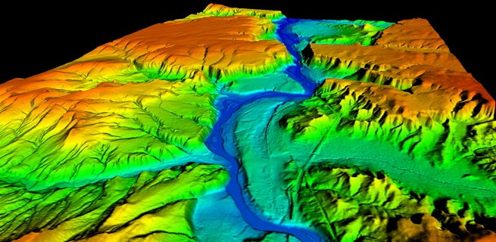
DIGITAL TERRAIN MODEL AT NATIONAL SCALE
input data: DTM from LiDAR dataset, photogrammetric derived point clouds;
189 tiles (40 x 40 km);
spatial resolution: 1, 2 and 5 m;
download: https://geoportal.ancpi.ro/portal/home/

Slide 22
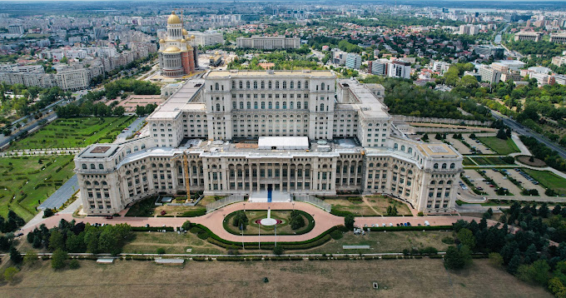
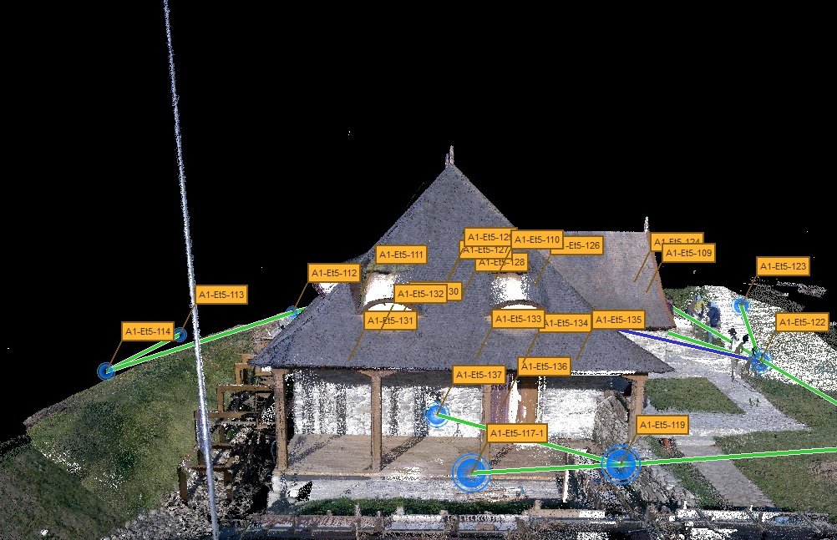
TERRESTRIAL LASER SCANNING PROJECTS
Objective: cadaster plans for the Palace of Parliament
Equipment used: BLK360
Objective: 3D mapping of objects
Additional measurements in the RGB point cloud
Generation of cadaster survey plan

Slide 23
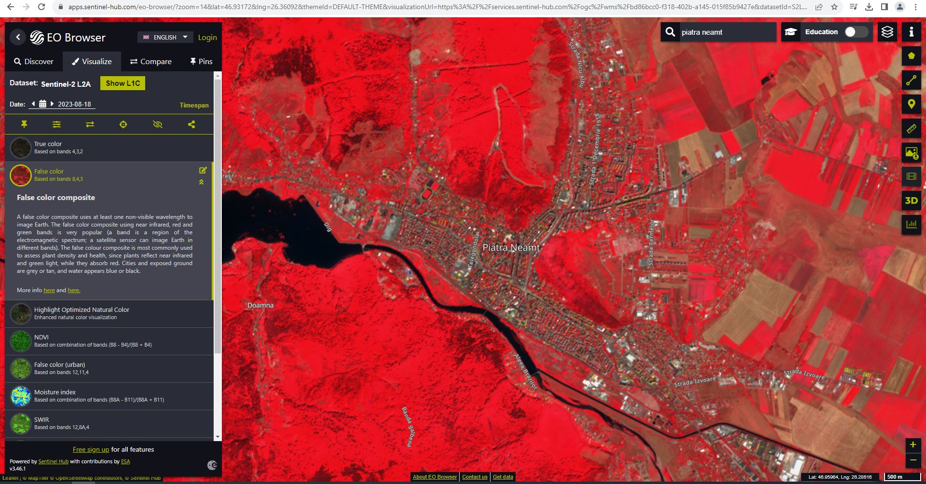
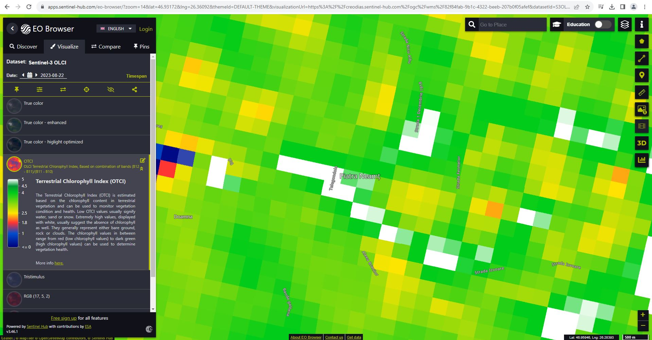
USAGE OF SATELLITE DATA
VEGETATION ASSESSMENT
for aerial flight approval
using Sentinel 3 images – derived OTCI raster (chlorophyll index)

Slide 24
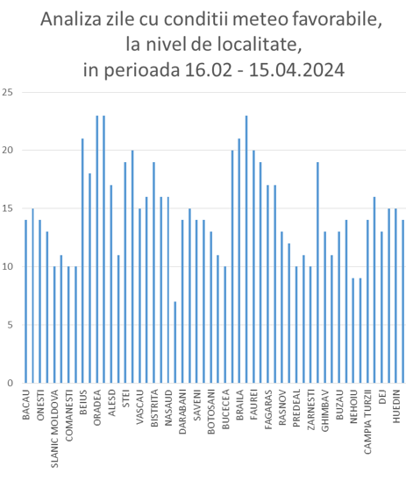
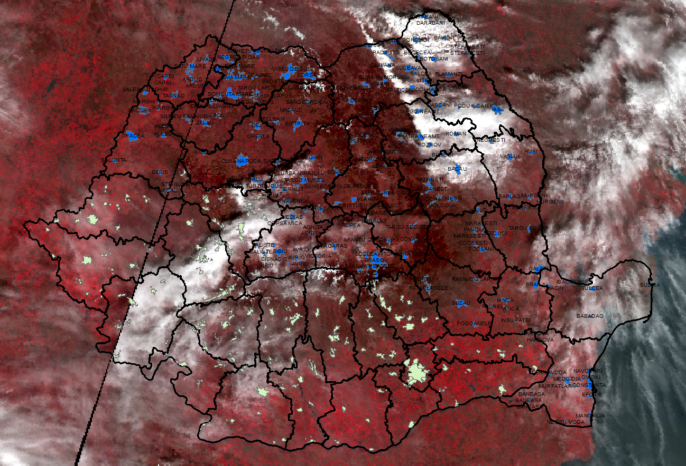
USAGE OF SATELLITE DATA
CLOUD COVER ASSESSMENT
for assessing meteorological conditions during aerial flights, for cloud cover, and establishing the number of optimal flight days at city level
using Sentinel 3 images – derived raster SLSTR_False_Color

Slide 25
MAIN STAKEHOLDERS
Romanian Government: Operating under the authority of the government, specifically the Ministry of Development, Public Works, and Administration the CNC plays a crucial role in national planning and development;
Local and Regional Authorities: Municipalities and regional councils rely on accurate cartographic data for urban planning, infrastructure development, and environmental management;
Other Government Agencies: Various ministries such as the Ministry of Environment, Water, and Forests, and the Ministry of Transport use the CNC's data for policy-making and project implementation;
Emergency Services: Agencies responsible for disaster management and emergency response depend on up-to-date maps for efficient coordination during crises;
Private Sector Companies: Businesses in sectors like construction, real estate, telecommunications, and utilities require precise geographic information for project planning and execution;
Academic and Research Institutions: Universities and research organizations use cartographic data for scientific studies, environmental assessments, and educational purposes;
General Public: Citizens access maps and geographic information for personal use, navigation, and community projects;

Slide 26
Thank you!
ileana.spiroiu@cartografie.ro

