Slide 1
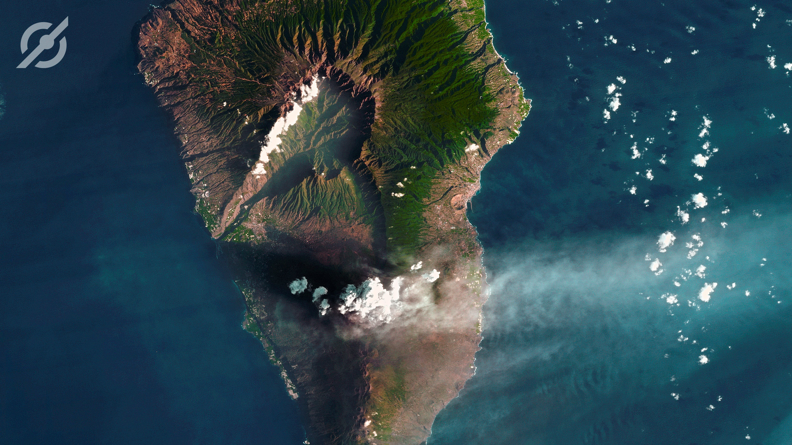

Earth Observation for Disaster Management
João Bentes de Jesus
Institutional affairs manager

Slide 3
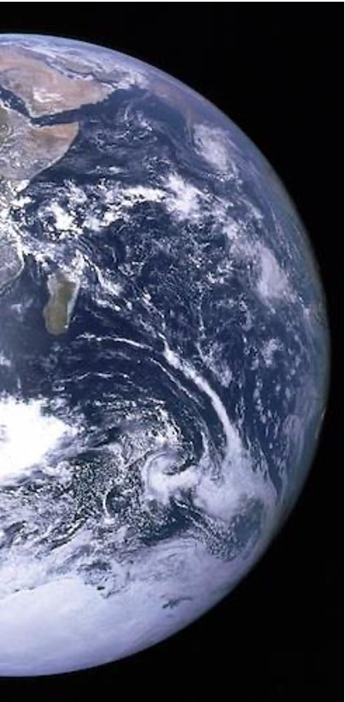
VALUE PROPOSITION
Delivering “Eyes on site”
unleashing the power of Space Earth Observation (EO) to everyone
Providing scalable EO solutions to
Know our world and solve global challenges
Leverage businesses
Take care of people
Support critical operations
ANYwhere, ANYTime TO EVERYONE
Notes:
O setor da Observação da Terra (OT) está a seguir a mesma tendência dos outros setores do Espaço:
Comunicações, cresceu até se tornar pervasivo, através da TV e agora das constelações em órbita baixa com cobertura global que fazem com que deixe de haver no Mundo zonas isoladas.
Navegação por satélite, inicialmente uma tecnologia militar, hoje em dia pervasiva e acessível em qualquer dispositivo.
A OT está apenas a começar e na transição do mercado dominado por utilizadores institucionais para um mercado dominado por utilizadores não especializados, o potencial de crescimento é enorme.

Slide 4








Fast facts
End to End control of operations with
2 satellites
1 of 2 European VHR imagery providers
50+ people in
Portugal & Spain
10+ years of experience
15 min
latencies
Global
operational and market reach
24/7
operations
6bn km² of
imagery archive

Slide 5



NEXT GEN satelliteS
2024
2025
NG PRECURSORS
Additional bands
Increased revisit
ATLANTIC CONSTELLATION
Intradaily revisit
<1m
VHR SATELLITES
Resolution: <50cm
Revisit: Daily

Slide 6
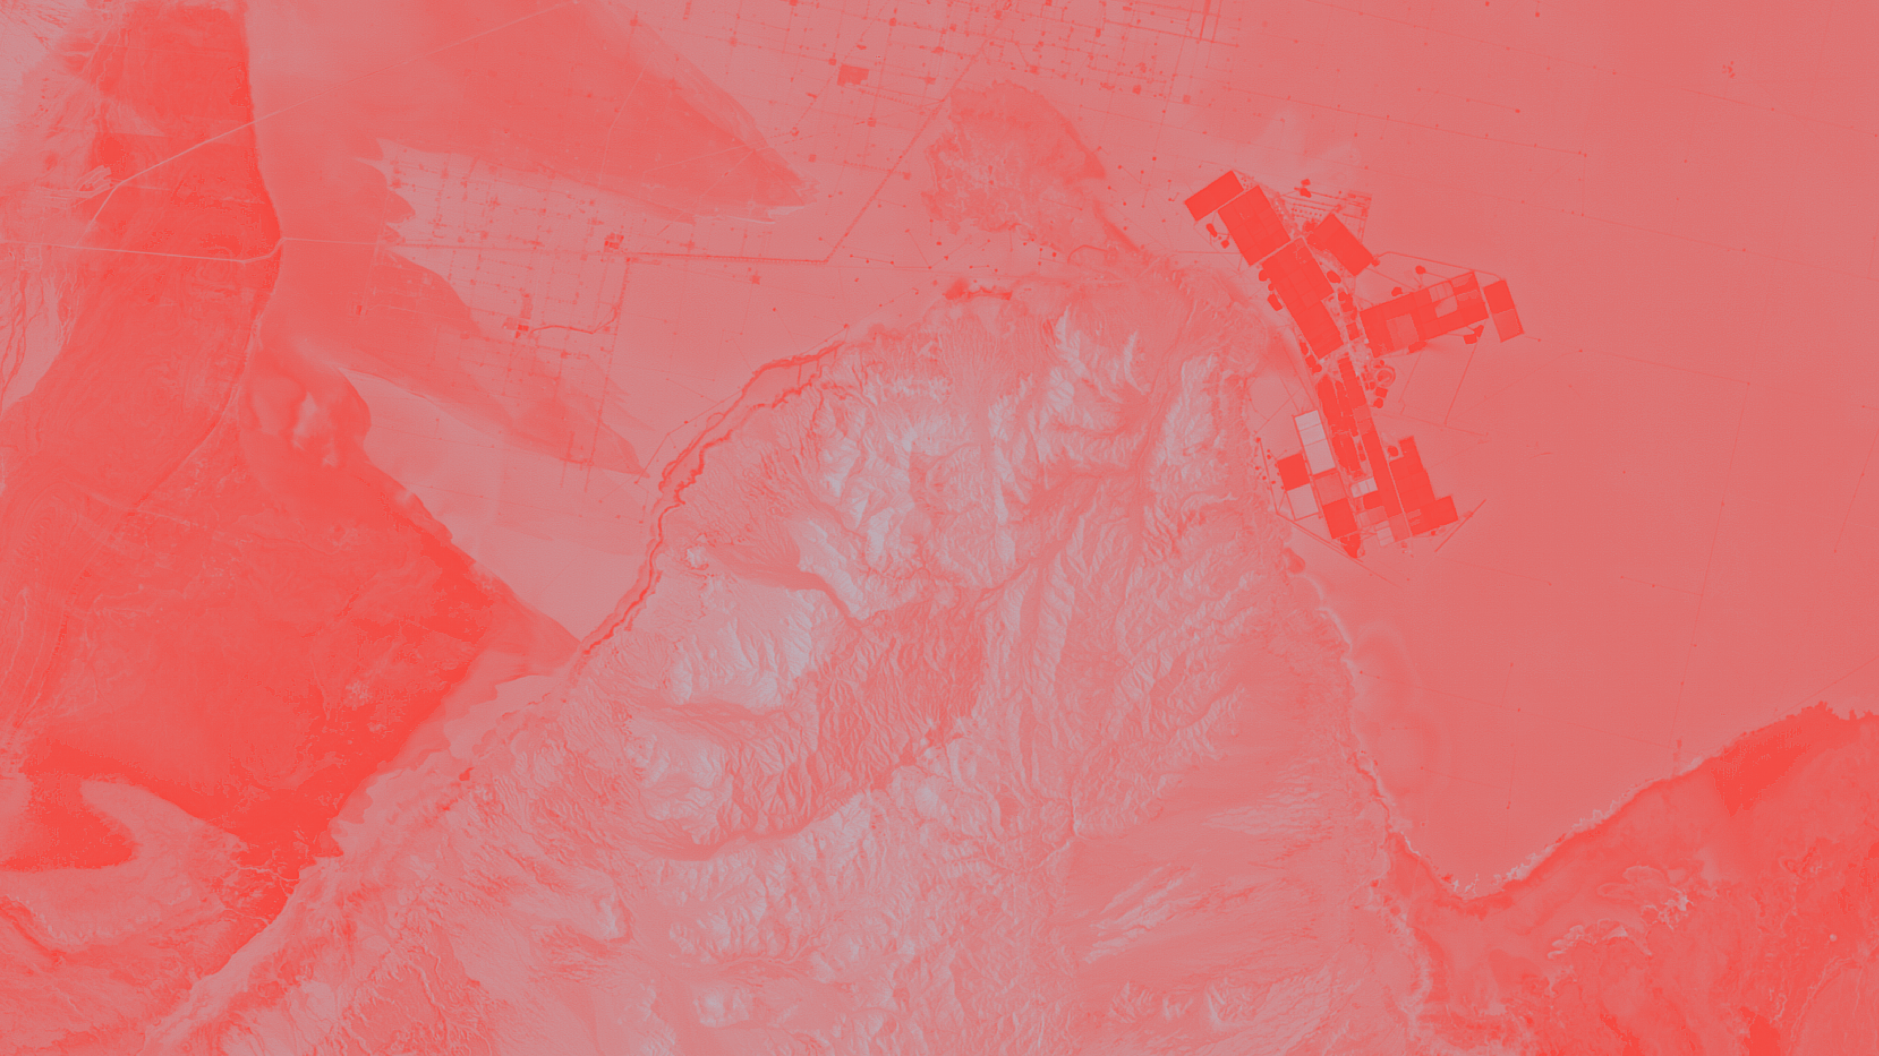


Emergency and disaster management
C.
All information presented is confidential and may be legally privileged.

Slide 7
Emergency and disaster management
C.
Floods
All information presented is confidential and may be legally privileged.

Slide 8
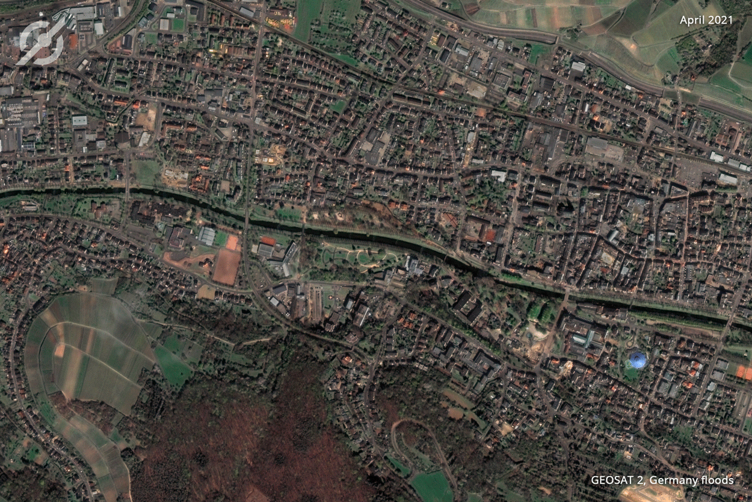
Germany

Slide 9
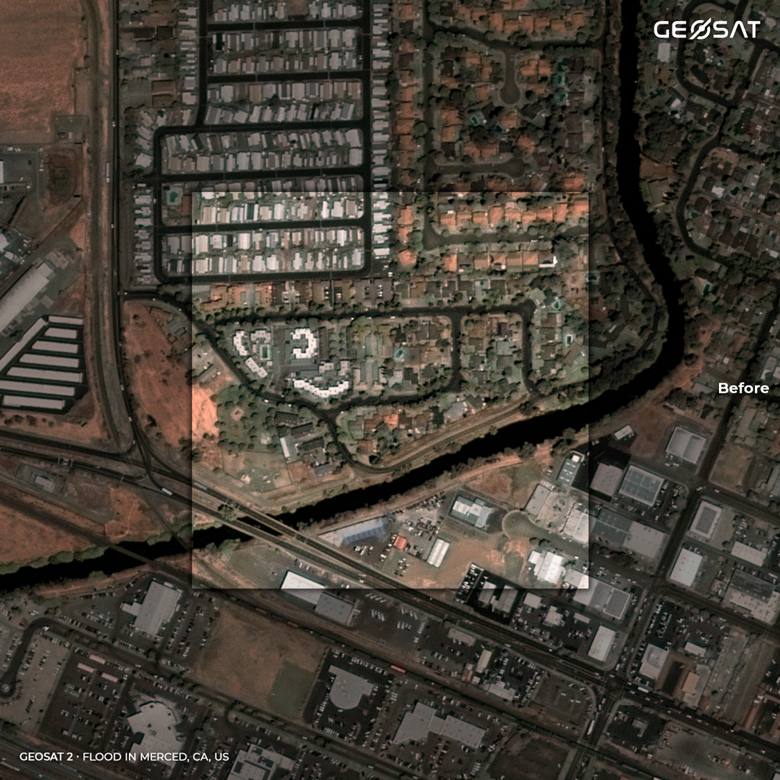
Germany

Slide 10
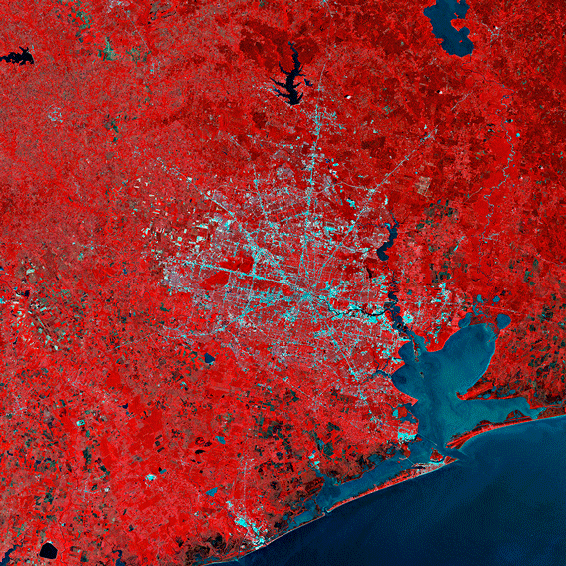
Germany
Houston

Slide 11
Emergency and disaster management
C.
fires
All information presented is confidential and may be legally privileged.

Slide 12
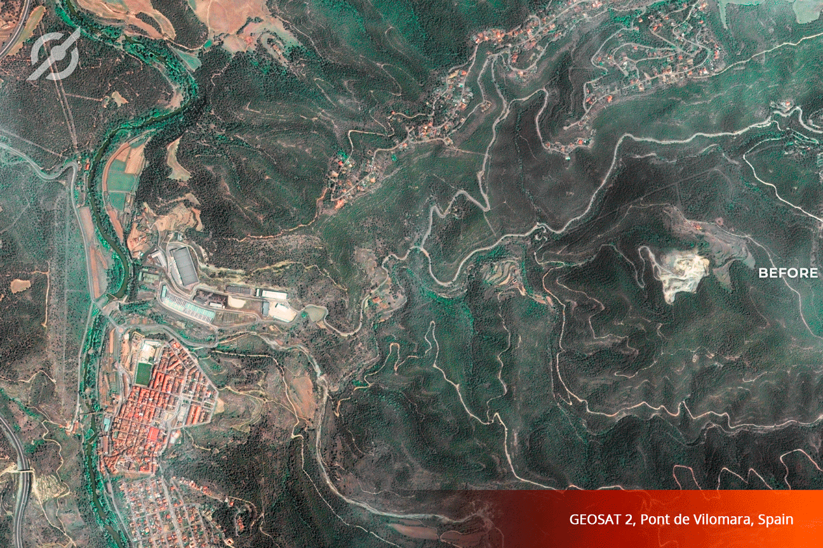

Slide 13
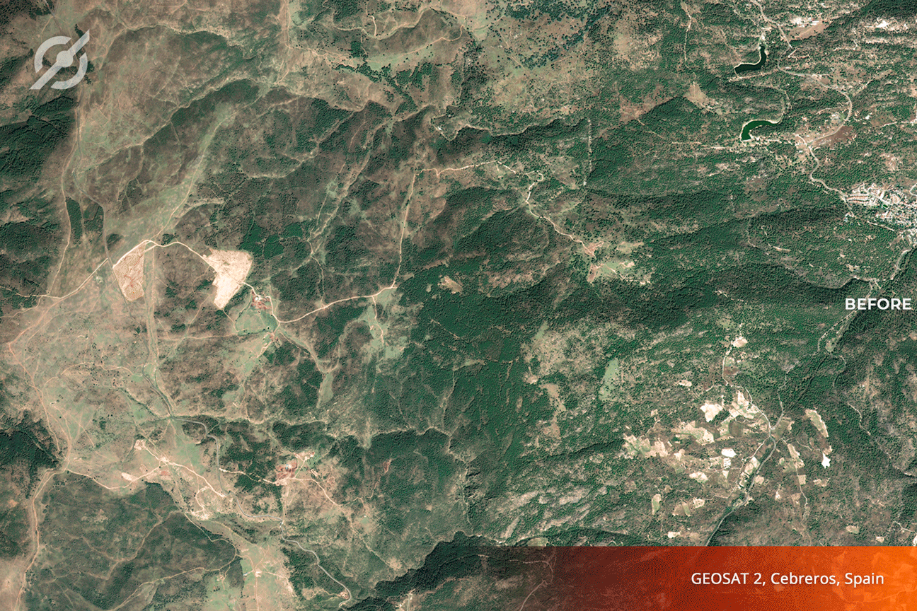

Slide 14
Emergency and disaster management
C.
Volcanic Eruptions
All information presented is confidential and may be legally privileged.

Slide 15
1st look
Cumbre Vieja
La Palma, Spain
GEOSAT-1 | 20m

Slide 16
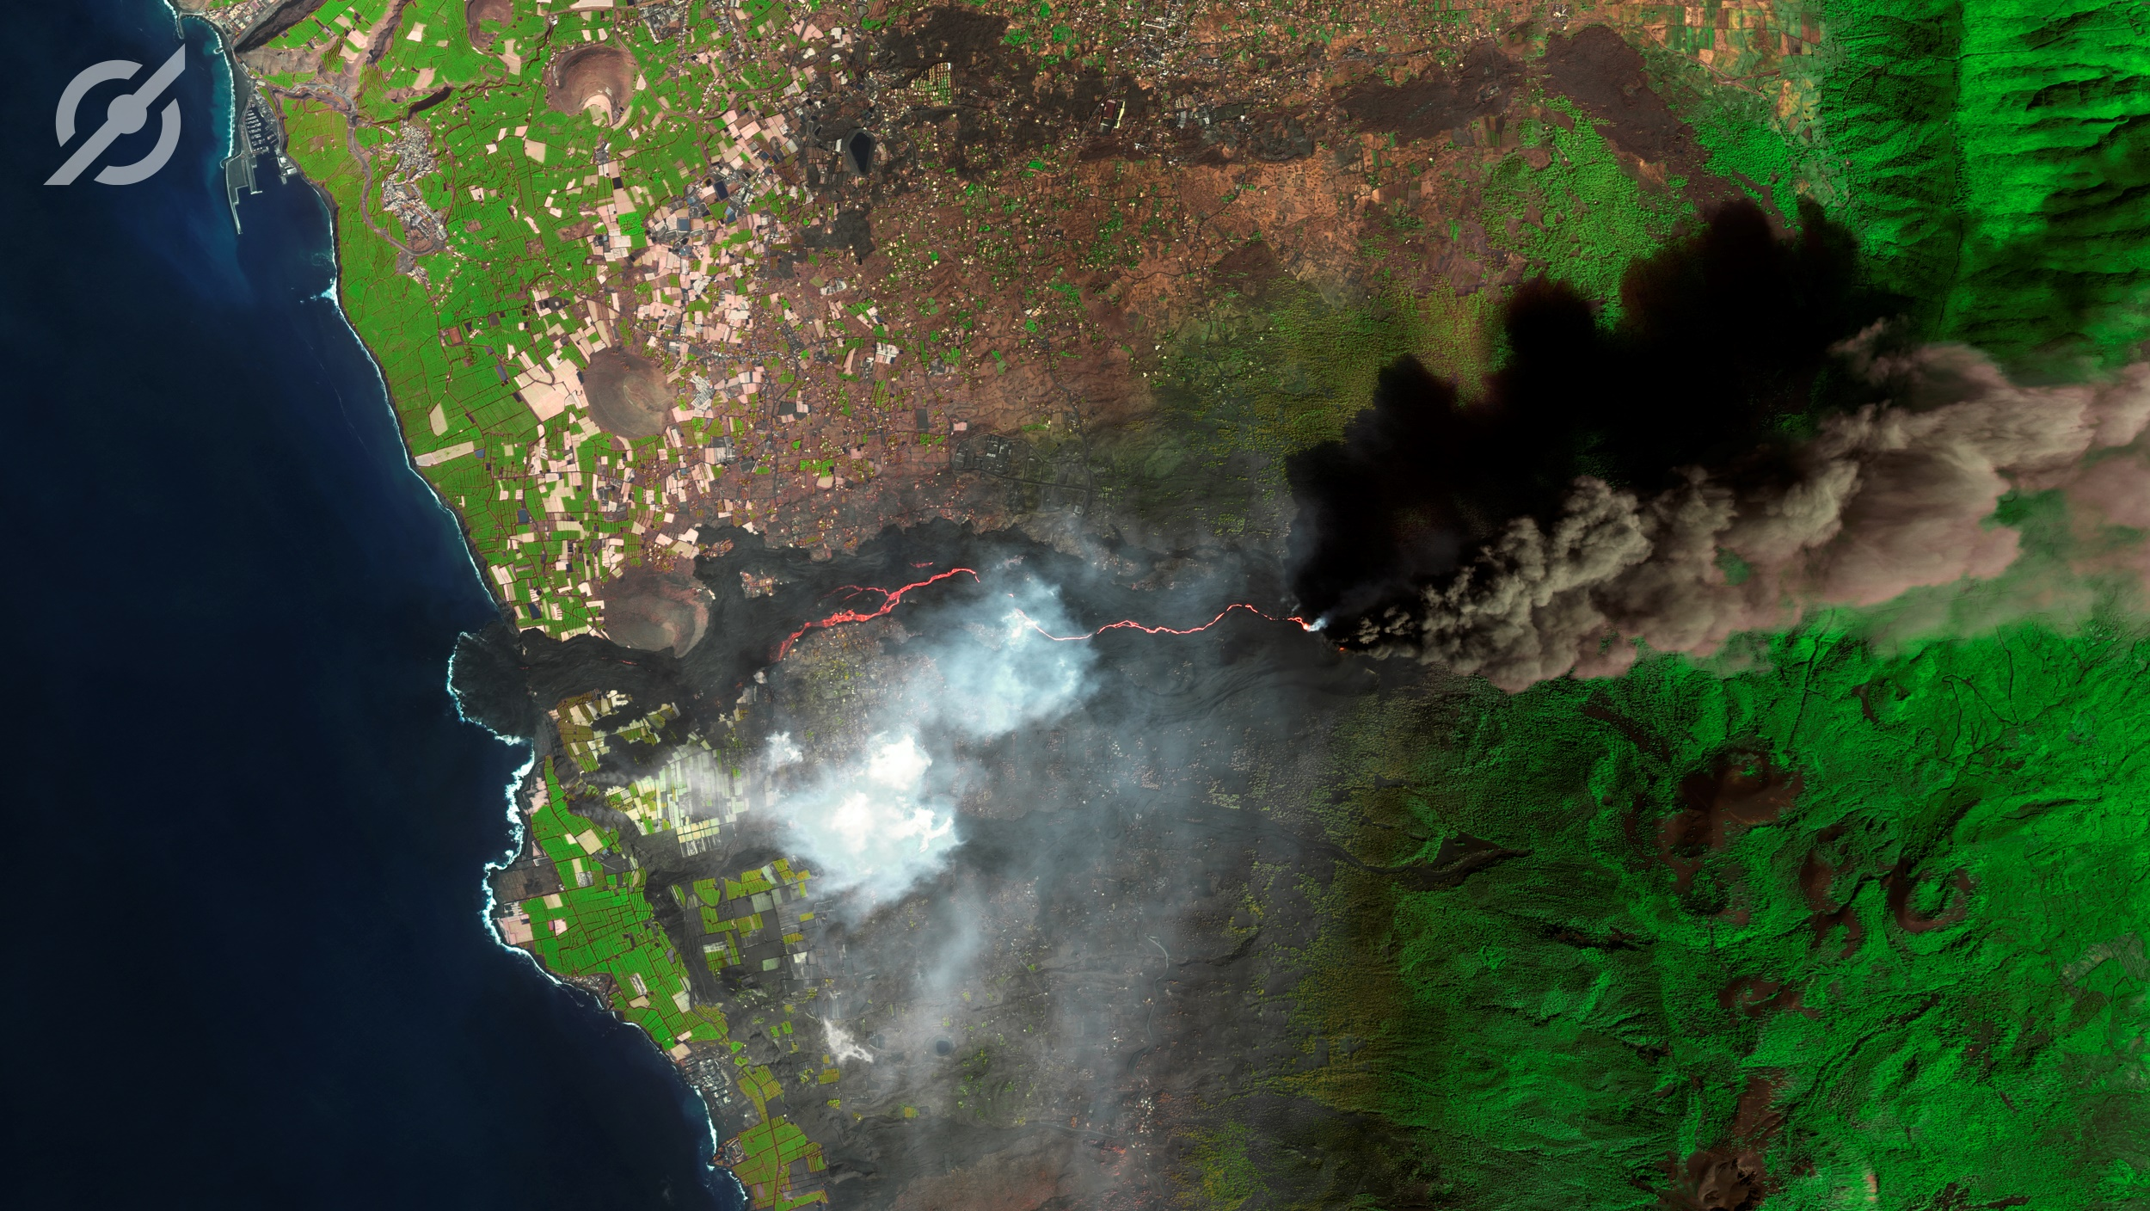
Zoom in
Cumbre Vieja
La Palma, Spain
GEOSAT-2 | 75cm

Slide 17
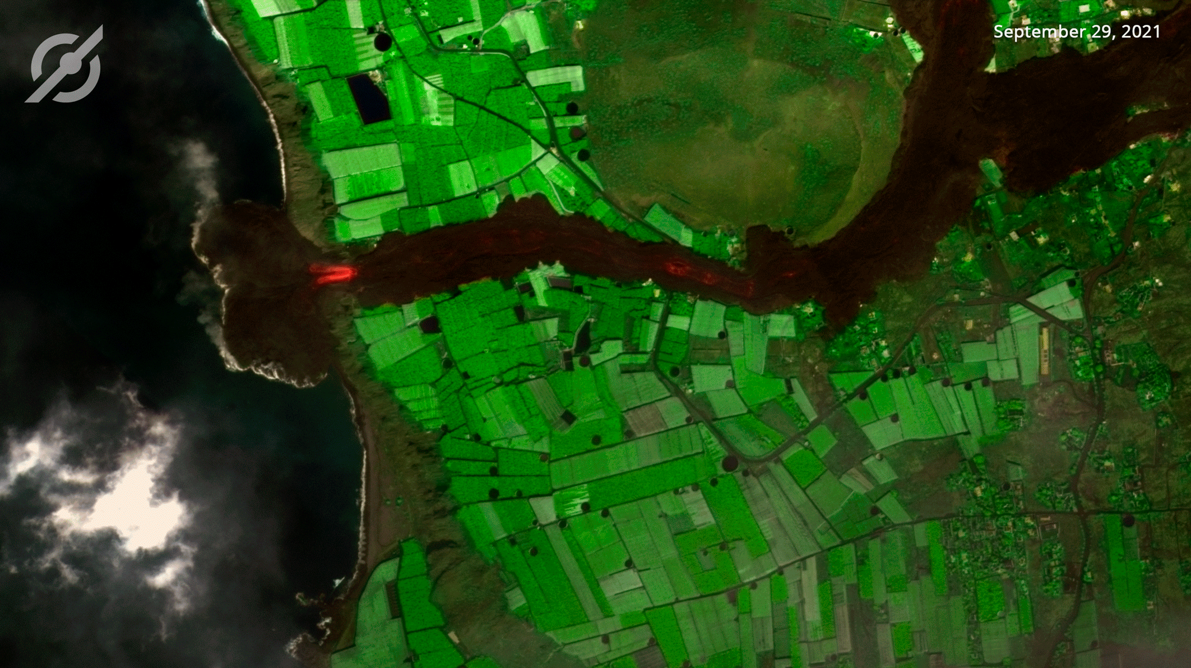
Change Detection
Cumbre Vieja
La Palma, Spain
GEOSAT-2 | 75cm

Slide 18
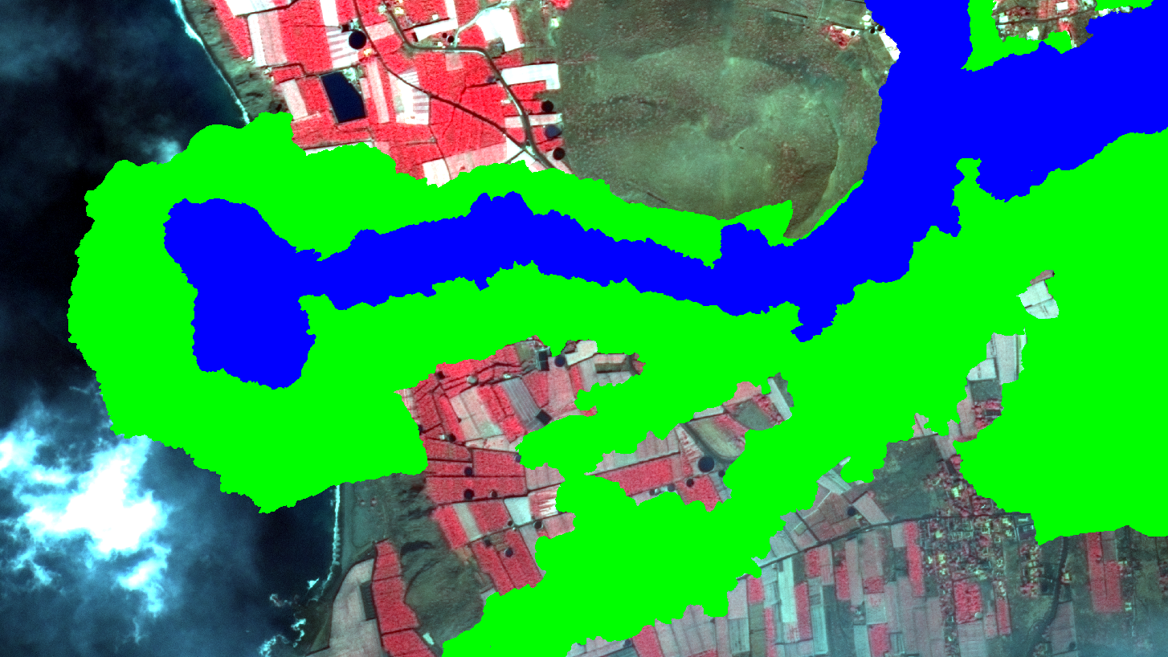

Impact assessment
Cumbre Vieja
La Palma, Spain
GEOSAT-2 | 75cm

Slide 19
Emergency and disaster management
C.
International Disaster Charter activations
All information presented is confidential and may be legally privileged.

Slide 20
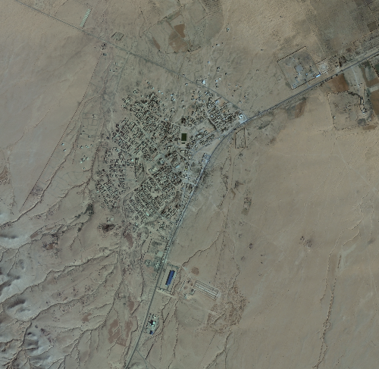
Event | Date
Floods in Lybia | 6/2/2024
Floods in Brazil | 29/02/2024
Floods in Bolivia | 6/3/2024
Floods in Mongolia | 15/03/2024
Cyclone Gamane in Madagascar | 29/03/2024
Severe weather in South Africa | 7/4/2024
Bi'r Al Ghanam, Lybia

Slide 21
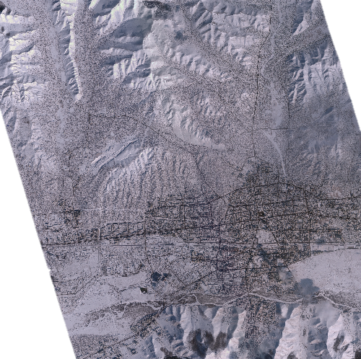
Event | Date
Floods in Lybia | 6/2/2024
Floods in Brazil | 29/02/2024
Floods in Bolivia | 6/3/2024
Floods in Mongolia | 15/03/2024
Cyclone Gamane in Madagascar | 29/03/2024
Severe weather in South Africa | 7/4/2024
Ulaanbaatar, Mongolia

Slide 22
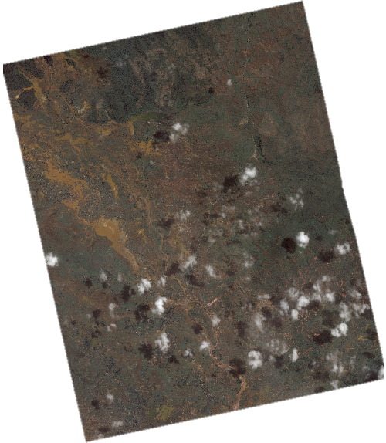
Event | Date
Floods in Lybia | 6/2/2024
Floods in Brazil | 29/02/2024
Floods in Bolivia | 6/3/2024
Floods in Mongolia | 15/03/2024
Cyclone Gamane in Madagascar | 29/03/2024
Severe weather in South Africa | 7/4/2024
Ambilobe, Madagascar

Slide 23
João Bentes de Jesus
joao.bentes@geosat.space

