Slide 1
How can satellite data support disaster risk management?
The potential behind the Copernicus Emergency Management Service
14 May 2024
André MOREIRA GONCALVES,
Communications consultant for Copernicus Emergency

Slide 2
The Copernicus Emergency Management Service

Slide 3
The Copernicus Emergency Management Service
+12 years experience
Supporting all actors in managing natural and man-made disasters
Across all disaster management phases
Preparedness: forecasts
Prevention: risk assessment and reduction
Response: rapid maps and monitoring of events
Recovery: post-disaster recovery analyses

Slide 4
The Copernicus Emergency Management Service
Complementary to national efforts
Supporting the EU’s
Emergency
Response &
Coordination
Centre (ERCC)
Jointly coordinated by three Commission DGs:
DG DEFIS: overall governance, budget implementation
DG JRC: operational implementation, technical coordination, contractual management, monitoring & quality assurance of deliverables
DG ECHO: operational coordination including interface with
the users & authorisation of activations
in Brussels
From the EU’s
Crisis Management Laboratory
in Ispra, Italy
Notes:
Pick either this slide or slide 5.

Slide 5
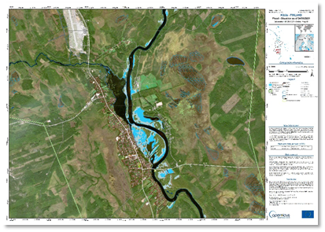
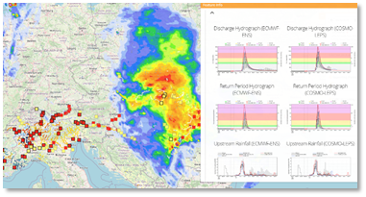
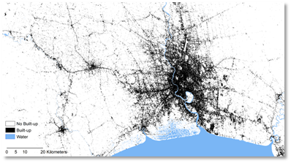
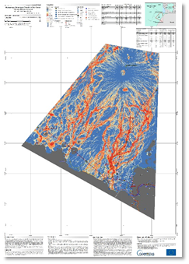
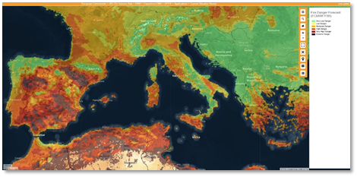
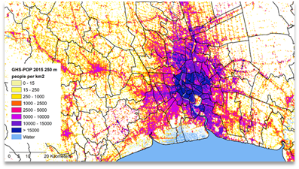
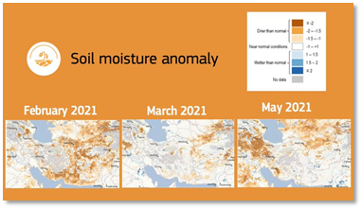
Notes:
Introduction to the 3 components.

Slide 6
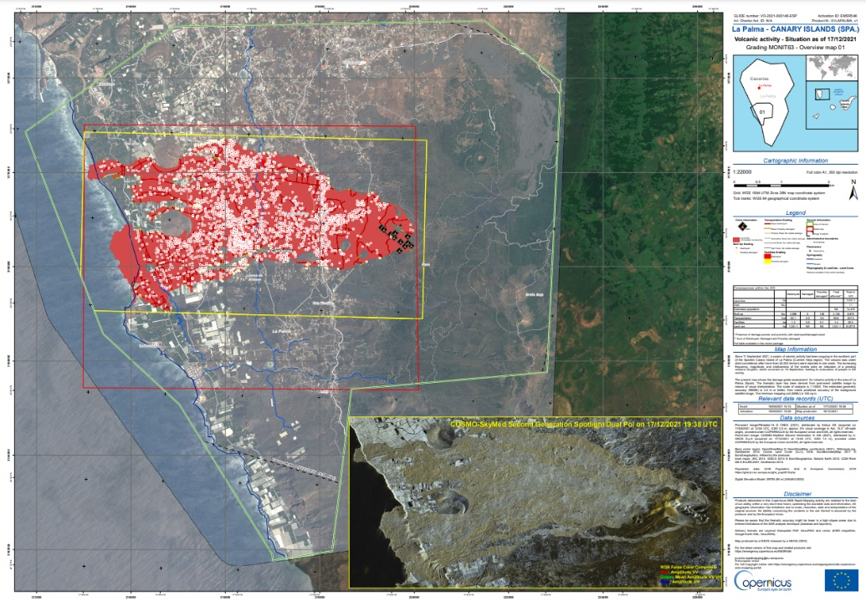
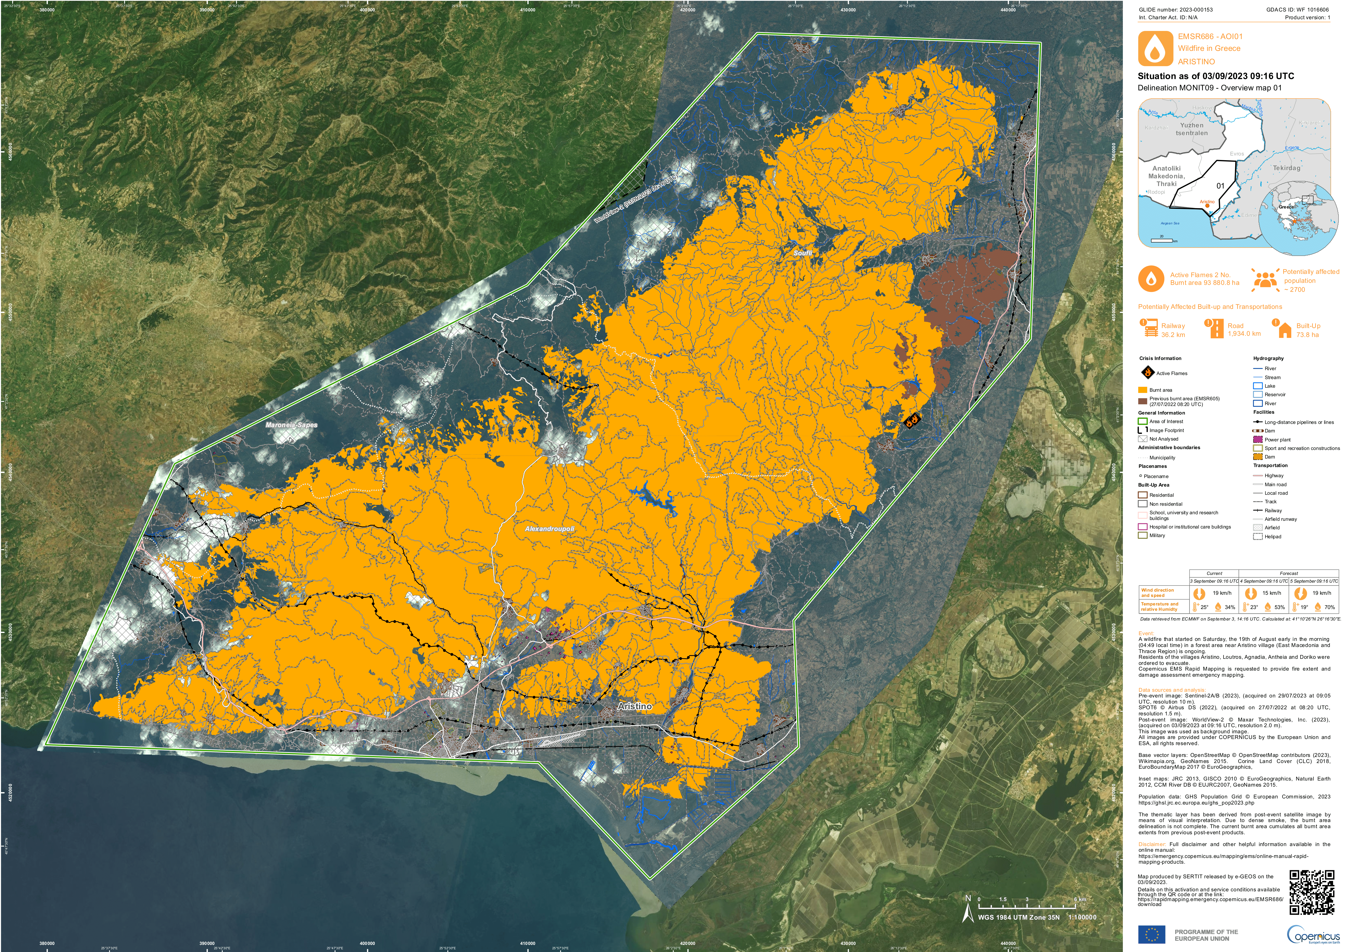
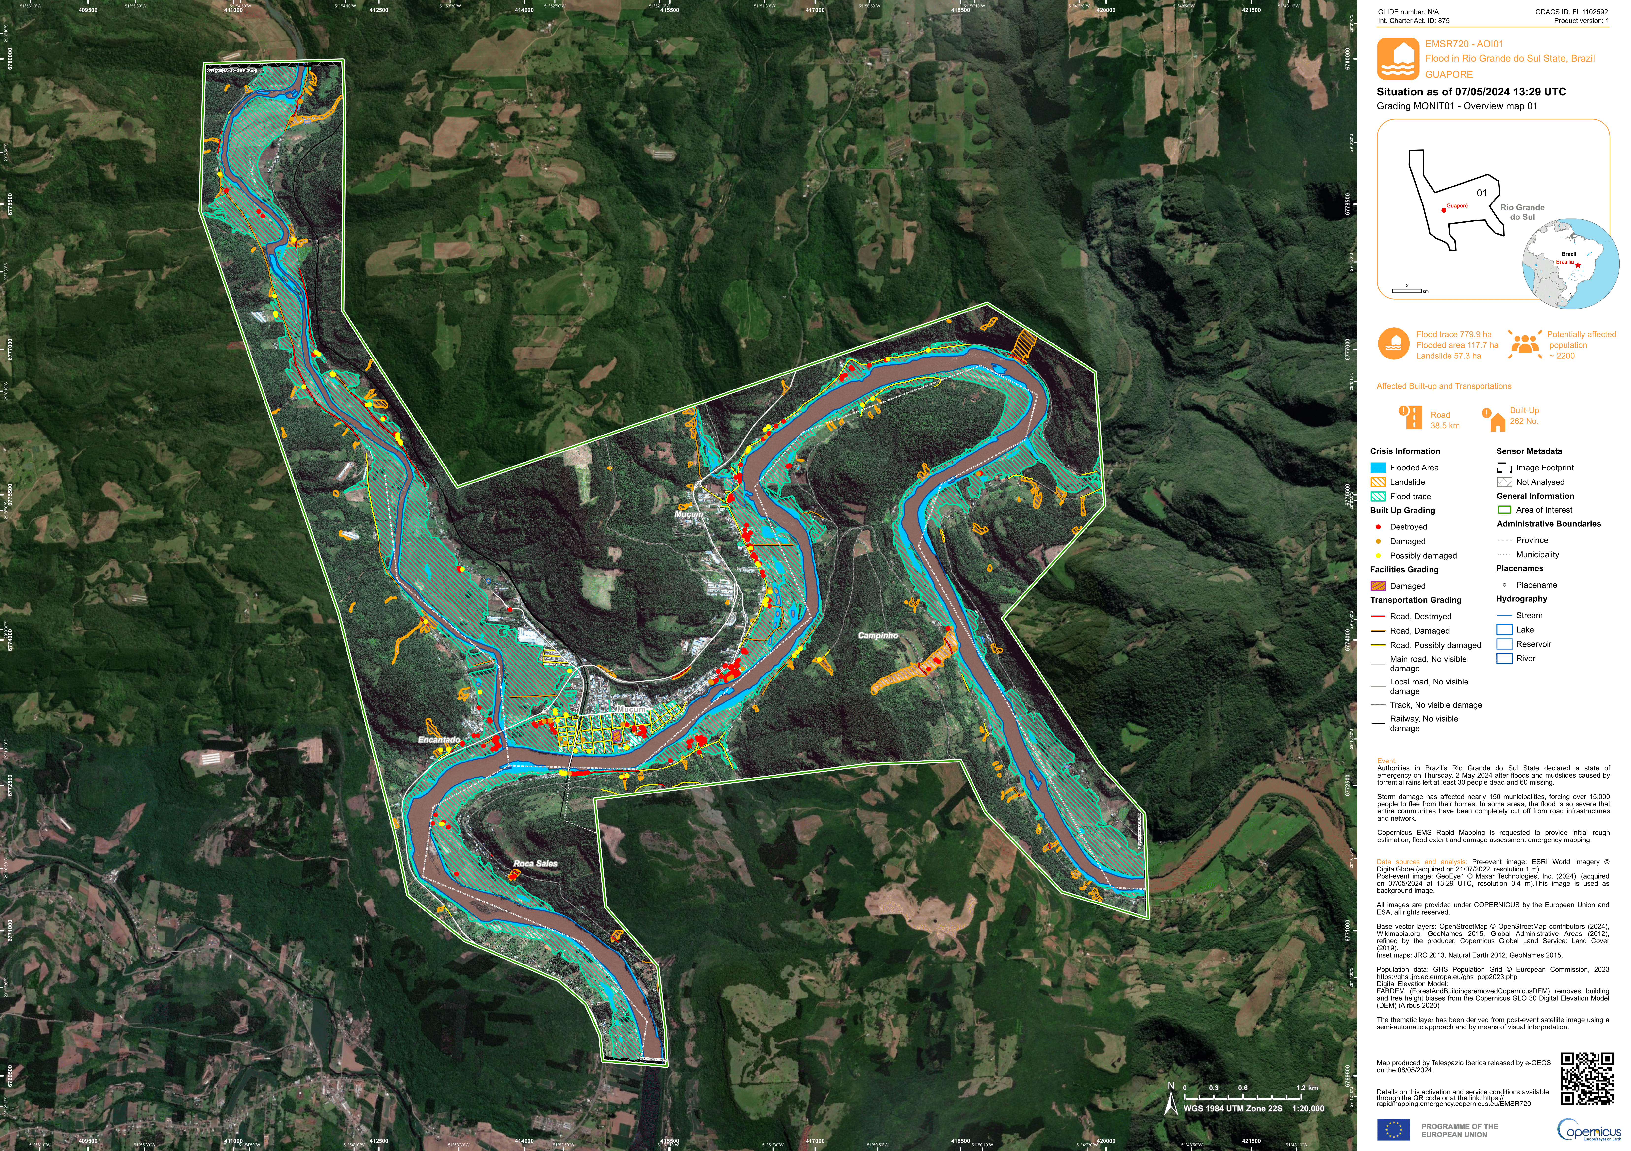
1. On-demand mapping
La Palma, Canarias, Spain (2021)
Aristino, Alexandropolis, Greece (2023)
Guaporé, Rio Grande do Sul, Brazil (2024)
La Palma, Spain (2021)
Notes:
Pick either this slide or slide 7. Needs to be updated to include a map from RRM but it was initially designed to introduce RM.

Slide 7
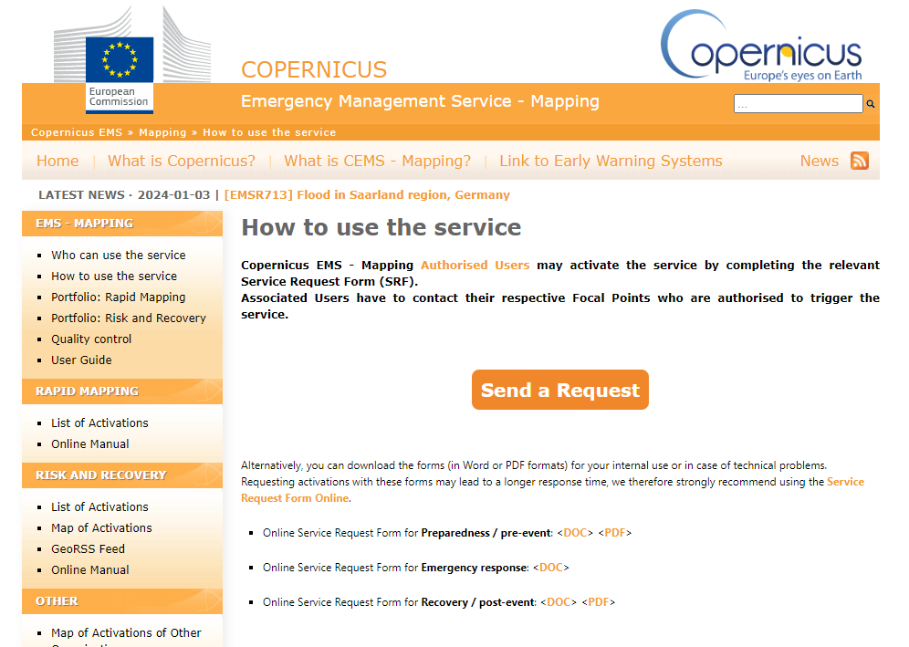
Who can use this on-demand service?
The activation is started by an authorized user of the service:
National Focal Point in EU Member States
National Focal Point User – Civil Protection Mechanism Country (e.g., Norway, Albania, Serbia, Türkiye)
EC services like the JRC, ECHO, DEFIS, EEAS, EU delegations, EU agencies (EEA)
They all can activate on behalf of end users, like other international bodies, local authorities, NGOs, etc.
Notes:
RM standard activation process.

Slide 8
1. Rapid mapping: how does it look like?
Delineation
(aprox. 7 hours)
Situational Reporting
(aprox. 4h, regular updates)
First Estimate
(aprox. 2 hours)
Grading
(aprox. 10 hours)

Slide 9
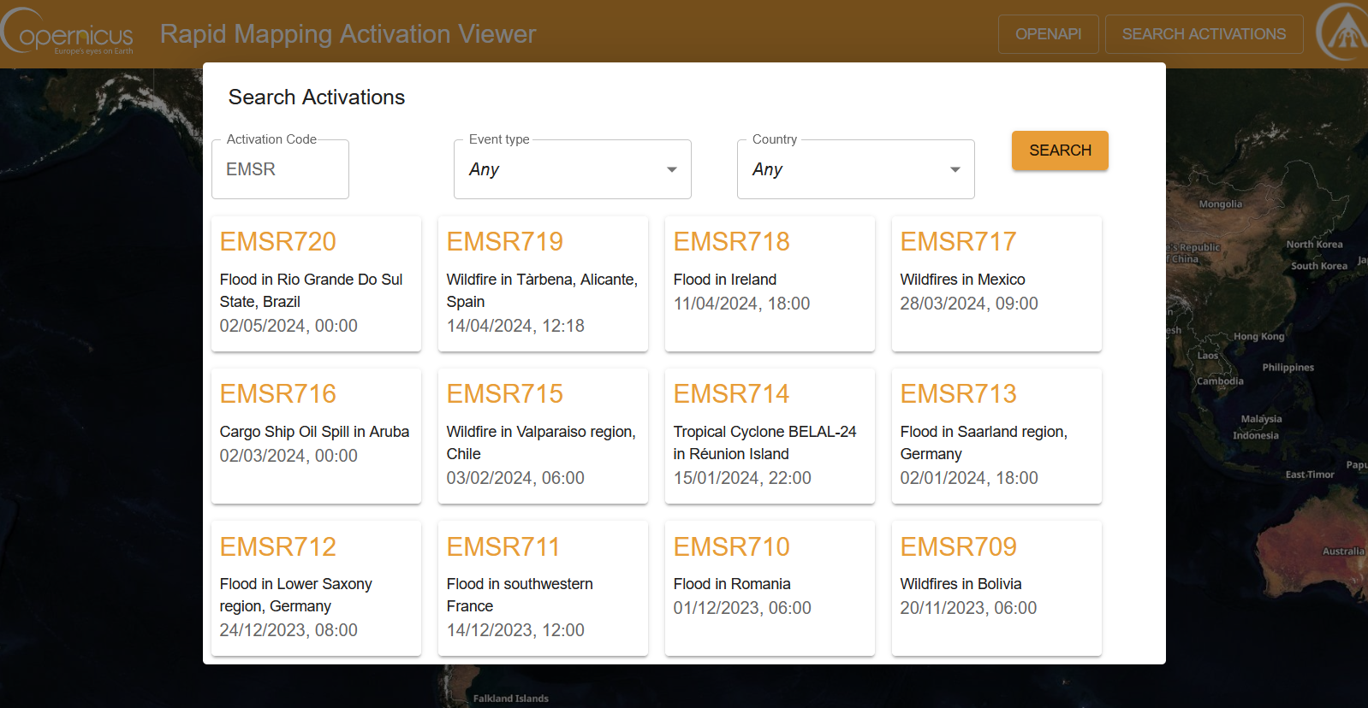
On-demand mapping: how does it look like?
Notes:
It’s a good practice to update this slide by screenshotting the latest activations.
Just follow this link: https://rapidmapping.emergency.copernicus.eu/

Slide 10
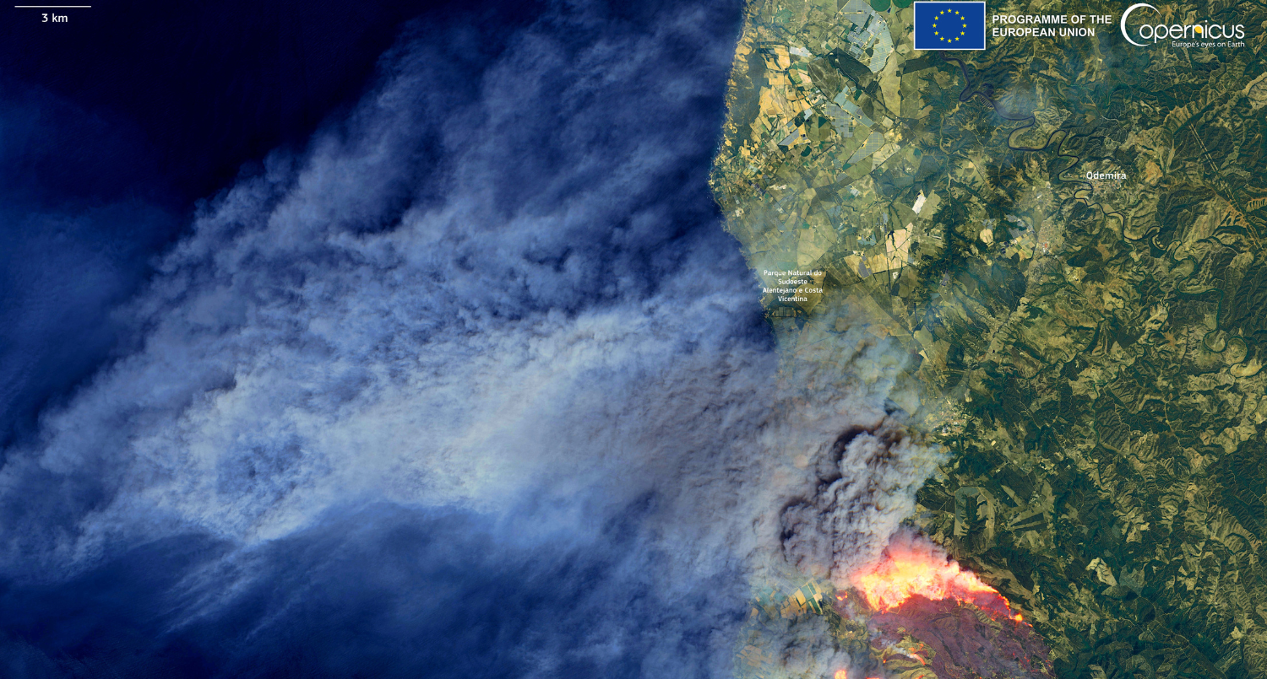
Copernicus Image of the Day – 08/08/2023
Major wildfire in Portugal in August 2023
© Copernicus Sentinel-2 imagery, 2023
Notes:
Slides focused on on-demand mapping in Portugal start here. Skip the next slides or replace them for new ones adapted to the region your presentation is focusing on.

Slide 11
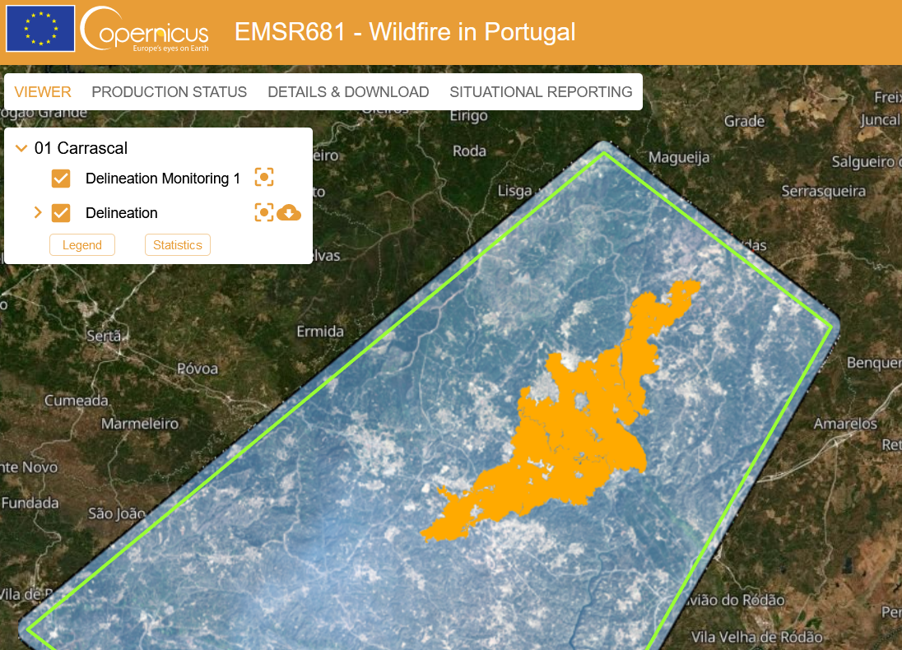
On-demand mapping: Carrascal, Portugal
Major wildfire in Portugal in August 2023
© Copernicus Sentinel-2 imagery, 2023
Notes:
RM quick overview, with an example in Portugal.

Slide 12
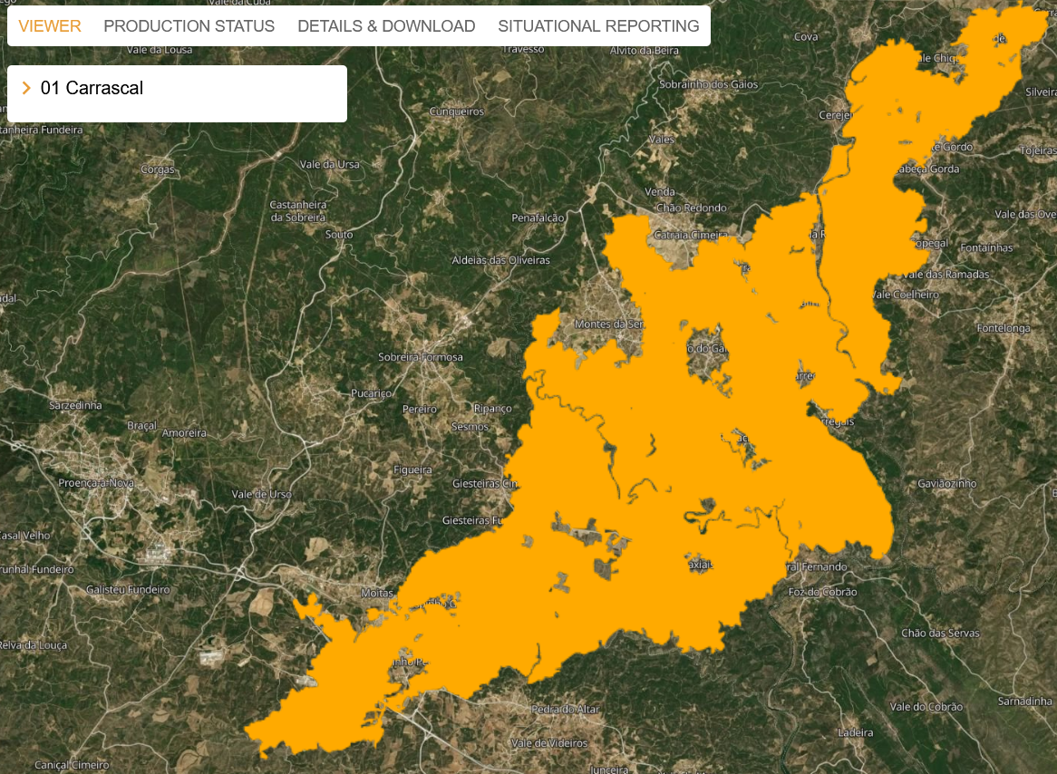
On-demand mapping: Carrascal, Portugal
Major wildfire in Portugal in August 2023
© Copernicus Sentinel-2 imagery, 2023
Notes:
RM quick overview, with an example in Portugal.

Slide 13
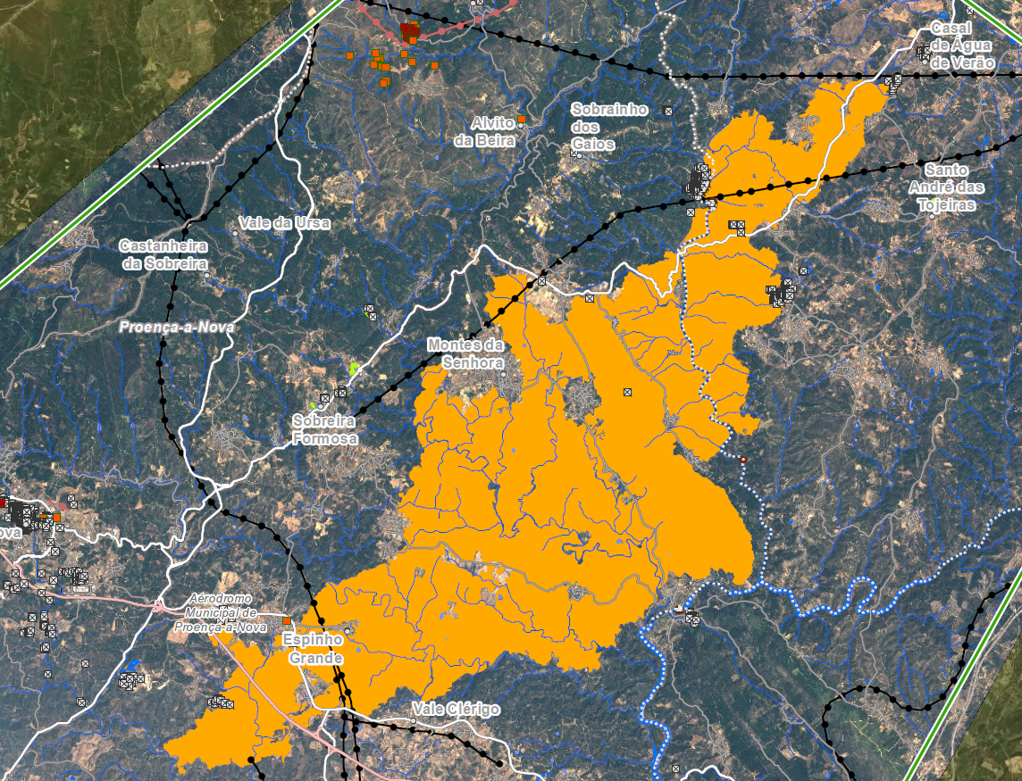
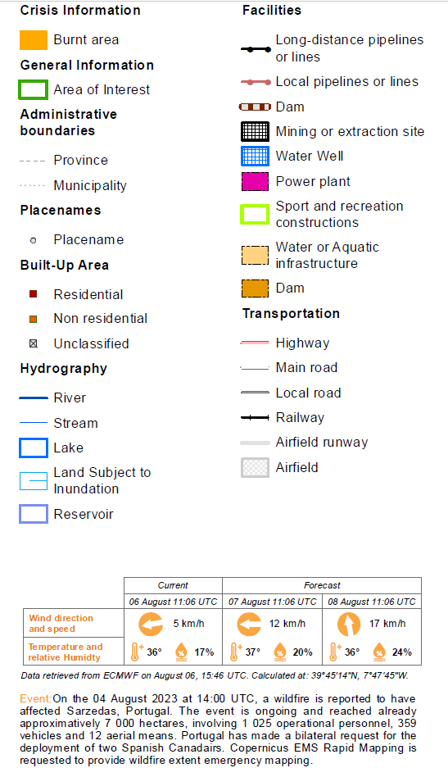
On-demand mapping: Carrascal, Portugal
Major wildfire in Portugal in August 2023
© Copernicus Sentinel-2 imagery, 2023
Notes:
RM quick overview, with an example in Portugal.

Slide 14
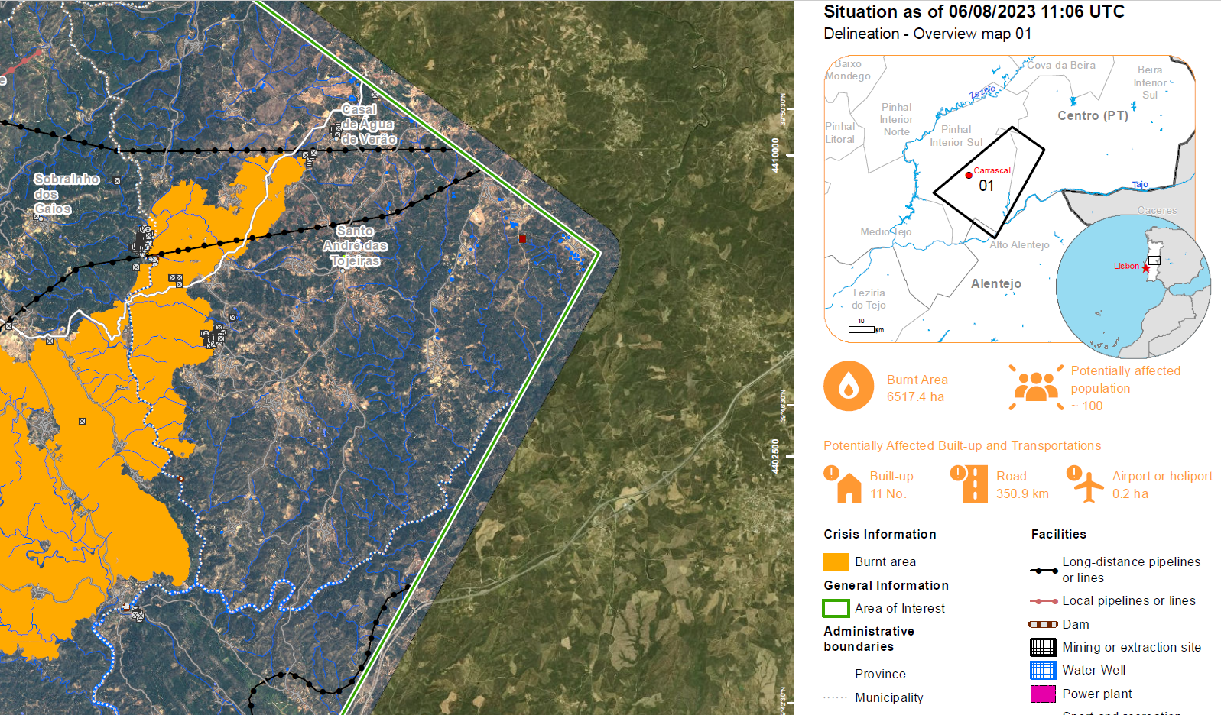
On-demand mapping: Carrascal, Portugal
Major wildfire in Portugal in August 2023
© Copernicus Sentinel-2 imagery, 2023
Notes:
RM quick overview, with an example in Portugal.

Slide 15
On-demand (rapid) mapping: how does it work?
Activation request (AU)
Approval: EC ERCC
Worldwide coverage service
Providing satellite-based maps and data for Civil Protection Authorities and authorised users
Delivering digital geodata and printed map outputs
24 hrs on average
Activation and production
ESA + SP
Activation EC JRC + Service Provider
Notes:
RM standard activation process.

Slide 16
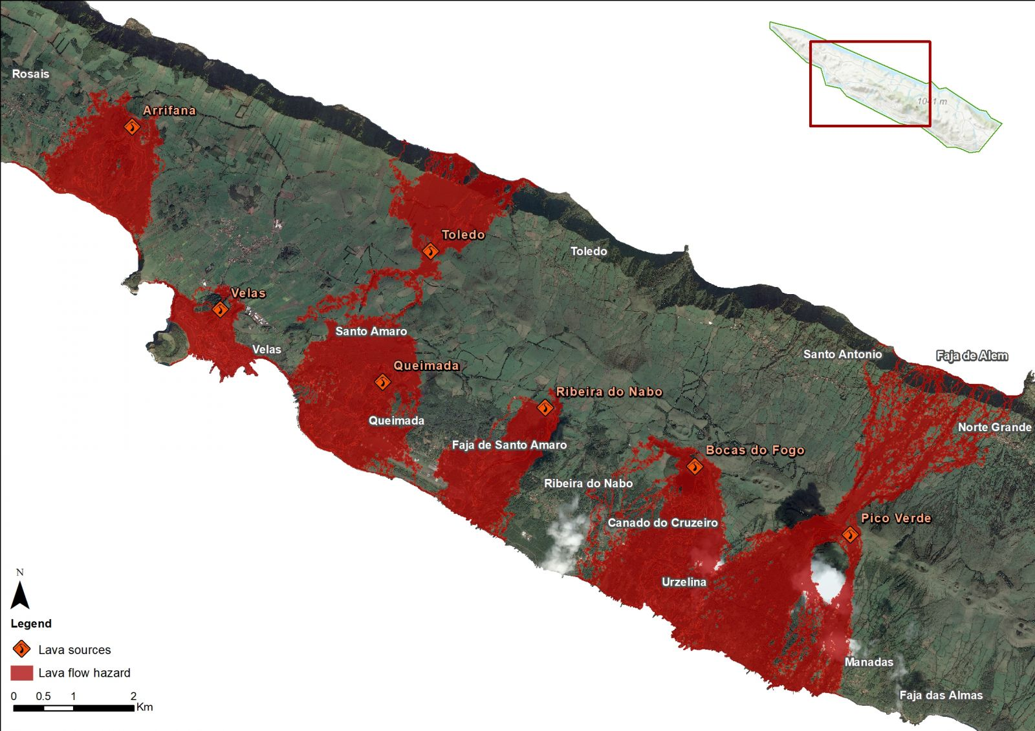
Risk assessment in Sao Jorge, Portugal
What do we see?
Modelling of the lava flows extents for each of the seven vent locations (lava sources indicated by the user).
Major wildfire in Portugal in August 2023
© Copernicus Sentinel-2 imagery, 2023
Notes:
RRM quick overview, with an example in Portugal.

Slide 17
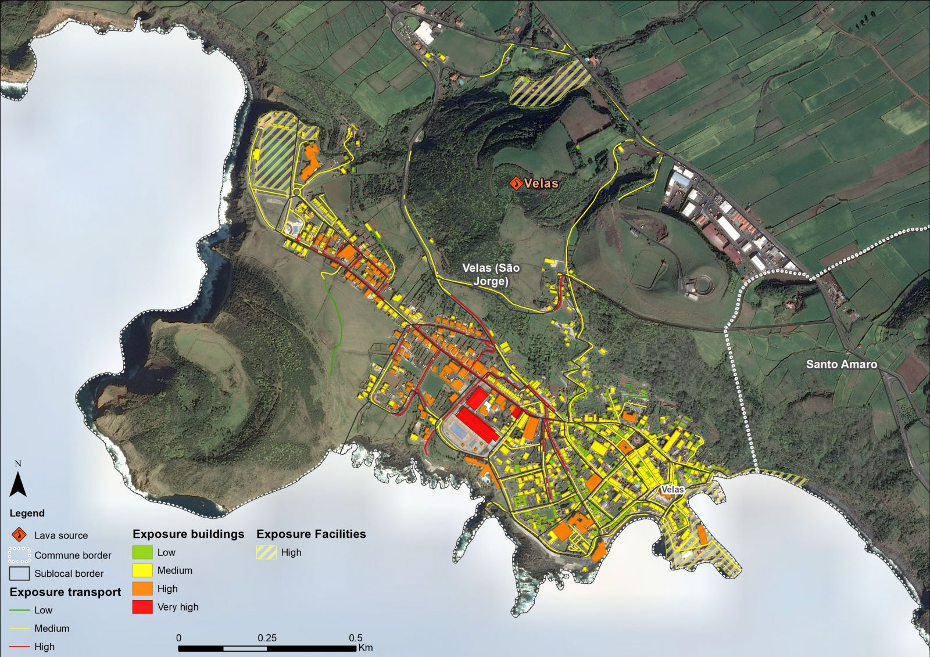
Risk assessment in Sao Jorge, Portugal
What do we see?
Exposure to people and assets, which results from the combination of reference dataset and hazard maps to provide the analysis of exposures and vulnerabilities over the population (low/high season), businesses and most relevant infrastructures affected by the potential lava flows.
Major wildfire in Portugal in August 2023
© Copernicus Sentinel-2 imagery, 2023
Notes:
RRM quick overview, with an example in Portugal.

Slide 18
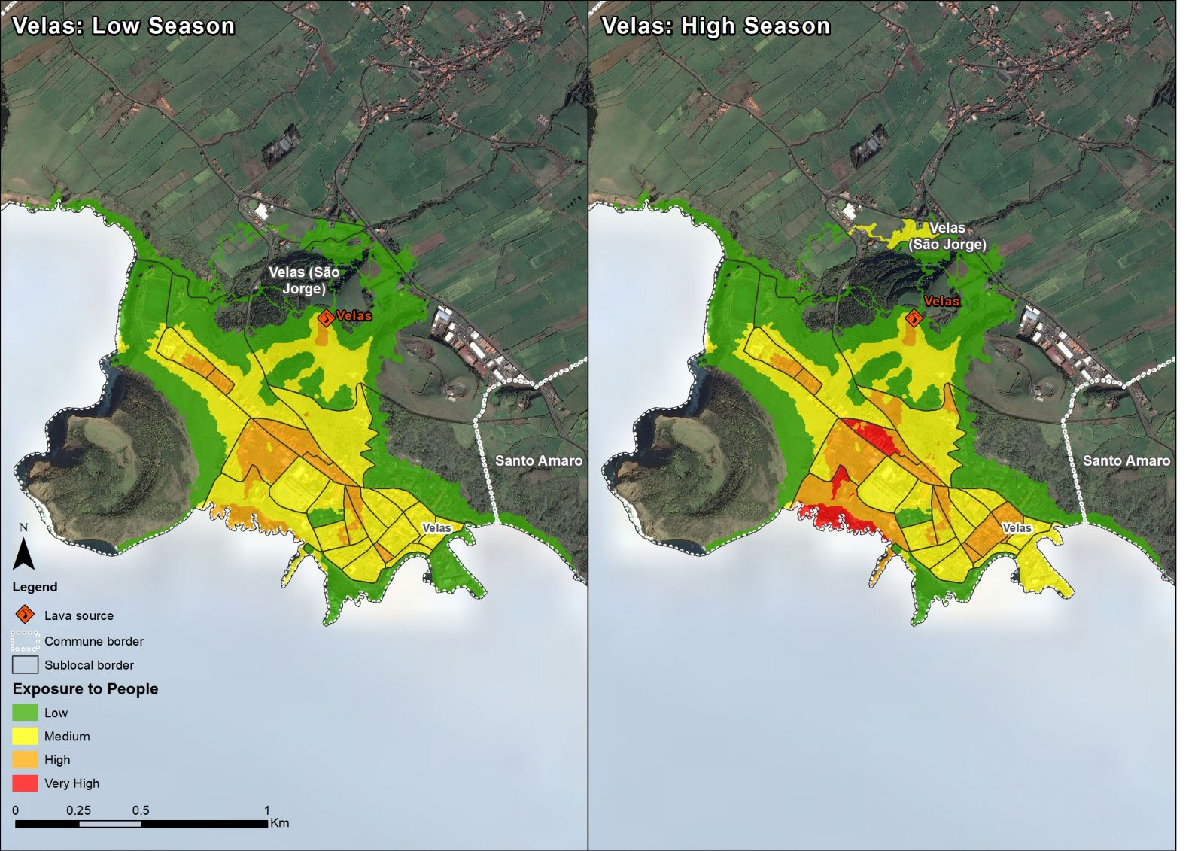
Risk assessment in Sao Jorge, Portugal
What do we see?
The main outcomes of the activation: vector data and maps containing reference information, population exposure (for low and high tourism seasons), and assets exposures relative to the seven different lava sources.
Results show that the most damaging eruption would be in Velas with more exposed population and assets than for any other lava source location.
Major wildfire in Portugal in August 2023
© Copernicus Sentinel-2 imagery, 2023
Notes:
RRM quick overview, with an example in Portugal.

Slide 19
2. Early-warning and monitoring
Drought
Forest fires
Floods
Notes:
I’m using numbers only to facilitate the audience’s understanding. In this case, drought and wildfires are the most frequent in Portugal so I’m presenting them first.

Slide 20
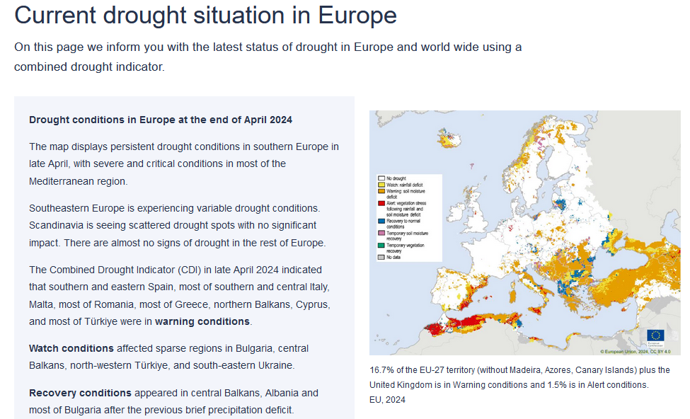
2. Early-warning and monitoring
2.1. The European & Global Drought Observatories
Indicators derived from different data sources provide drought-relevant information.
Often aggregated in analytical reports with the detailed description of severe drought events (e.g. precipitation measurements, satellite measurements, modelled soil moisture content).
Interactive map viewers allow for displaying and analysing drought information.
Notes:
Invite users to follow the page “drought in Europe” for an updated assessment on the drought situation in Europe.

Slide 21
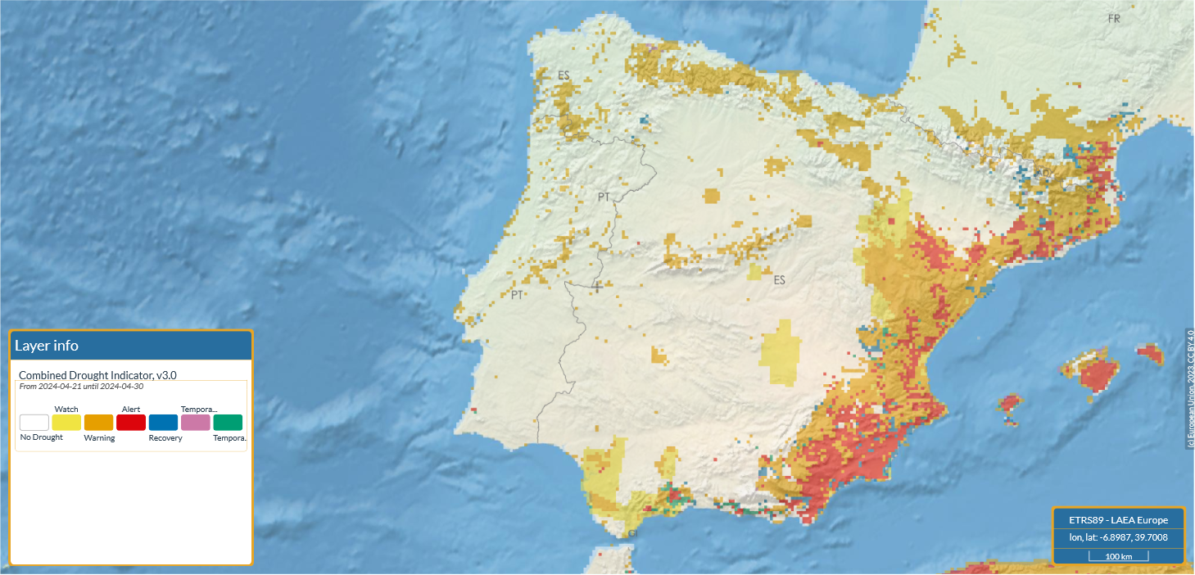
2. Early-warning and monitoring
2.1. The European & Global Drought Observatories
Notes:
CDI is a key product from EDO/GDO. It includes soil moisture, precipitation and vegetation health (+ crop and snow masks).

Slide 22
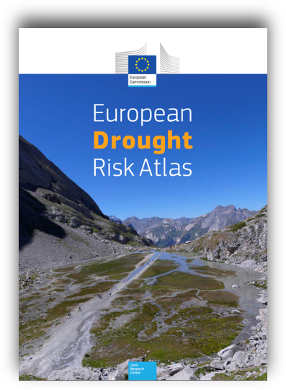
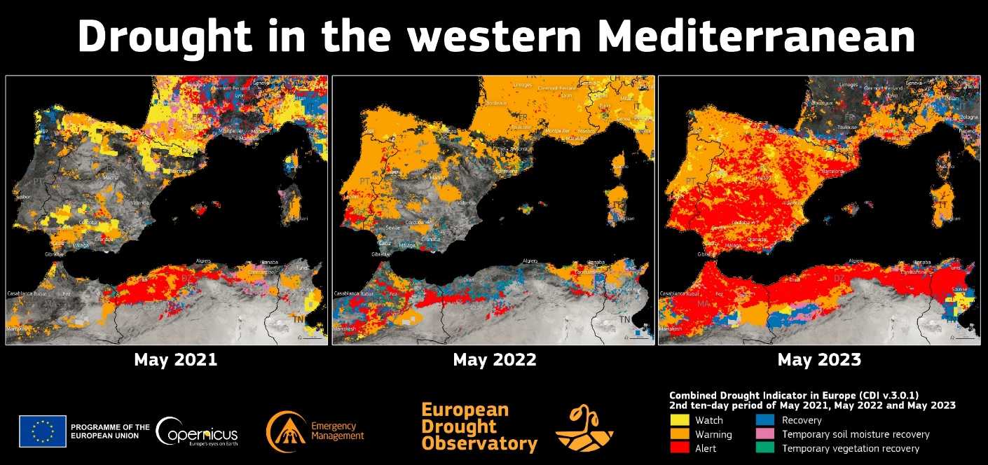
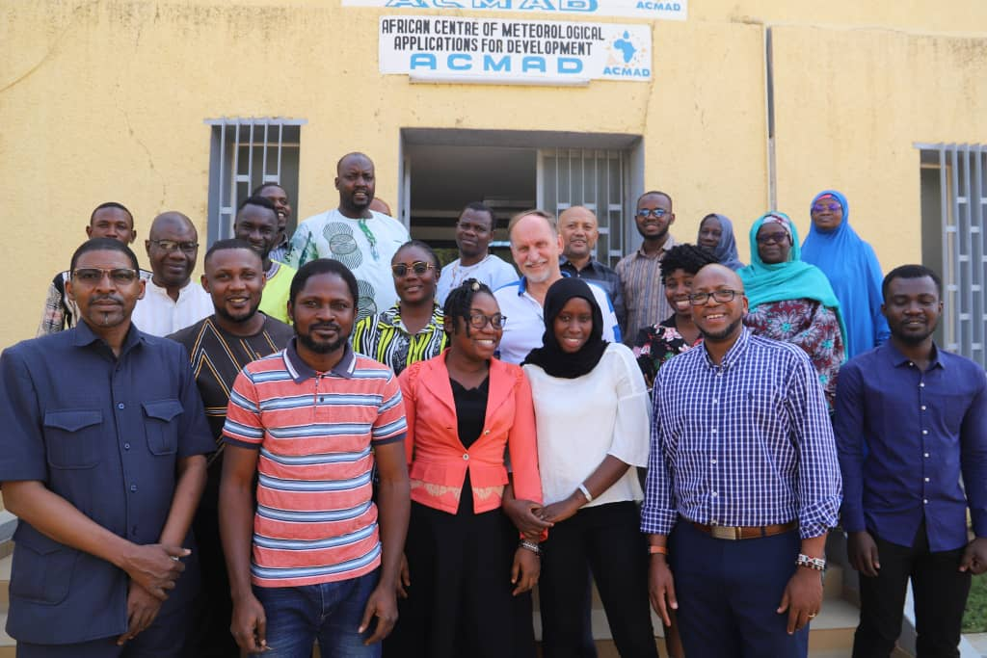
2. Early-warning and monitoring
2.1. The European & Global Drought Observatories
Complex and cascading effects: agriculture (rain fed vs. irrigated agriculture), public water supply, energy supply, river transportation, ecosystems (terrestrial, freshwater) call for dedicated reports.
Assessing current and future drought risks. First assessment drought risk and impacts in the EU for a global warming of 1.5, 2 and 3 degrees. Using AI.
Capacity building in South America and Africa, supporting regional meteorological centres with technical drought workshops and/or status reports.
Notes:
Key points resulting from the work of EDO/GDO.

Slide 23
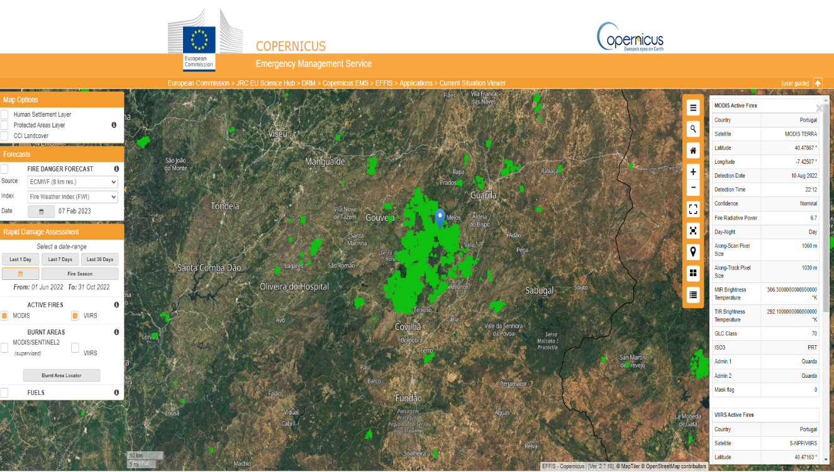
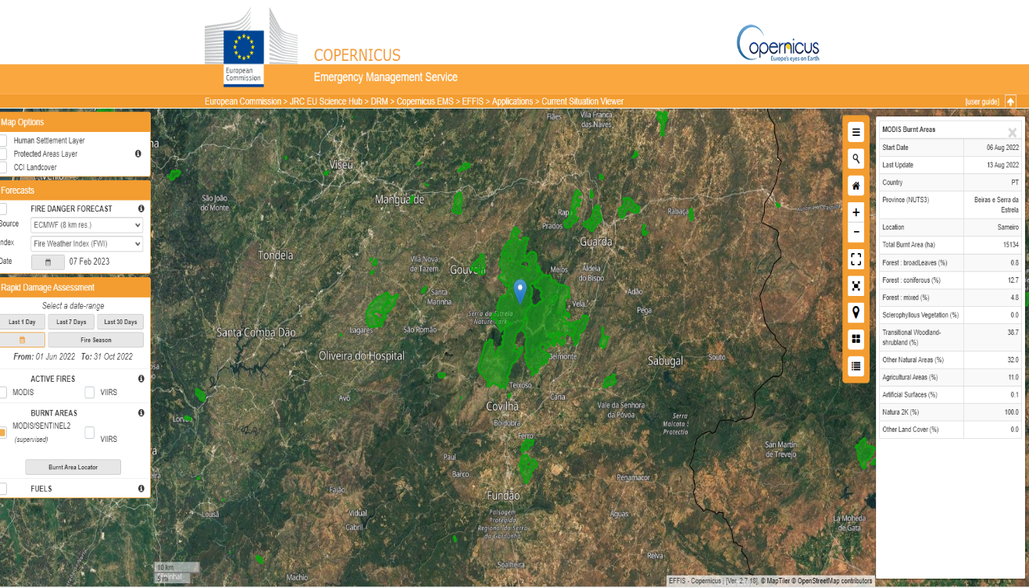
2. Early-warning and monitoring
2.2. The European Forest Fires System
Provides real time forest fire information
Maps all forest fires and reports those with +30 hectares
Complements national systems, harmonising data and methods
Users: EC services, EU Parliament, national forest/fire management services and civil protection in the EU and outside. Incl. FAO, UNEP.
Provides operational support to ECHO (ERCC, civil protection), DEFIS (Copernicus regulation), REGIO (EU solidarity fund), ENV, JRC
EFFIS Fire Detection
EFFIS Burnt Area Maps
Notes:
A few examples (there are more) of EFFIS product/applications on the right.

Slide 24
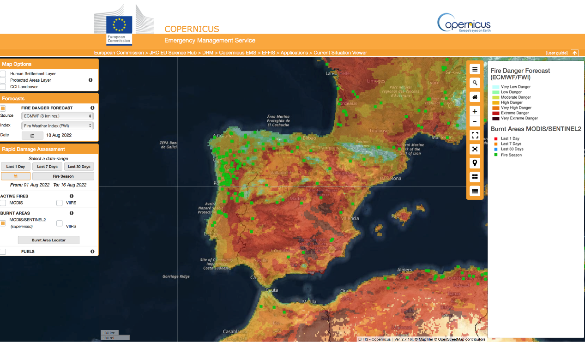
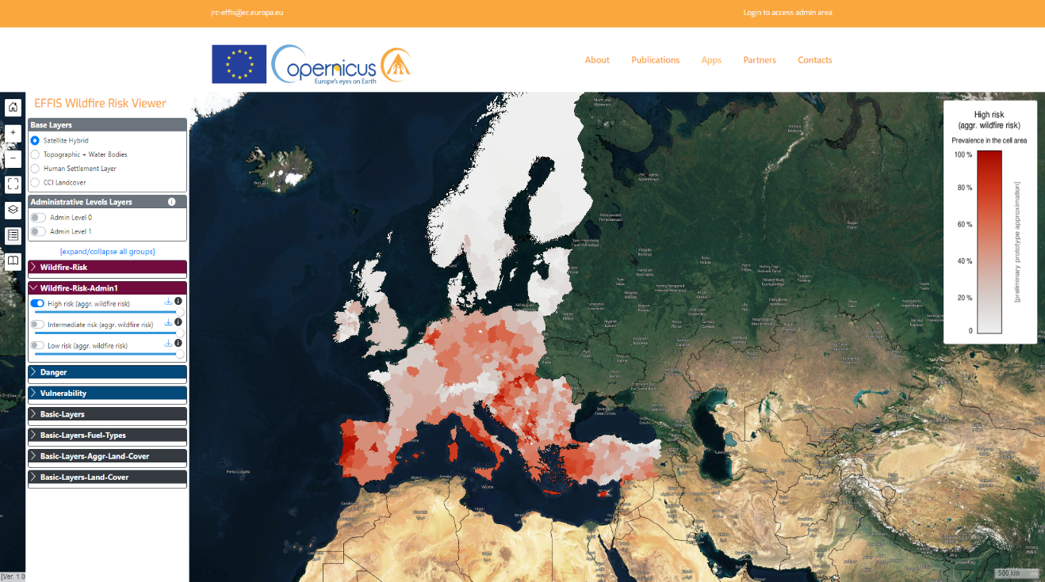
2. Early-warning and monitoring
2.2. The European Forest Fires System
Provides real time forest fire information
Maps all forest fires and reports those with +30 hectares
Complements national systems, harmonising data and methods
Users: EC services, EU Parliament, national forest/fire management services and civil protection in the EU and outside. Incl. FAO, UNEP.
Provides operational support to ECHO (ERCC, civil protection), DEFIS (Copernicus regulation), REGIO (EU solidarity fund), ENV, JRC
Danger Forecast
Wildfire Risk
Notes:
Few examples (there are more) of EFFIS product/applications on the right.

Slide 25
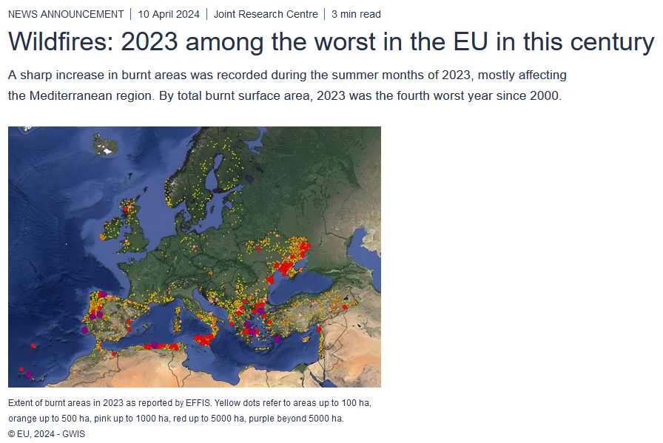
2. Early-warning and monitoring
2.2. The European Forest Fires System
Notes:
#DYK fact.

Slide 26
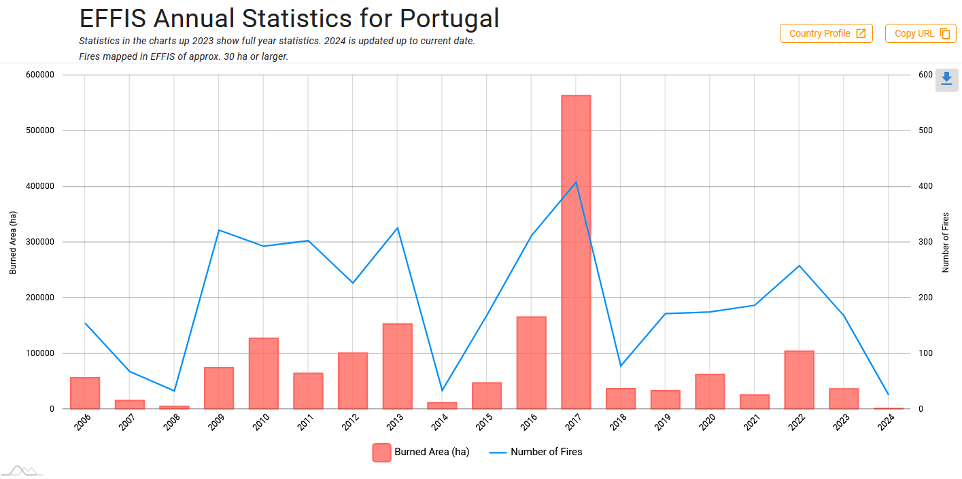
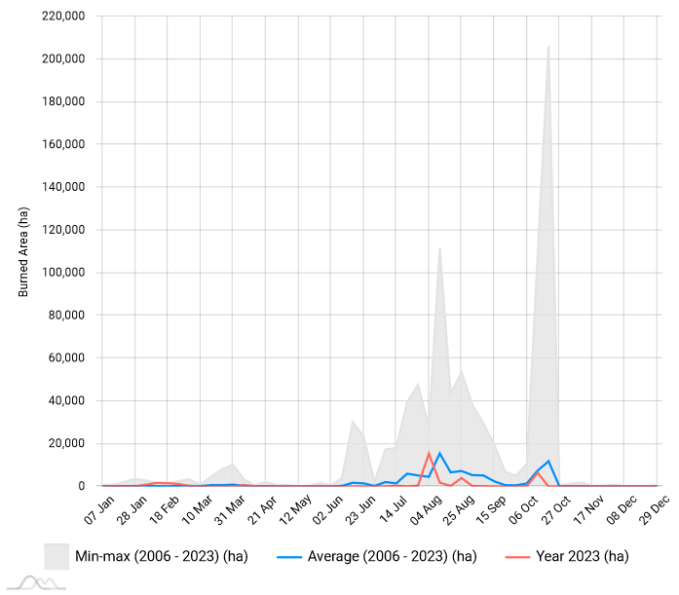
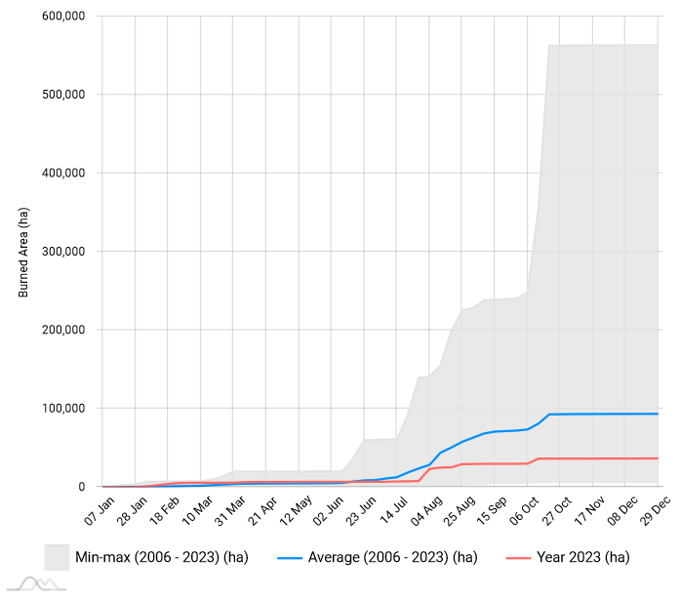
2. Early-warning and monitoring
2.2. The European Forest Fires System
EFFIS Weekly Burnt Areas
EFFIS Weekly Cumulative Burnt Areas

Slide 27
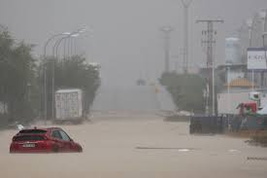
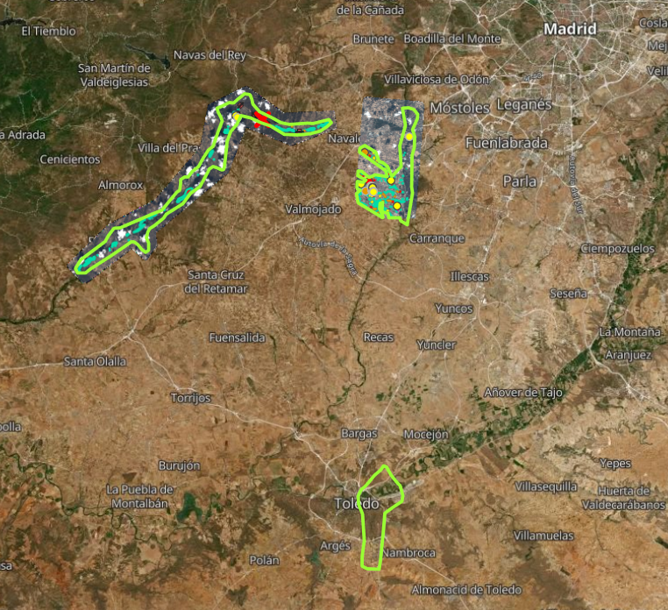
2. Early-warning and monitoring
2.3. The Global and European Flood Awareness Systems
Satellite information + hydrological modelling + meteorological predictions + in situ measurements
EFAS: first operational pan-European flood forecasting and monitoring system
Supports preparedness for anticipated and ongoing floods in Europe, particularly in large transnational river basins.
Reporting points and notifications system available to EFAS partners only.
Notes:
A real image of the floods in Spain
A first estimate map from RM for this event
EFAS showed the probably of rainfall on 28-03 (50mm), before the flood took place.
The layer shows the probability of exceeding 50 mm of cumulative (total) precipitation over the forecast range (next 5 days).

Slide 28
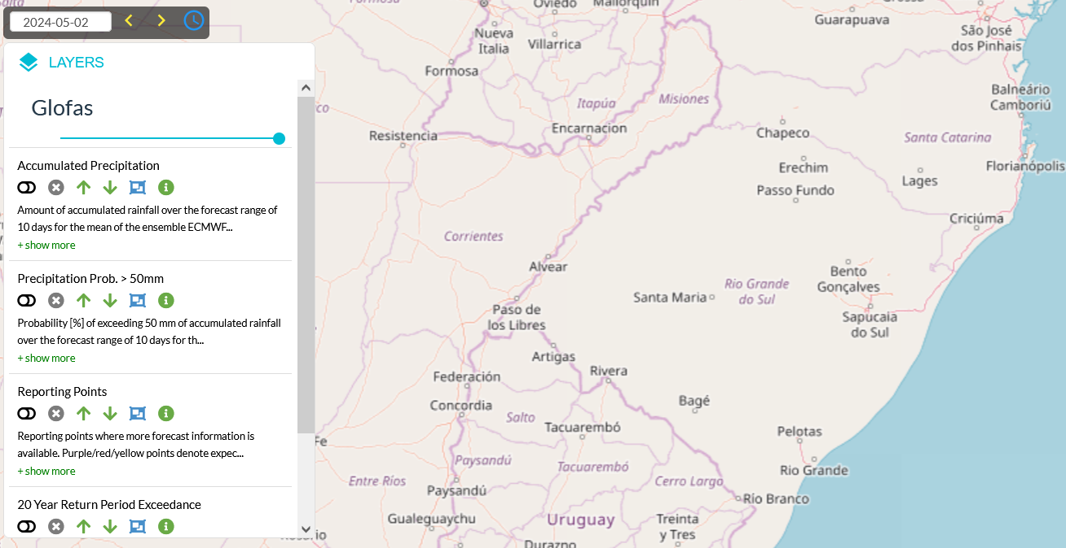
2. Early-warning and monitoring
2.3. The Global and European Flood Awareness Systems
Satellite information + hydrological modelling + meteorological predictions + in situ measurements
GloFAS supports preparatory measures for flood events worldwide.
Its reporting points are fully open and there no notification system.
0.05 degrees resolution
Hydrologic model calibration with nearly 2000 in-situ gauging stations
Notes:
A series of changing images on GloFAS & the floods in Rio Grande do Sul (Brazil, May 2024) starts here. This one shows the map viewer without filters.

Slide 29
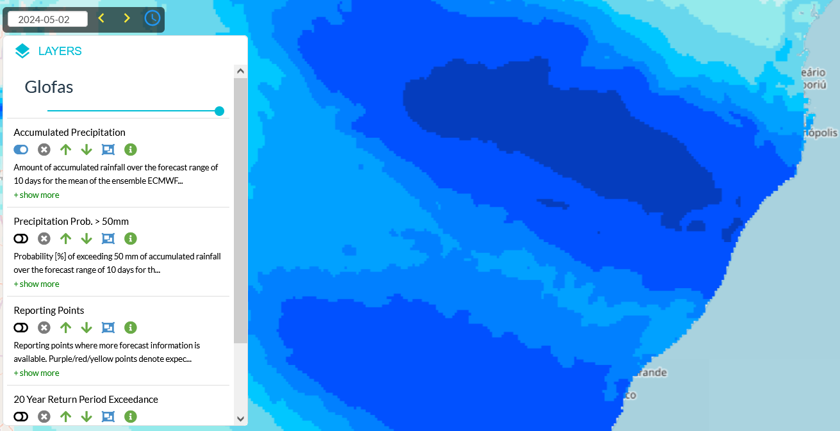
2. Early-warning and monitoring
2.3. The Global and European Flood Awareness Systems
Satellite information + hydrological modelling + meteorological predictions + in situ measurements
GloFAS supports preparatory measures for flood events worldwide.
Its reporting points are fully open and there no notification system.
0.05 degrees resolution
Hydrologic model calibration with nearly 2000 in-situ gauging stations
Notes:
A series of changing images on GloFAS continues. This one shows the map viewer with the accumulated rainfall for the coming 10 days.
Amount of accumulated rainfall over the forecast range of 10 days for the mean of the ensemble ECMWF forecast. More information is available from GloFAS Meteorological products wiki page.

Slide 30
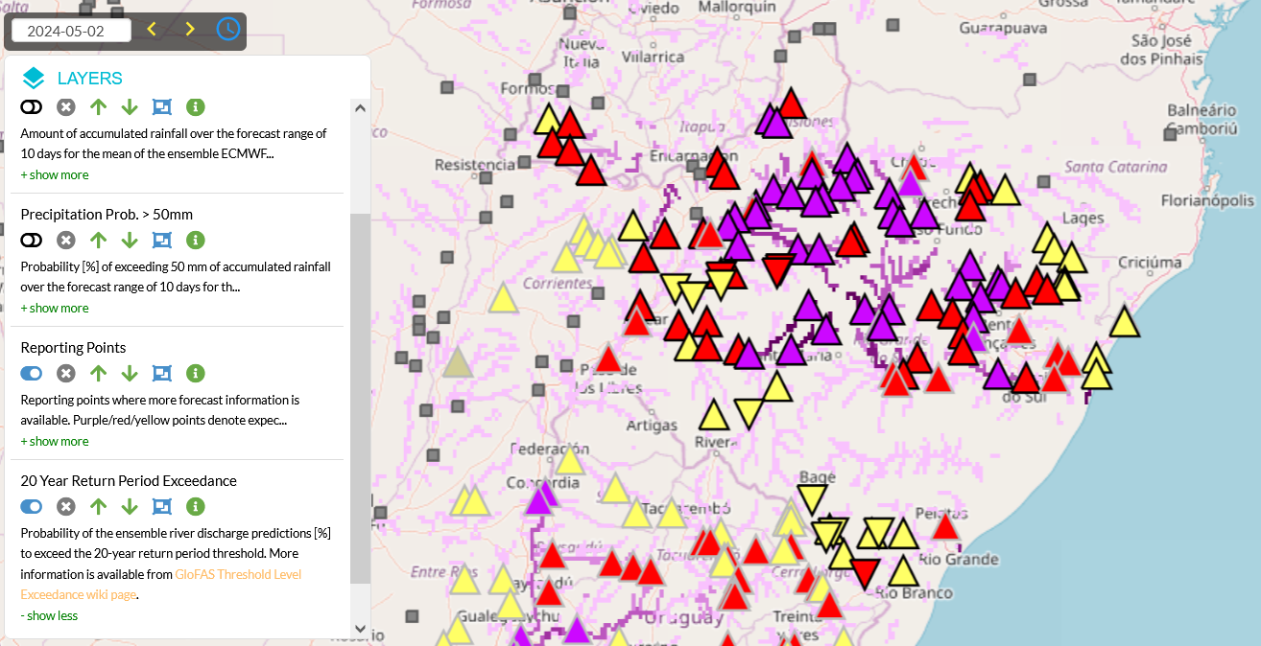
2. Early-warning and monitoring
2.3. The Global and European Flood Awareness Systems
Satellite information + hydrological modelling + meteorological predictions + in situ measurements
GloFAS supports preparatory measures for flood events worldwide.
Its reporting points are fully open and there no notification system.
0.05 degrees resolution
Hydrologic model calibration with nearly 2000 in-situ gauging stations
Notes:
A series of changing images on GloFAS continues. This one shows reporting points (triangles) + 20-y return period exceedance.
Reporting points where more forecast information is available. Purple/red/yellow points denote expected floods to exceed 20-year (purple), 5-year (red) or 2-year (yellow) return period by at least 30%. This flood category (colour) is determined by the highest probability in the 30-day period. Black contour shows flood peak in the first 3 days of the forecast, while pale colours indicate distant floods beyond the first 10 days of the forecast. Numbers denote the percentage of ensemble members exceeding the specific return period. The shape denotes rising (upward triangle), decreasing (downward triangle), or stagnant (circle) trend of the ensemble median discharge within the forecast horizon. The grey squares represent reporting points with no flood, when the 2-year return period probability is less than 30%. For more information please check out the: Reporting Points wiki page.
Probability of the ensemble river discharge predictions [%] to exceed the 20-year return period threshold. More information is available from GloFAS Threshold Level Exceedance wiki page.

Slide 31
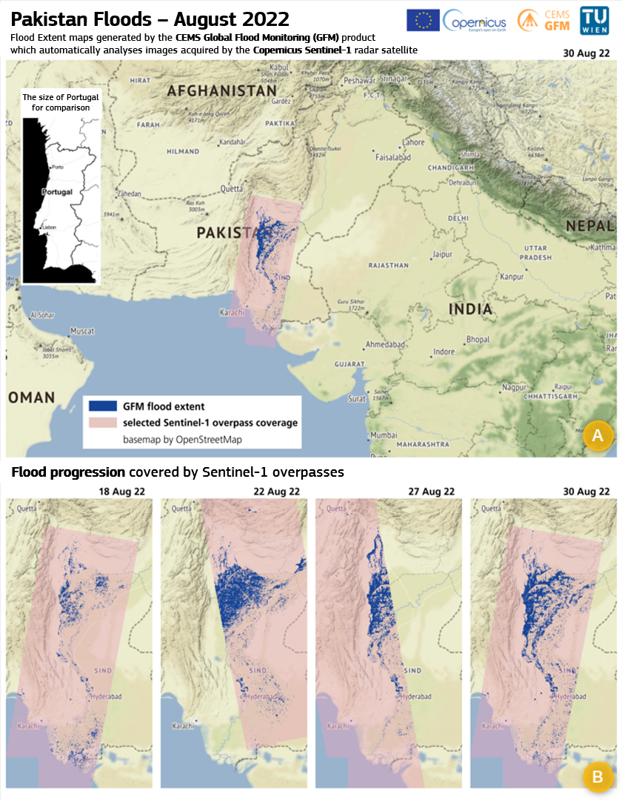
2. Early-warning and monitoring
2.3. The Global and European Flood Awareness Systems
The Global Flood Monitoring (GFM) tool
Provides a continuous global & systematic monitoring thanks to Sentinel-1 SAR imagery which enables all day and all-weather flood monitoring
Significantly enhances the timeliness: less than 8 hours between sensing and product delivery
Improves the effectiveness of activation requests
Notes:
Quick overview of GFM. Data needs to be updated to a more recent event.

Slide 32
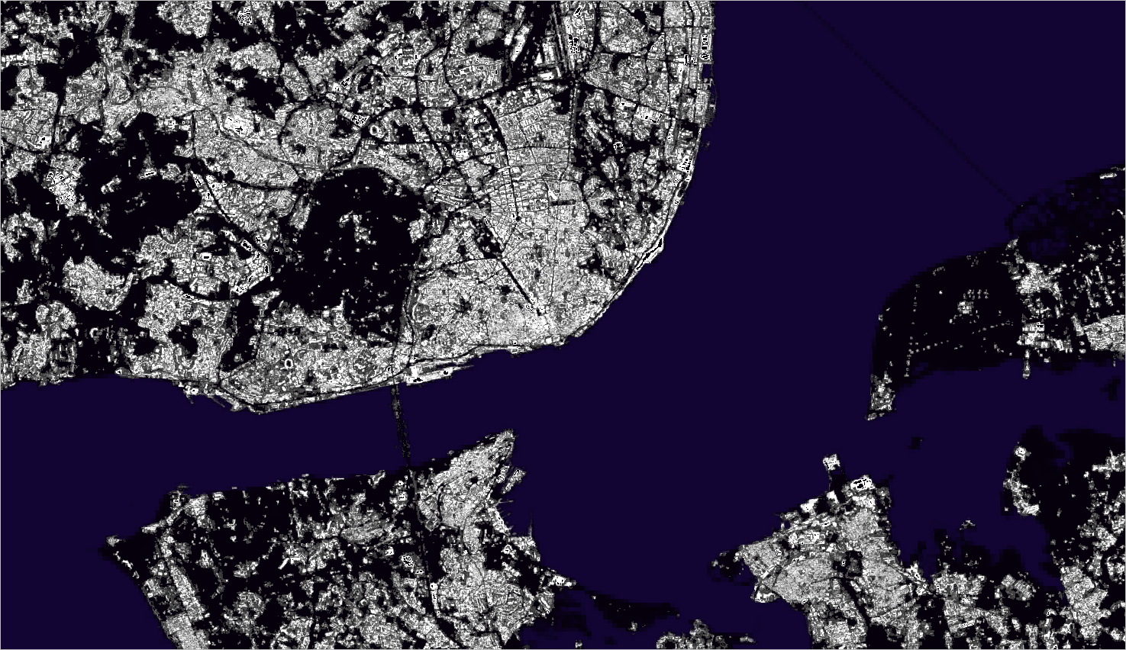
3. Exposure mapping
Data source:
GHS-BUILT-S 10m (2018)
Notes:
You could ask Johannes UHL (GHSL) to prepare static and interactive animations for a specific region.

Slide 33
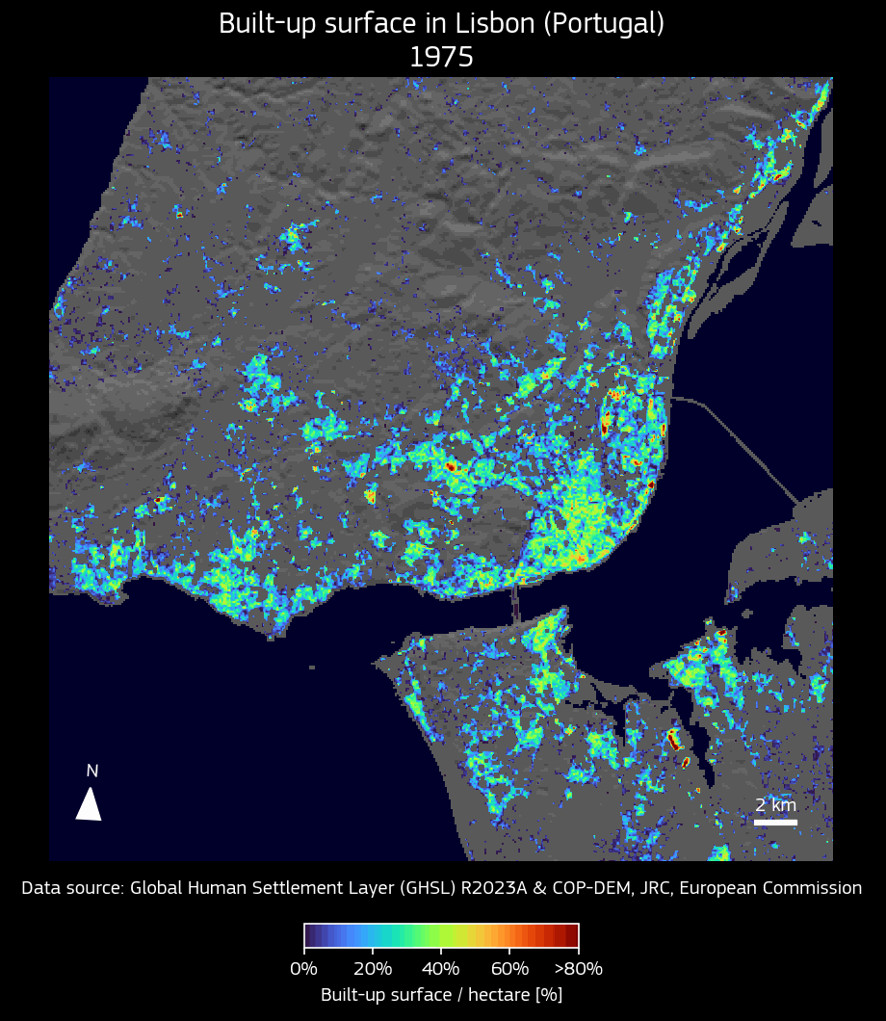
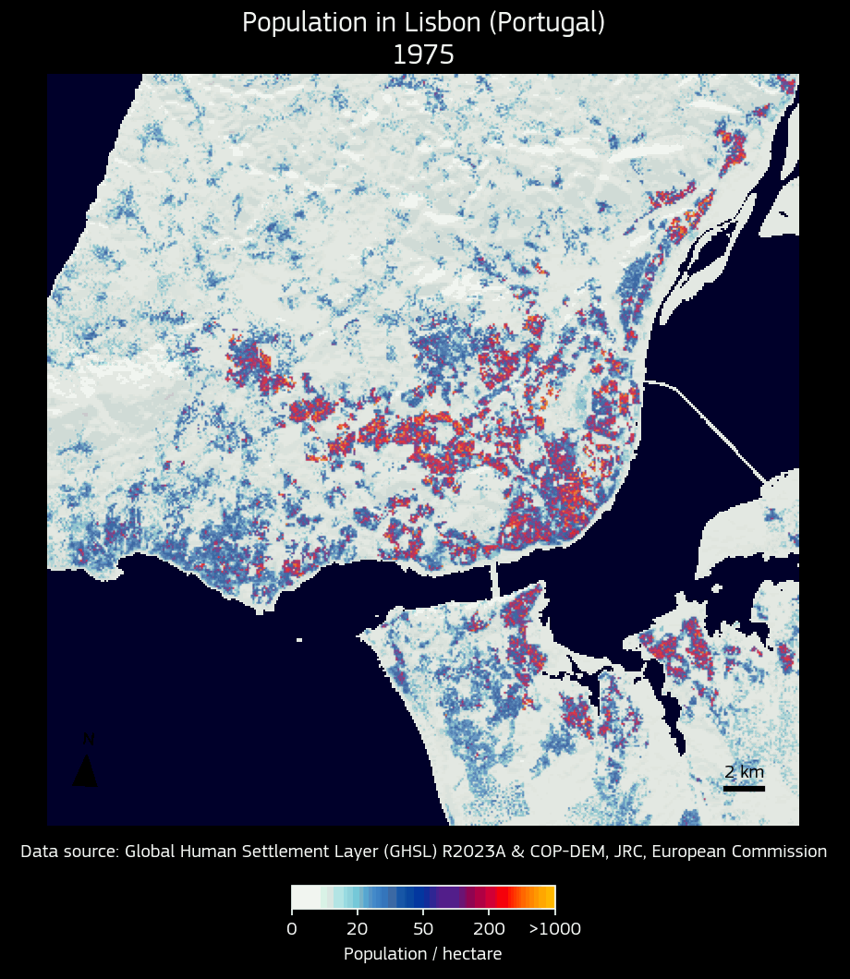
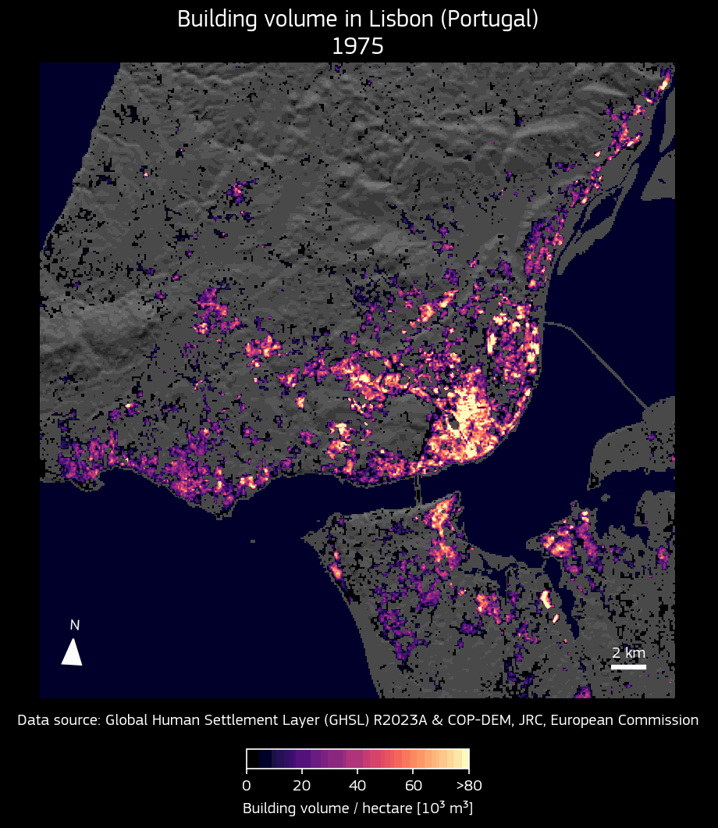
3. Exposure mapping
The Global Human Settlements Layer (GHSL)
Highly accurate information derived from satellite and census data on the presence of settlements and population
Detailed information on disaster exposure, essential for managing manage crises and assessing disaster risk
Information used in the CEMS on-demand mapping and early warning products

Slide 34
3. Exposure mapping
The Global Human Settlements Layer (GHSL)
Information on population and settlements is relevant for many other application domains, international frameworks and other Copernicus services:

Slide 35
Thank you!
https://emergency.copernicus.eu/
© European Union 2024
Unless otherwise noted the reuse of this presentation is authorised under the CC BY 4.0 license. For any use or reproduction of elements that are not owned by the EU, permission may need to be sought directly from the respective right holders.

