Slide 1
How can
the national Land cover monitoring system (SMOS)
help
in disaster management?
Mário Caetano
14/05/2024

Slide 2
01
Land cover monitoring system SMOS

Slide 3

What’s SMOS?
Designed and developed by DGT (Directorate-General for Territory)
Production of reference and thematic cartography on land use and land cover
Collaborative and multifunctional system that involves
  Public Administration,
  national scientific and technological system,
  private sector
  citizens
Guided by users' needs and with an open data policy

Slide 4









Key features
Space technologies
Open data
Artificial Intelligence
Collaboration
Continuous monitoring
Efficiency
More information and rigorousness
Evolution

Slide 5


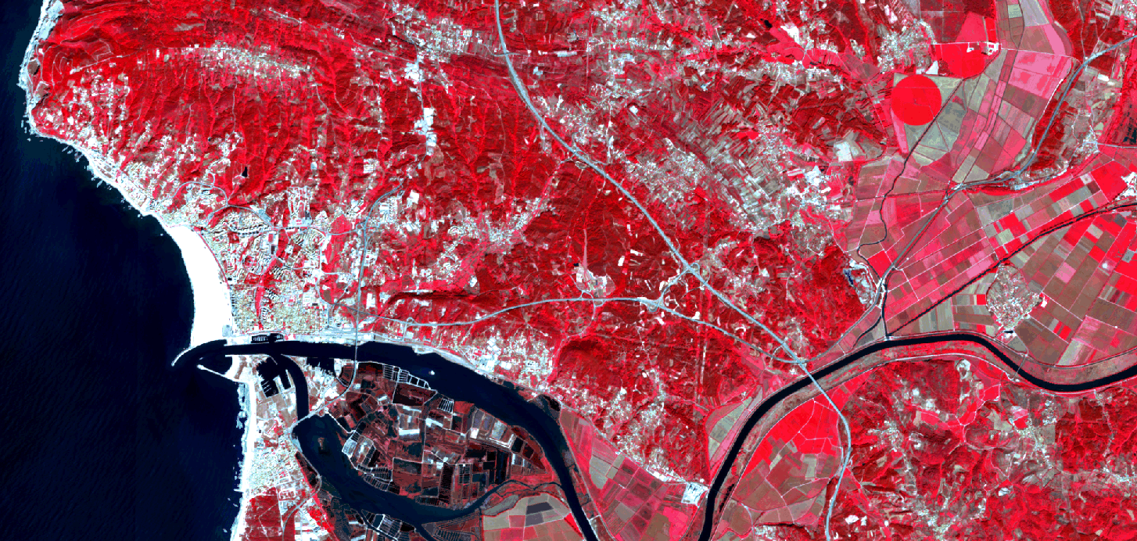


Space technologies
Sentinel-2

Slide 6
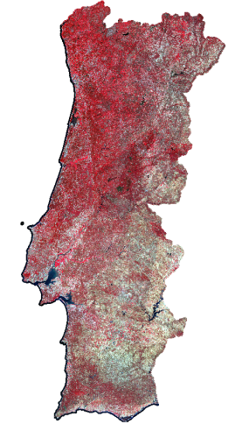
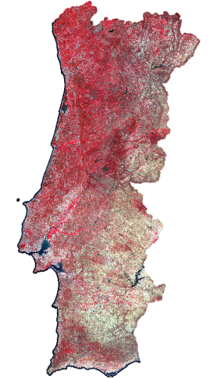
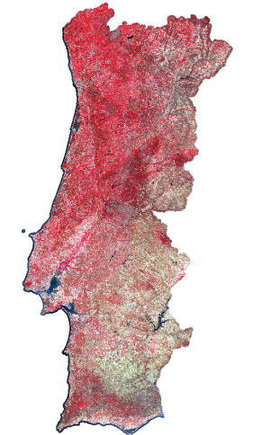
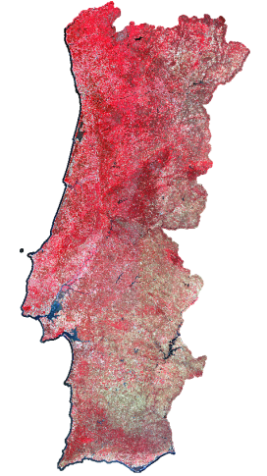
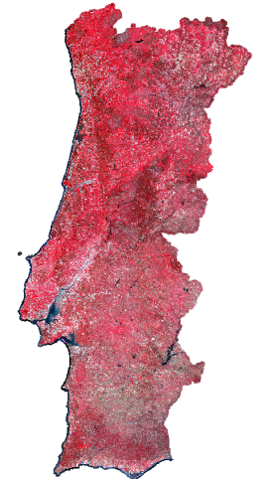
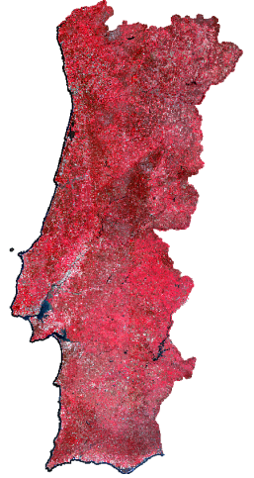
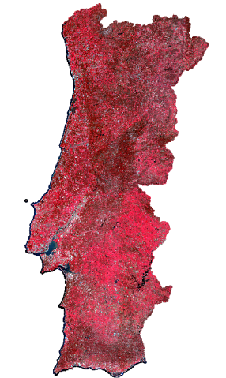
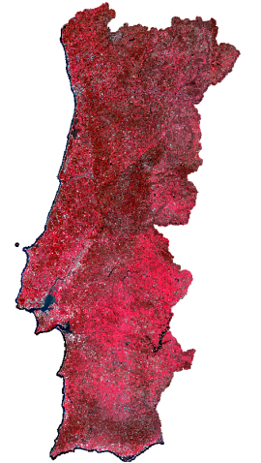
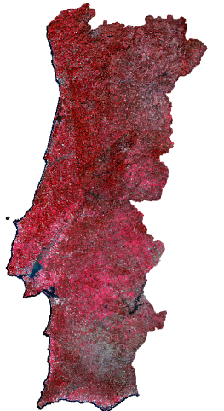
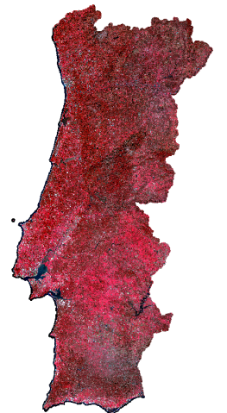
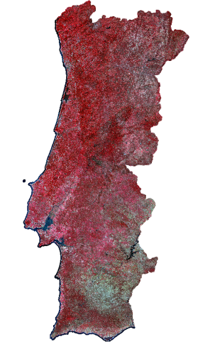
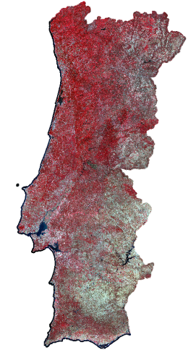
Artificial Intelligence
Spectral bands
Vegetation indices
Temporal metrics
big data
>1.5 TB / year
Artificial intelligence for classifying spatial, spectral and temporal patterns

Slide 7

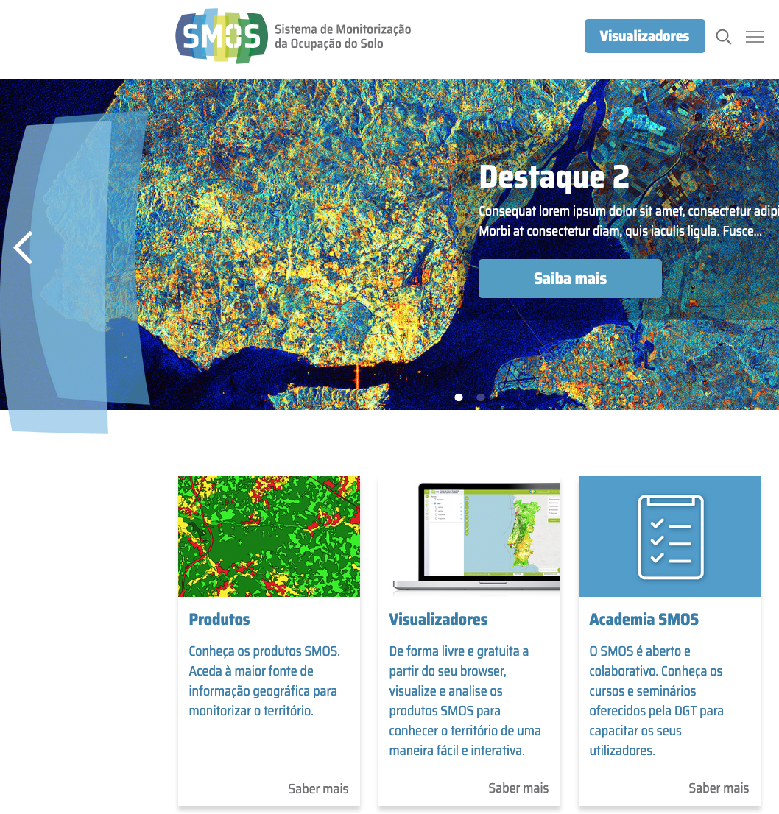



Open data
All SMOS products are available free of charge through visualization and download services
SMOS viewers
SNIG, the National Spatial Data Infrastructure (NSDI)
smos.dgterritorio.gov.pt
snig.dgterritorio.gov.pt

Slide 8







Collaboration

Slide 9
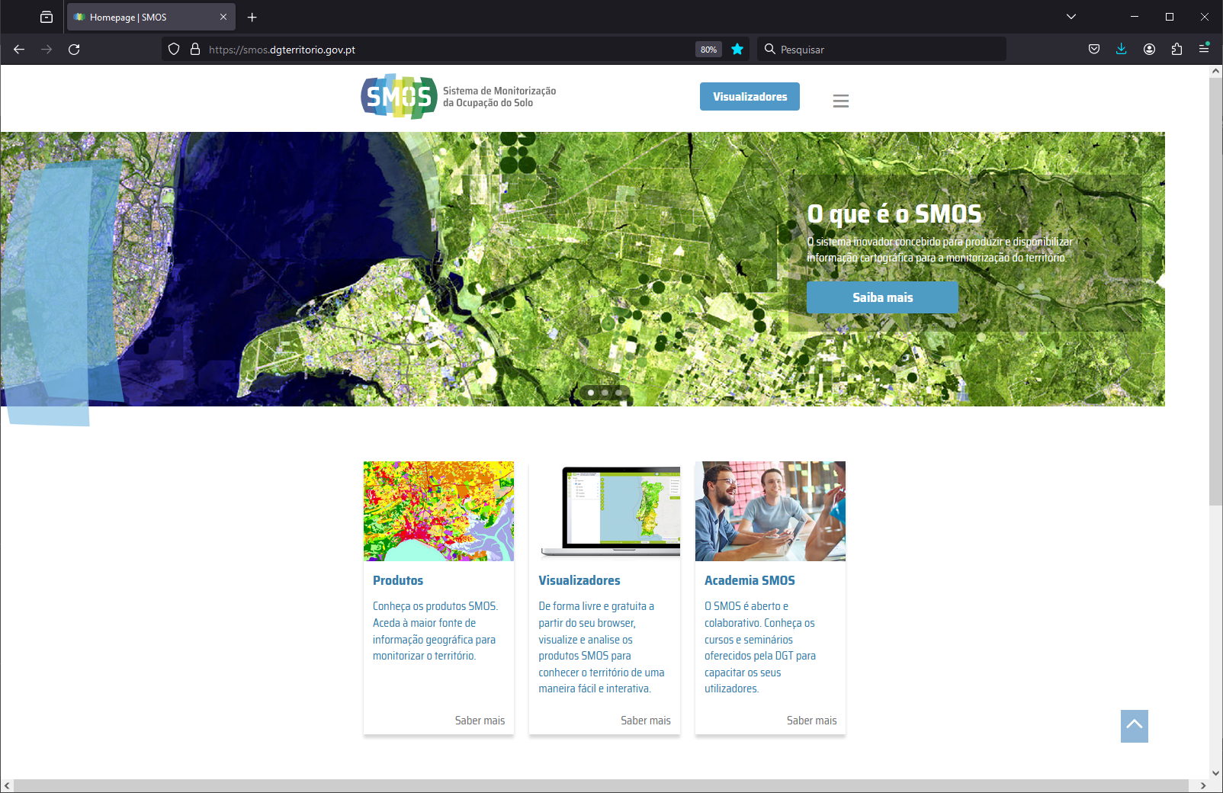
https://smos.dgterritorio.gov.pt

Slide 10
02
SMOS products and viewers

Slide 11
Cartography organized in three families
Topographic cartography – BDNC
Image cartography:
Ortophotomaps
Sentinel-2 Mosaics
VHSR satellite imagery
Reference cartography
COS – Land use Land cover map
LCLU cartography
COSc - COS conjunctural
MIAEV – Intra-Annual Vegetation Status Maps
MACAT – Annual map of temporary agricultural crops
Specific cartographic products
CAE – Built-up area map
CIAE – Wildland-urban interface map
Others under development

Slide 12
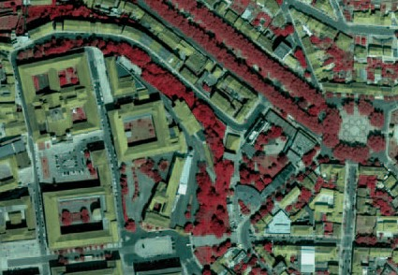
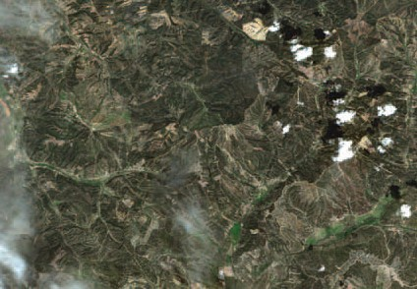
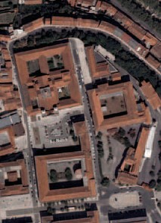
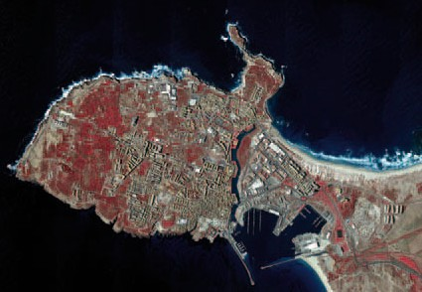
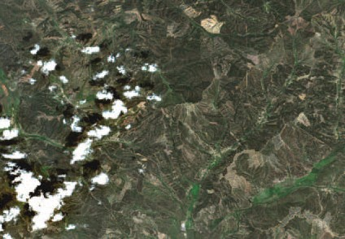
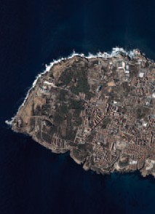
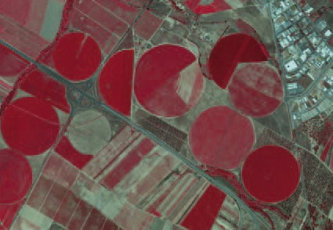
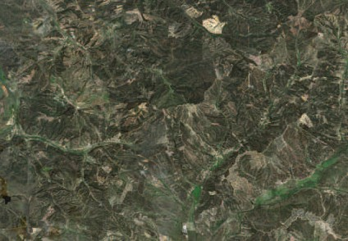
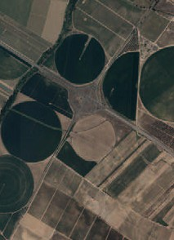
Reference cartography
Orthophotomaps
Sentinel-2 Mosaics
Raster products with pixels of 25 cm to 1 m in true and false colours
Monthly raster products with pixels of 10 m in true and false colours composed of several images of the same month, allowing a cloud-free view of the country.

Slide 13
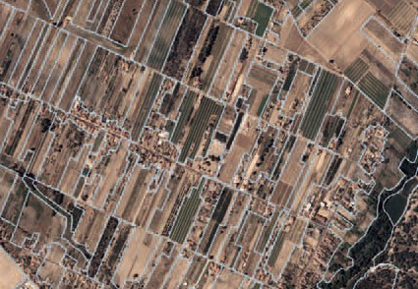
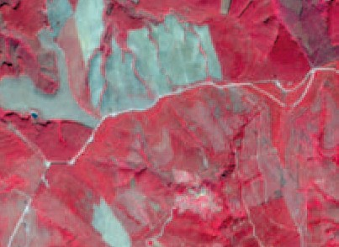
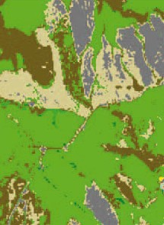
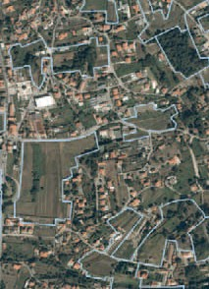
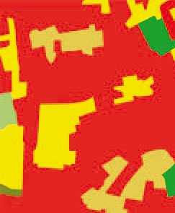
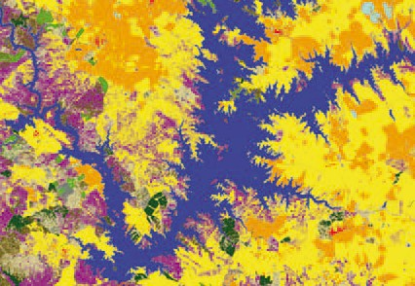
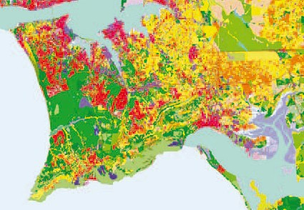
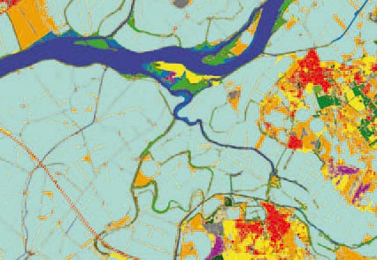
LCLU cartocaphy
COS – Land use land cover map
COSc – Conjuntural land cover map
Vector product with 83 classes and a MMU of 1 ha produced based on visual interpretation of orthophoto maps.
Annual raster product with 15 classes and 10 m pixels size based on Sentinel-2 image automatic classification with Artificial Intelligence

Slide 14
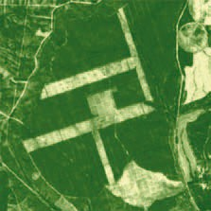
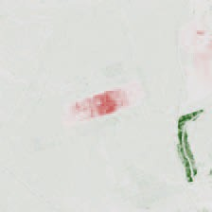
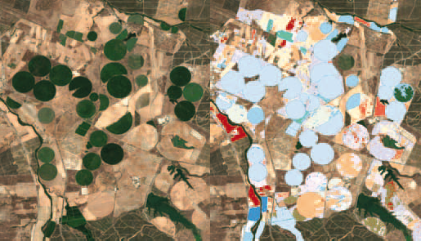
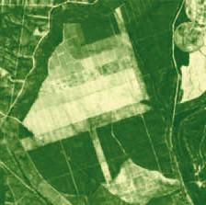

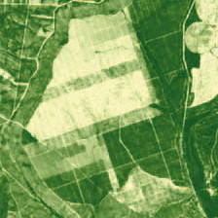
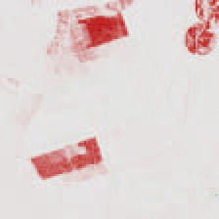
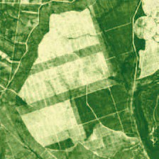
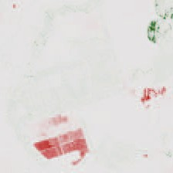
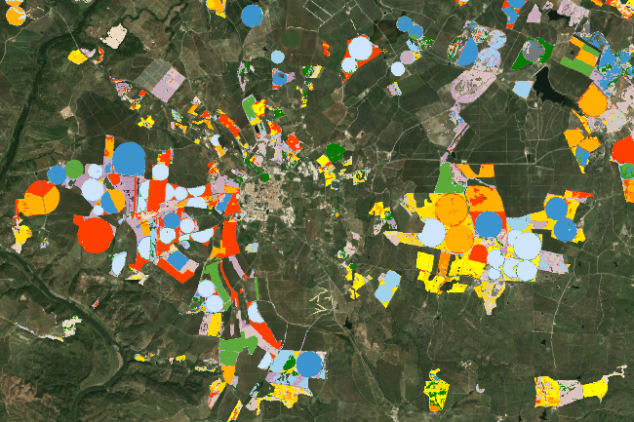
Specific cartographic products
MIAEV - Intra-Annual Vegetation Status Maps
MACAT - Annual Map of Temporary Agricultural Crops
Monthly products to monitor the greenness of the vegetation through quantitative indicators calculated from multitemporal series of Sentinel-2 vegetation indices.
Annual raster product with 10 meter pixel size and representing more than 30 annual agricultural crops based on automatic classification of Sentinel-2 images and other auxiliary data.

Slide 15
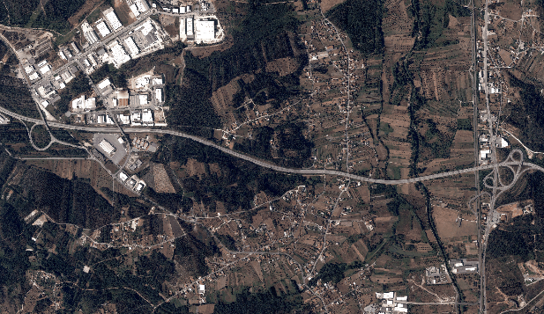
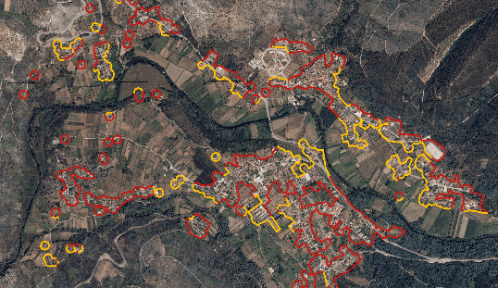
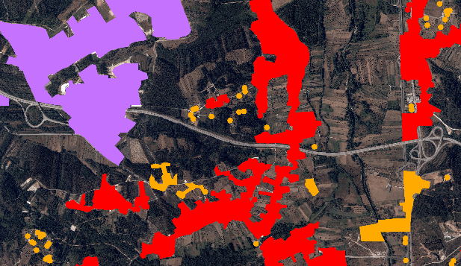
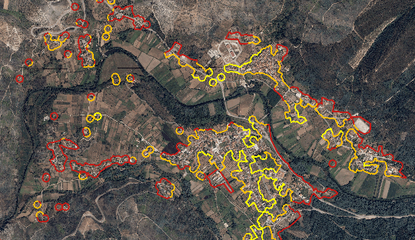
Specific cartographic products
CAE – Built-up área map
CIAE – Wildland-urban interface map (structural and conjunctural)
Vector product that represents and classifies the built-up areas of mainland Portugal, classifying them according to the number and type of residential buildings they include. Its production combines data from Statistics Portugal and DGT.
Vector products that classify the interface (perimeter) of the built-up areas of the CAE as a function of the distance to combustible vegetation. There are two CIAE, one structural and another one conjunctural, which differ in the data and methodology used to identify the fuel cover

Slide 16
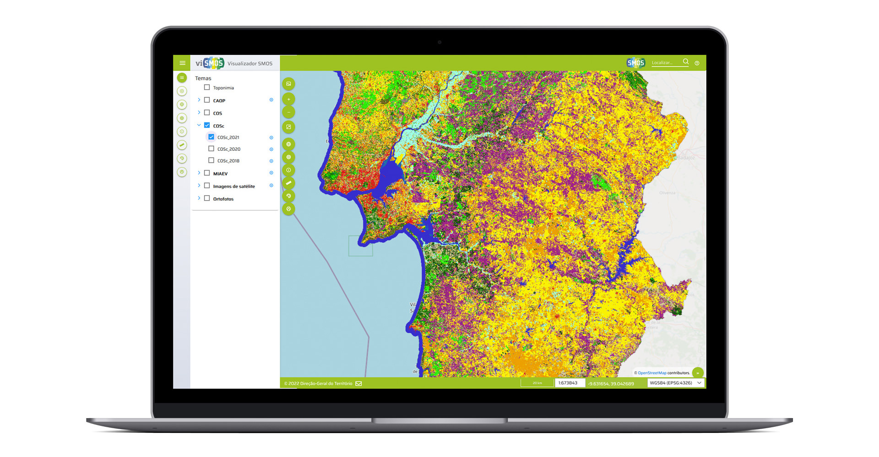
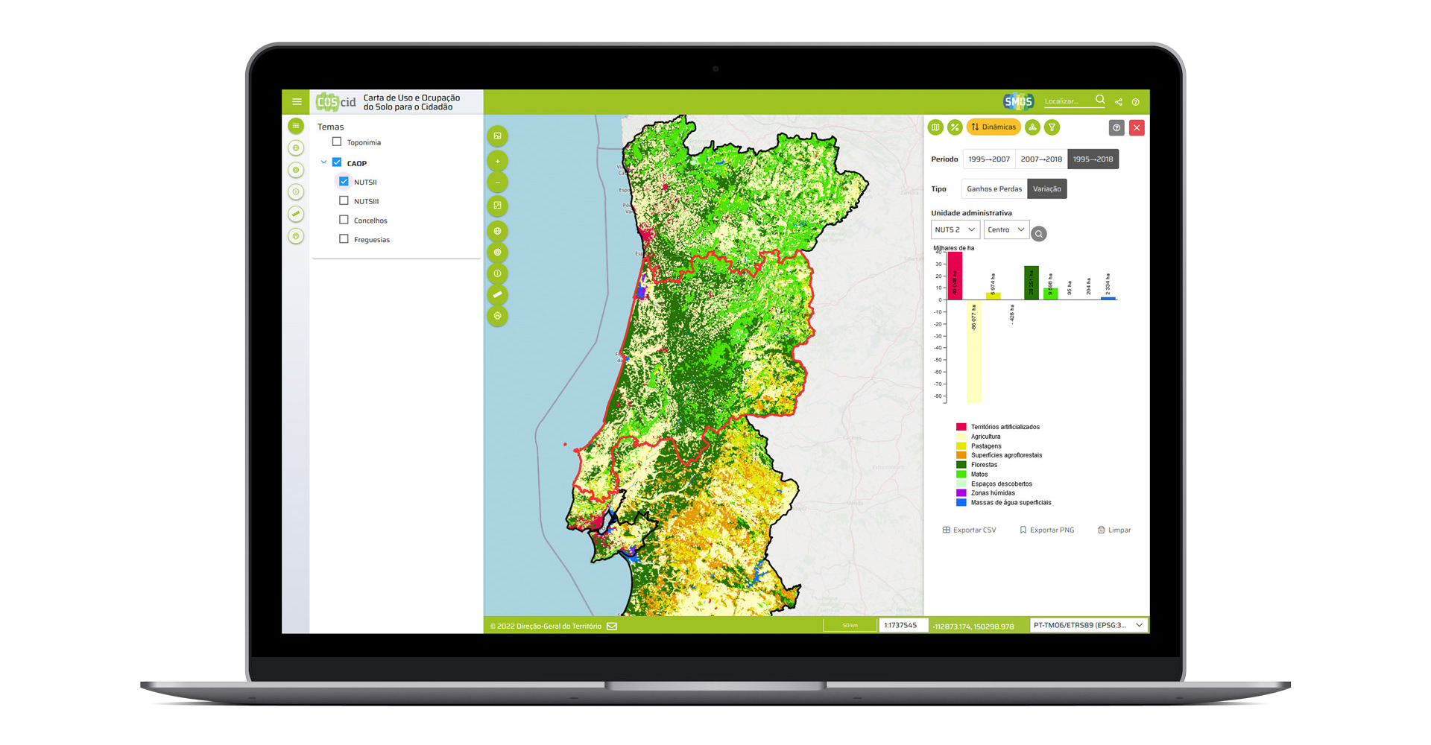
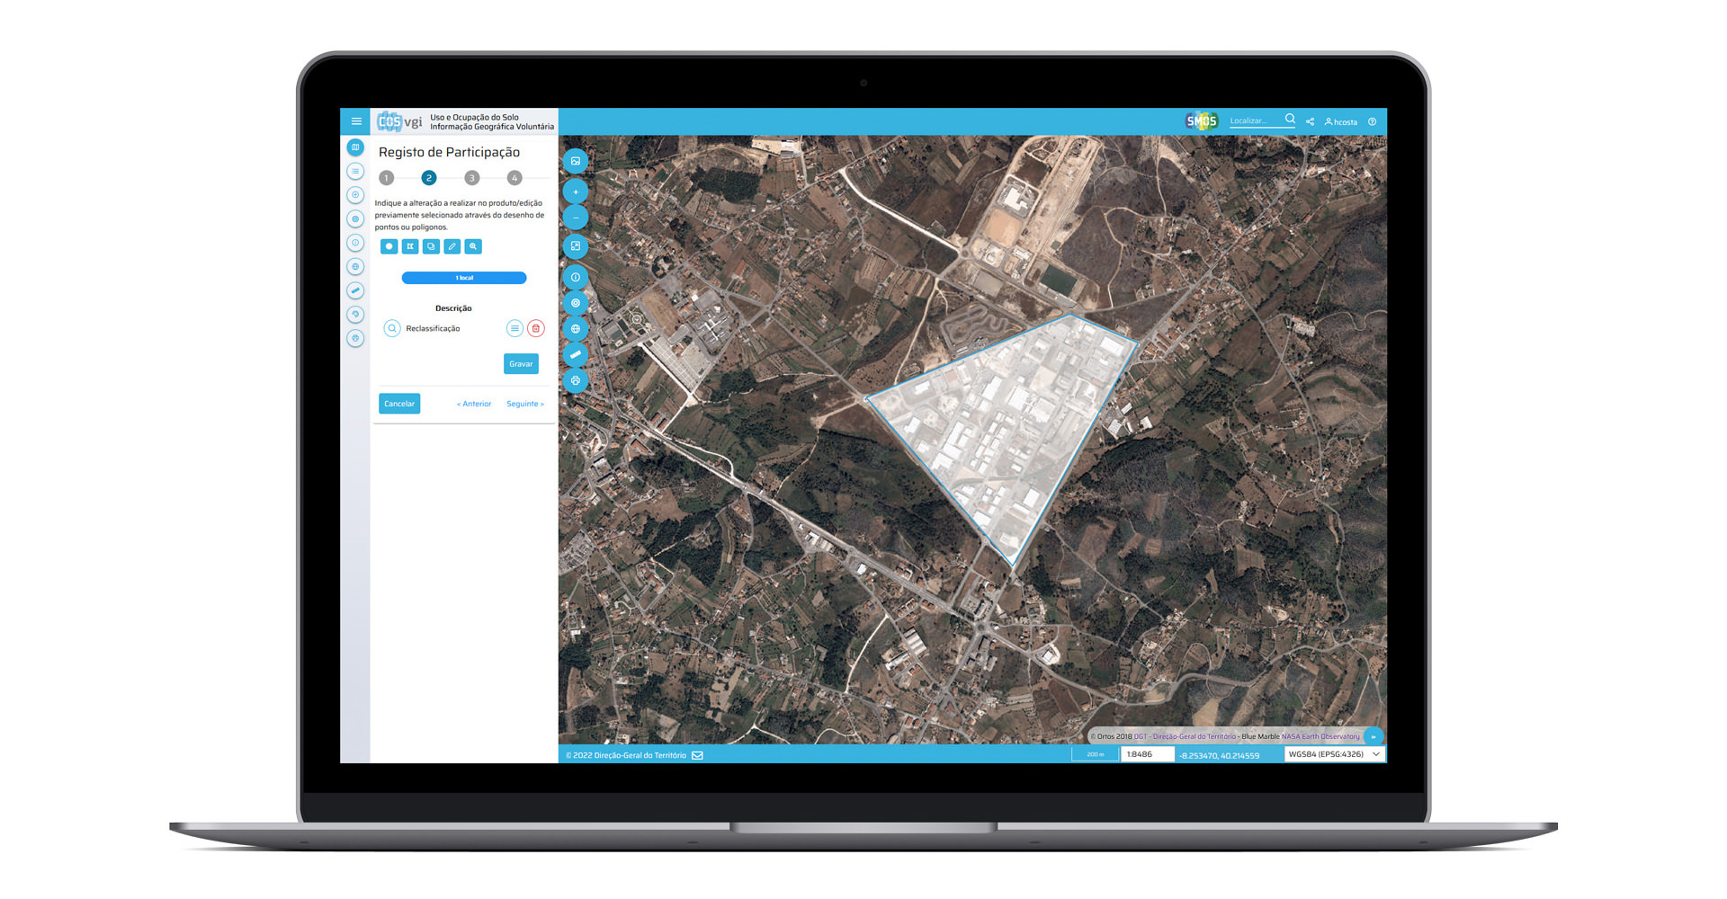



SMOS viewers
Available at smos.dgterritorio.gov.pt
viSMOS
COScid
COSvgi
Visualization and interaction with all SMOS products;
Allows users to compare products and detect LCLU changes;
Getting to know the territory better
Visualization and production of statistics, dynamics and various information on LCLU of mainland Portugal based on COS.
Volunteered geographic information;
Allows users to submit proposals for changes and improvements to COS and COSc.

Slide 17
03
Risk management

Slide 18
Risk management cycle
Analysis and evaluation
Monitoring and recovery
Mitigation and planning

Slide 19
03.1
Mitigation and planning

Slide 20
Cartography for landscape planning, decision making, and more
Current products
  LCLU cartography
  Wildland-urban interface
Future products
  LiDAR (DTM, DEM, and vegetation structure)
  Topographic cartography
  Very high spatial resolution imagery
Available for downloading for careful analysis

Slide 21
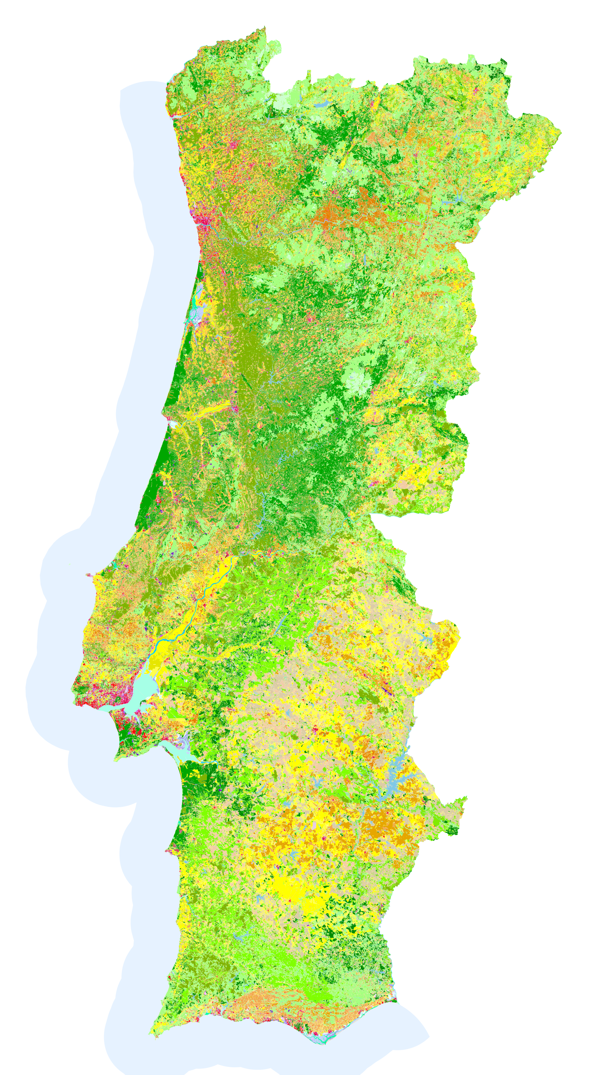
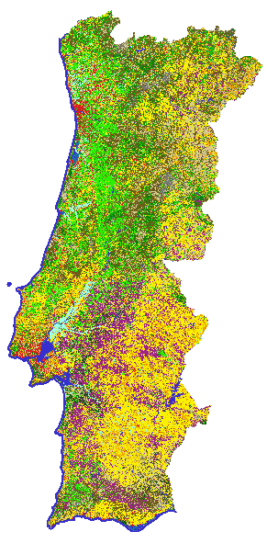
LCLU cartography
COS
COSc
Pre-fire season COSc (partially updated)
Updated classes
(vegetation loss)
83 land use classes
1 ha MMU
15 land cover classes
10 m pixel size

Slide 22
ICNF Rural Fire Danger maps
There are 3 Rural Fire Danger maps
Danger map | Updating frequency | SMOS cartography used as input
Structural (long-term planning) | Decennial (Next update: 2030-2040) | COS
Conjunctural (mid-term planning) | Annual (January) | COSc
Pre-fire season (short-term planning) | Annual (July) | Pre-fire season COSc

Slide 23
Wildland-urban interface
There are 3 Wildland-urban interface maps
Wildland-urban | Updating frequency | Vegetation fuel modelled from
Structural (long-term planning) | Depending on COS | COS
Conjunctural (mid-term planning) | Annual (January) | COSc
Pre-fire season (short-term planning) | Annual (July) | Pre-fire season COSc

Slide 24

Wildland-urban interface

Slide 25

Wildland-urban interface
2020

Slide 26

Wildland-urban interface
80 m
90 m
2021

Slide 27

LiDAR
LiDAR coverage of continental Portugal
10 points/m²
One point every 31,6 cm
2023-2024
Simultaneous acquisition of orthophotos with 0.25 m spatial resolution and 4 spectral bands (blue, green, red, near-infrared)
Fonte: researchgate.net/figure/Airborne-laser-scanning_fig5_342376734

Slide 28

LiDAR
Acquisition of LiDAR (Light Detection And Ranging) coverage for the territory of Mainland Portugal.
Start: 15 December 2023
End: Q1 2025.
New Digital Terrain Model (DTM) and Digital Surface Model (DSM) (0.5 m and 2 m spatial resolutions) and a series of derivative products with information on vegetation.
Open data policy (MDT, MDS e LiDAR cloud points).

Slide 29
LiDAR - Characteristics
Lidar points classification:
1 - Other
2 - Terrain
3 - Low vegetation (0 m – 0,5 m)
4 - Medium-high vegetation (0,5 m – 2 m)
5 - High vegetation (> 2 m)
6 - Built-up
7 - Noise
9 - Water
26 - Bridges
Positional accuracy:
Absolute vertical accuracy should be better than 10 cm

Slide 30

Very high spatial resolution imagery
Acquisition of Pleiades Neo satellite images with 30 cm GSD in the panchromatic band and 1.20 m multispectral bands.
Reference period: 2023
Two types of products
  Single-acquisition images with pansharp and standard corrections (6 spectral bands)
  Seamless mosaic of orthorectified images with 30 cm spatial resolution (4 bands – Blue, Green, Red and Infra-Red)
Acquisition of images still in progress, phased in two batches and two deliveries.

Slide 31
03.2
Analysis and evaluation

Slide 32


Cartography for analysis and evaluation
Cartography
  Sentinel-2 mosaics
  MIAEV
  COSc
Available for visualization (WMS and viewer) for easy assessment
  viSMOS

Slide 33


Cartography for analysis and evaluation
Monthly Sentinel-2 mosaics and MIAEV to identify and delimit the events, such as wildfires
Sentinel-2 mosaic
MIAEV

Slide 34


Cartography for analysis and evaluation
LCLU cartography to assess the impact and damages on land use and land cover
COS
COSc

Slide 35
03.3
Monitoring and recovery

Slide 36
Cartography for recovery assessment
Cartography
  LCLU cartography
  MIAEV
Available for downloading and visualization

Slide 37



Recovery from wildfires
Mação municipality
Sentinel 2
Sept 2017
Burnt area 2017

Slide 38
Recovery from wildfires
Sentinel-2 - September 2017

Slide 39



Recovery from wildfires
Sentinel-2 - September 2018
COSc 2018

Slide 40


Recovery from wildfires
Sentinel-2 - September 2020
COSc 2020

Slide 41


Recovery from wildfires
Sentinel-2 - September 2021
COSc 2021

Slide 42


Recovery from wildfires
Sentinel-2 - September 2022
COSc 2022

Slide 43
smos.dgterritorio.gov.pt

