Slide 1
Satellite-based Services for Disaster Risk Management Workshop
EMSA EU’s eyes on the sea
Head of Department 2
Safety, Security and Surveillance
Alfeite, Portugal / 14 May 2024

Slide 2
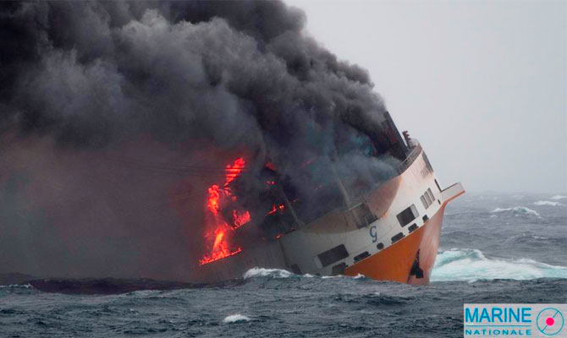
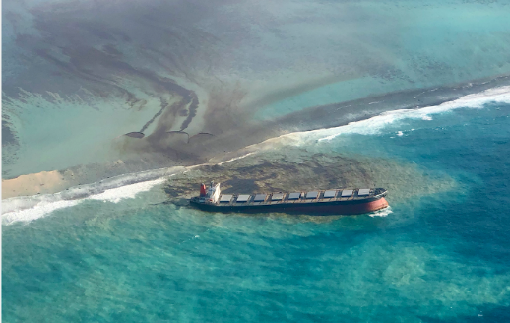





EMSA: EU’s eyes on the sea
European Maritime Safety Agency
    Regulatory Agency of the European Union, ensuring a high, uniform and effective level of:
    Maritime safety
    Security
    Prevention and response to marine pollution caused by ships, oil and gas installations
Technical and operational support to EFTA countries, EU Member States and Commission
Cooperation with Frontex and EFCA in support of authorities implementing Coast Guard functions

Slide 3
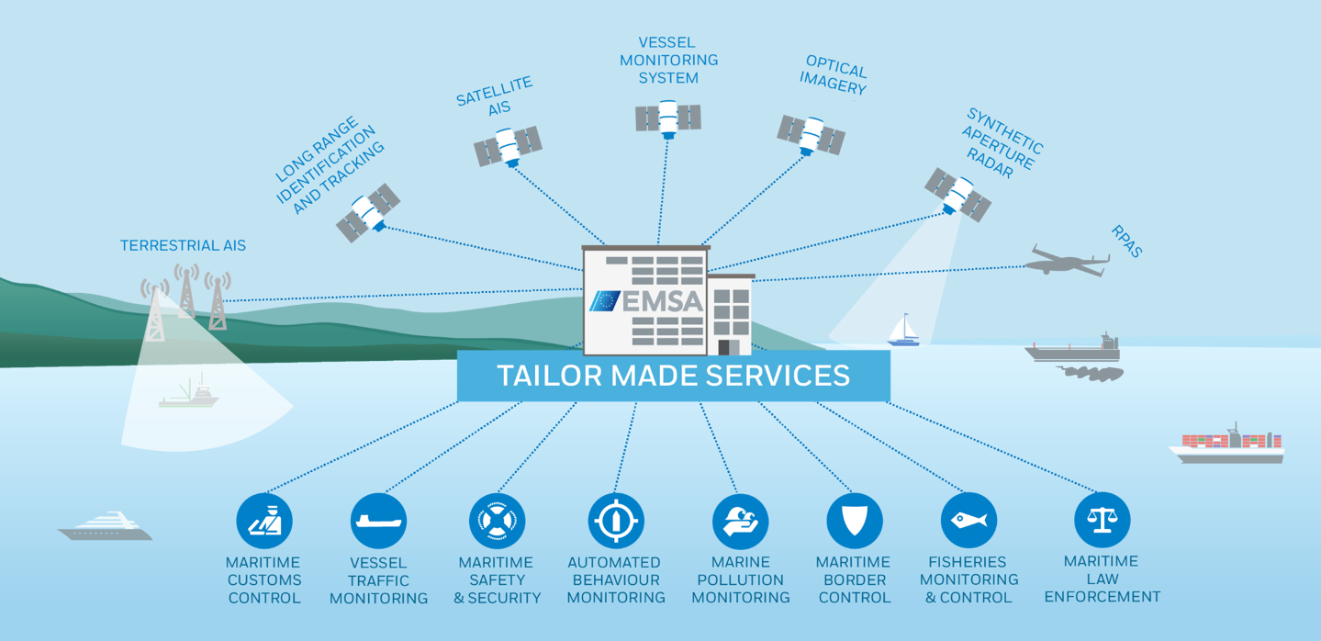
EMSA Integrated Maritime Services
EMSA: EU’s eyes on the sea
Notes:
EMSA uses latest technologies to create a comprehensive and reliable “maritime picture” by fusing data from various sensors and sources:
satellite synthetic aperture radar images,
satellite optical imagery
terrestrial and satellite vessel position data
drones - 9 RPAS deployments (biggest civilian RPAS services provider in Europe)
ship reporting and compliance systems
met-ocean data

Slide 4









EMSA: EU’s eyes on the sea
  EMSA EO services
EMSA User communities
CleanSeaNet
Maritime Surveillance
Border control
Emergencies - Coast Guard Cooperation
SATELITE MISSIONS
SERVICE PROVIDERS
EO DATA CENTRE
SAR
SENTINEL-1A
PAZ 1
TERRASAR-X TANDEM-X
RADARSAT-2
ICEYE
OPTICAL
GEOEYE-1
PLEIADES 1A and 1B
WORLDVIEW-1, 2 and 3
SPOT 6
SAR
KSAT
CLS
EGEOS
EDISOFT
OPTICAL
AIRBUS/EUSI
KSAT
EDISOFT
DELIVERY TO USERS VIA:
WEB PORTAL
MOBILE APP
SYSTEM TO SYSTEM
ALERTS AND NOTIFICATIONS
Notes:
CleanSeaNet - European satellite-based oil spill and vessel detection service, supporting Coastal States in identifying and tracing oil pollution on the sea surface, contributing to the identification of polluters.
Copernicus - service which provides satellite images and value-added products to support monitoring of human activity at sea for a wide range of user communities ( fisheries control, maritime safety and security, customs, law enforcement, marine environment pollution monitoring, and support to international organisations).
Frontex – Within the framework of the EMSA/Frontex Service Level Agreement (SLA), EMSA provides EO services, information products and tools tailored to FRONTEX needs for supporting border control activities.
Support to Emergencies – EMSA provides EO services in the scope of the Contingency. The CP applies to maritime events entailing immediate risk to health, life, property, or environment, including emergency response to oil spill accidents and assistance to search and rescue operations involving potential loss of human life at sea or risk to safety of navigation
Focus of this presentation will is on EO support to emergencies

Slide 5
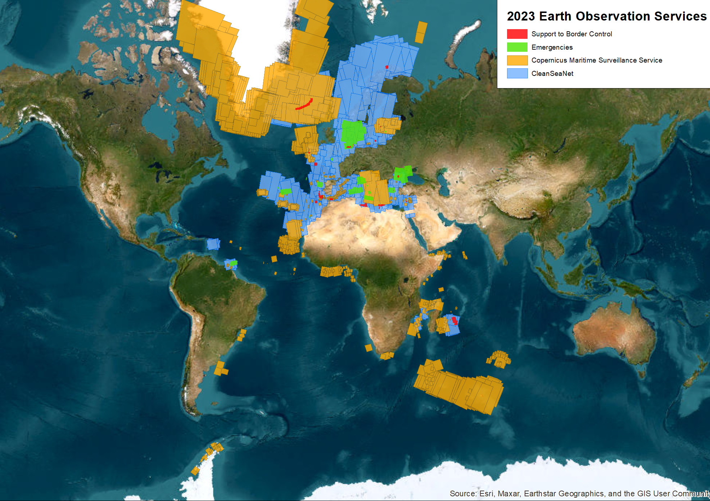
Example of density map with
global coverage of EMSAEO services delivered in 2020
EMSA: EU’s eyes on the sea
Notes:
Earth observation - 16k+ satellite images (radar and optical)

Slide 6
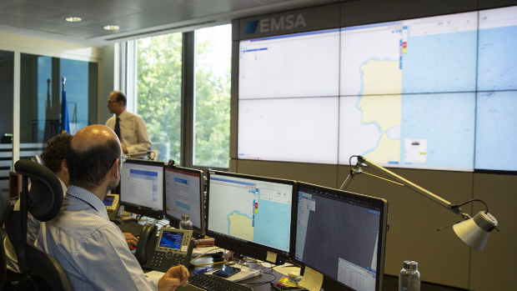
EMSA: EU’s eyes on the sea EO support to emergencies
  EMSA EO support to Emergencies
    Response to maritime incidents that may entail risk of pollution or loss of human life at sea. e.g. Response and monitoring of major oil spill, support to search and rescue operations
    EO tasking and delivery times are critical
    24/7 service with trained staff on EO planning and ordering and emergency management

Slide 7
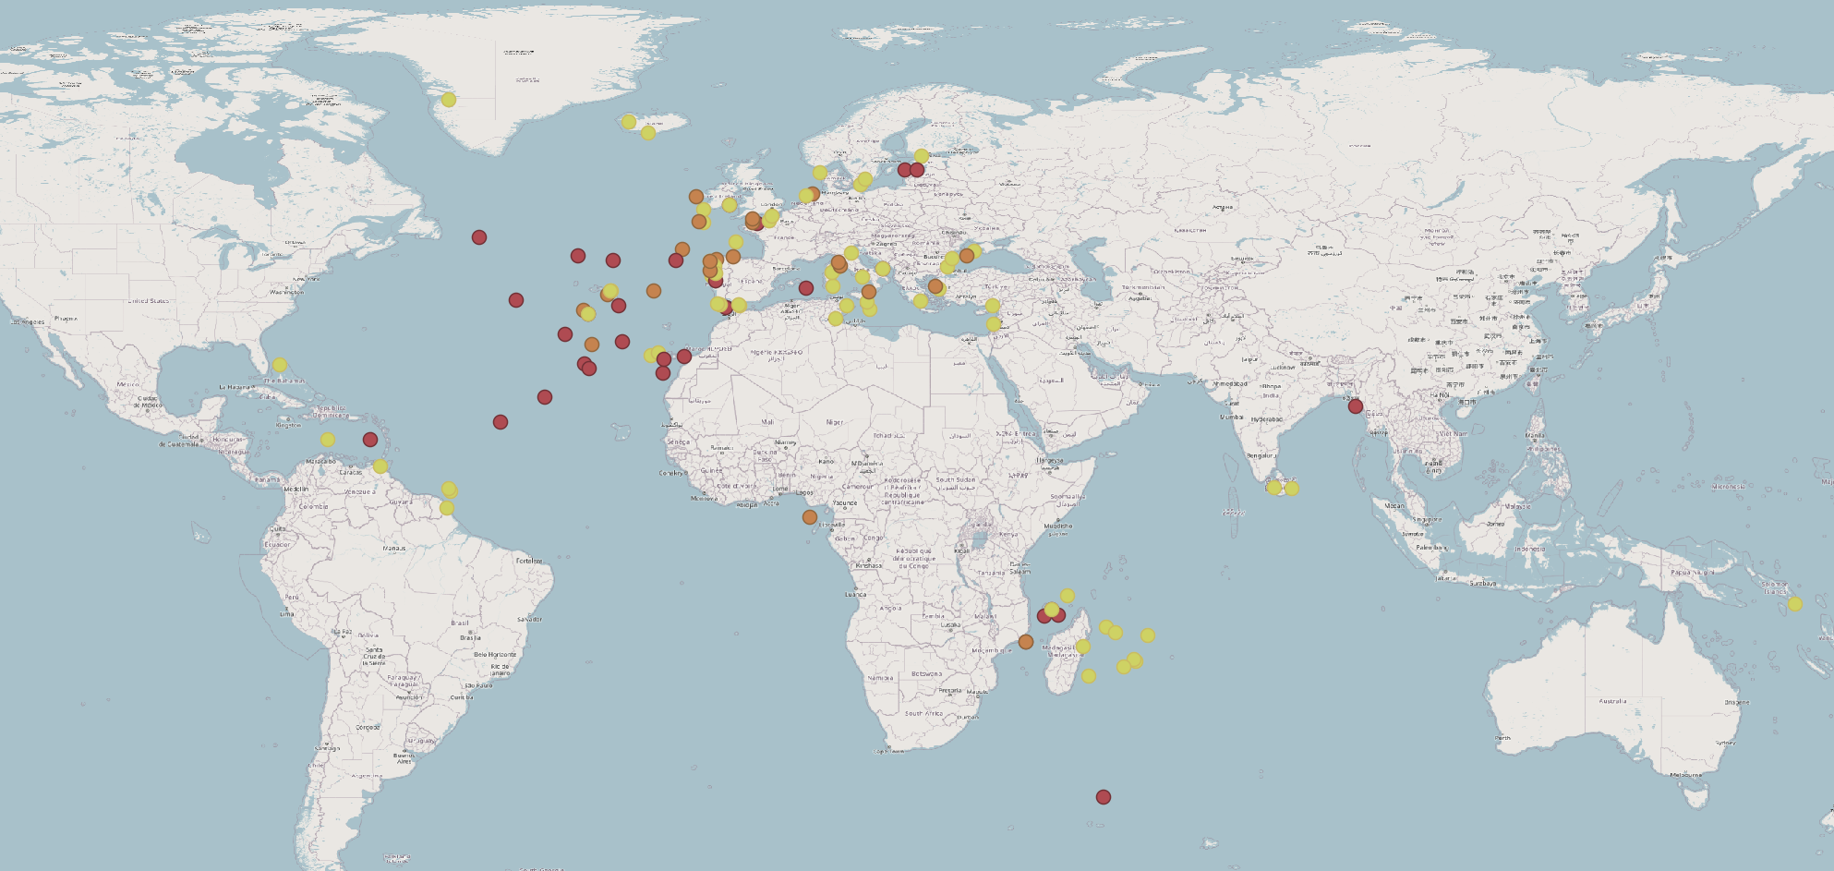
EMSA: Contingency Plan Activations
Contingency Plan activations since 2019
Search and Rescue
Pollution Response
Surveillance

Slide 8
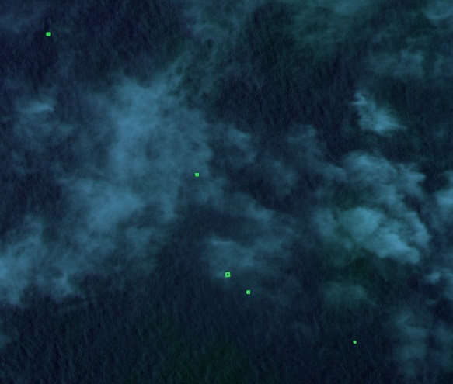
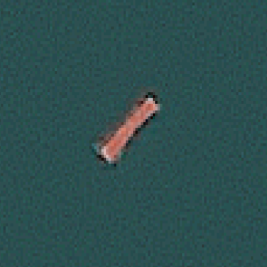
EMSA: EU’s eyes on the sea EO support to emergencies
EMSA EO support to Emergencies
    Use case: Drifting containers, Atlantic Ocean, Jan 2022
      MRCC Delgada reported 30 containers fell from a vessel near Azores. Satellite images were tasked to find them, as they pose a navigational hazard to vessels in the area
      2 potential containers were located using satellite images. Their location was used to recalculate the search area
      12 additional containers were detected after the recalculation of the area of interest
© EMSA, contains modified WV2 and WV3 data. © 2022 European Space Imaging / Maxar Technologies
Notes:
EMSA newsletter:
EMSA’s EARTH OBSERVATION SERVICES: DETECTION OF DRIFTING CONTAINERS
In a recent maritime safety operation, coordinated by the MRCC Delgada, EMSA detected drifting containers using satellite images. The MRCC Delgada reported that the M/V Madrid Bridge lost 30 containers after being caught in stormy weather 250 NM southwest off the Azores archipelago.
Following a request for assistance by the Portuguese authorities, EMSA activated the emergency phase of the contingency plan. In two of the planned satellite images, 14 potential containers were detected drifting at the sea surface, posing an immediate hazard to navigation, particularly to fishing vessels and yachts. The detection of lost containers is paramount for resetting the drift model and recalculating the search area, updating the navigational warnings, and providing life-saving information to mariners sailing in the vicinity of an incident.

Slide 9
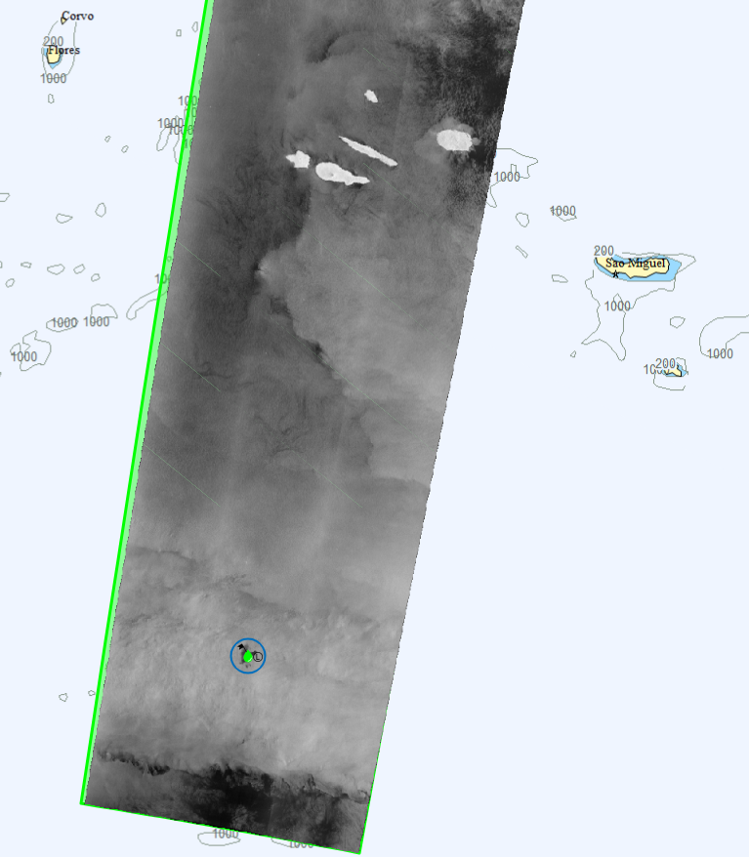
EMSA: EU’s eyes on the sea EO support to emergencies
EMSA EO support to Emergencies
    Use case: Potential oil spill, Atlantic Ocean, Feb 2022
      MRCC Delgada requested satellite imagery to monitor possible oil spills, from the Ro-Ro Felicity Ace, after the vessel was caught on fire
      A spill was detected after the sinking of the vessel
      All 22 crew members were rescued, by the M/V Resiliant Warrior, after contact by MRCC Delgada
FELICITY ACE, picture published on 02/03/2022 (sapo.pt) © Portuguese Navy, 2022
Potential spill detected over the wreck of Ro-Ro FELICITY ACE © EMSA, contains modified Copernicus Sentinel-1 data, 2022
Notes:
One potential spill detected over the vessel wreck

Slide 10
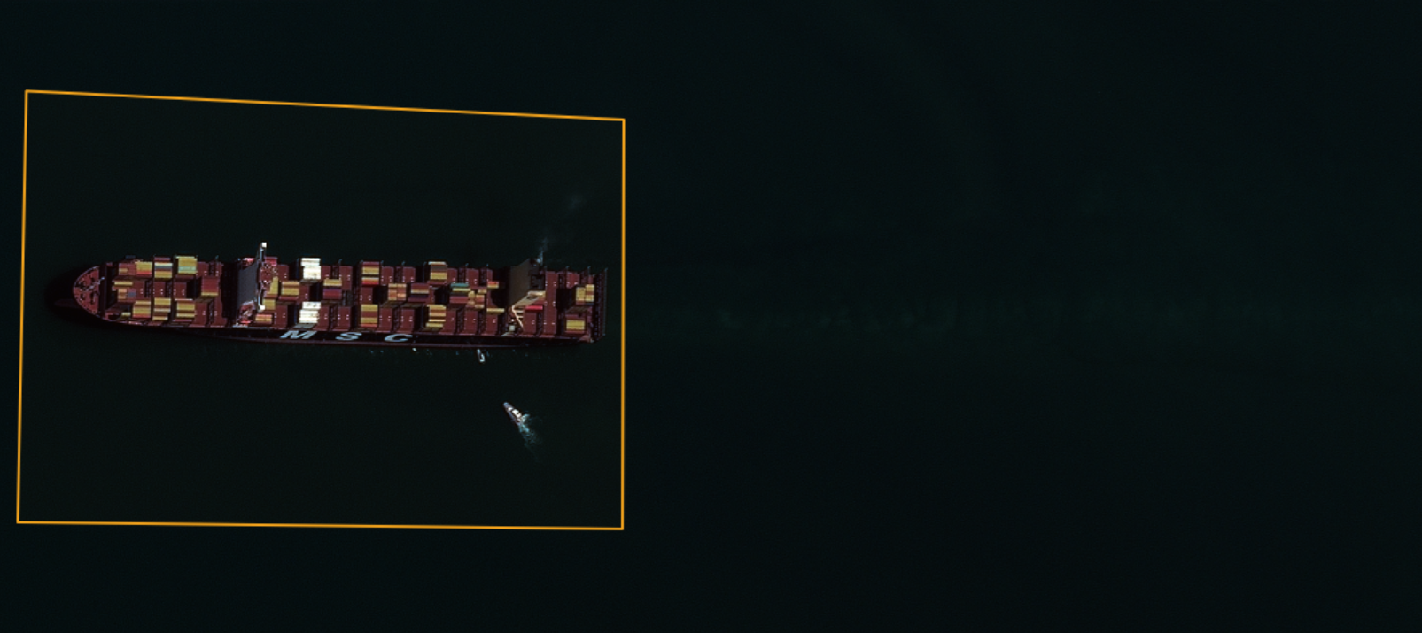
Emergency MSC ARIES - April 2024 (sl. 1)
On 13 April 2024, the Portuguese Maritime Administration was informed that the container vessel MSC Aries, flying under Portuguese flag, was deviated by Iran’s Revolutionary Guard after her passage of Strait of Hormuz. The vessel was seized 50nm northeast of Fujairah, with 25 crewmembers on board. All the communications were turned off and reported positions as well. After the deviation, the vessel was found heading in a Northern direction close to the Iranian side, probably heading for the port of Bandar Abbas. EMSA support was requested in order to provide information regarding the actual position of the vessel (e.g. LRIT) and satellite images. EO SAR images were requested for the AOI from the last known position to the port of Bandar Abbas. Optical imagery was also delivered, based on later reported position of the vessel of interest.
Notes:
Service ID 2404160052
© European Maritime Safety Agency, contains modified WorldView 2 data, (2024). © (2024) European Space Imaging / Maxar Technologies

Slide 11
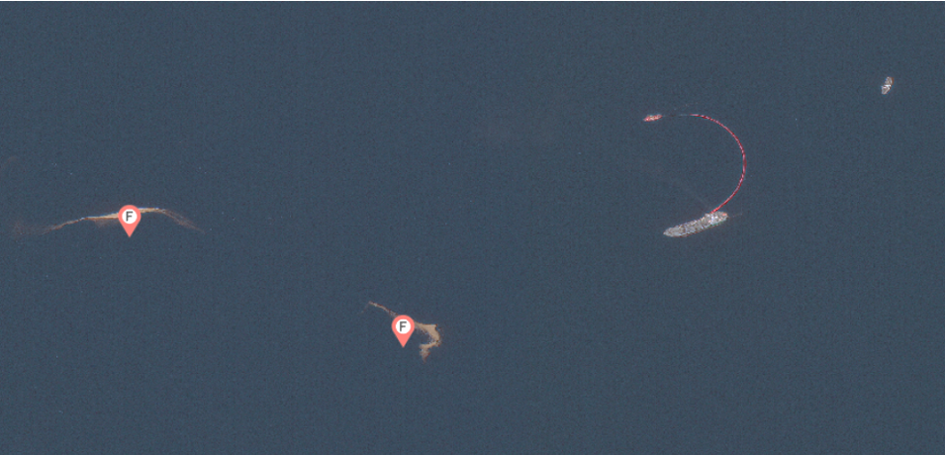
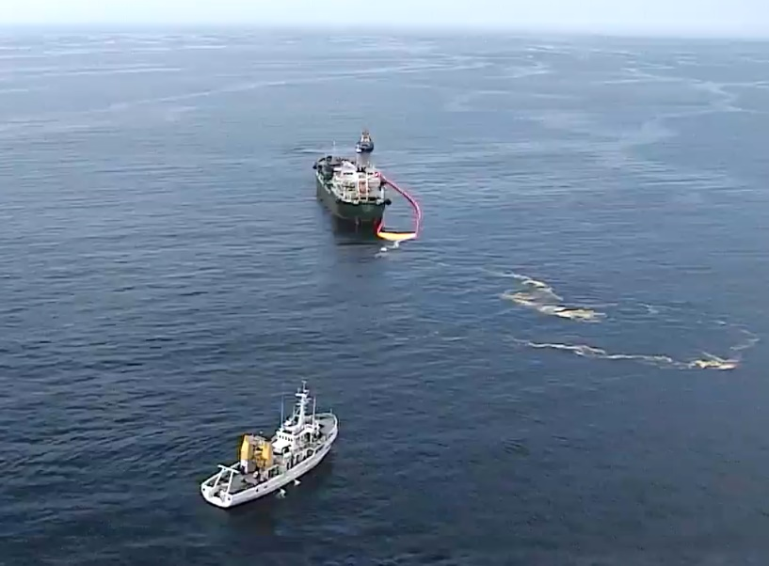
EMSA: EU’s eyes on the sea
EMSA EO support to exercises in Portugal
      Atlantic POLEX exercise Apr 2024
      Portuguese National Maritime Authority / EMSA
      Oil spill simulated with popcorn release
      The F red flags in the optical image mark the detection of oil spill simulated material
boom
simulated spills
Optical image
RPAS image
© EMSA, contains modified GE-1 data, 2024. © 2024 European Space Imaging / Maxar Technologies
© EMSA, 2024
Notes:
EMSA support to exercises in Portugal
Social Media:
We supported... - European Maritime Safety Agency (EMSA) | Facebook
We supported Portuguese authorities in this year’s ATLANTIC POLEX exercise which took place in Portimão this week.
The scenario centred around a simulated oil spill, with popcorn poured on the water to stand in for oil!
Our satellite picture shows how clearly the exercise – and the popcorn – can be seen from space on the surface of the water.
Our chartered oil spill response vessel, the Bahia Tres, with its on-board RPAS, was on site to assist Portuguese authorities in the exercise, and as the photos show, recovering the spilled popcorn.

Slide 12
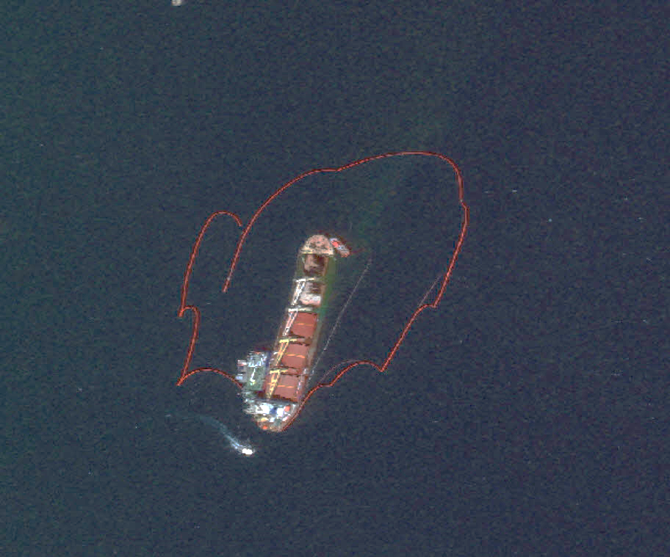
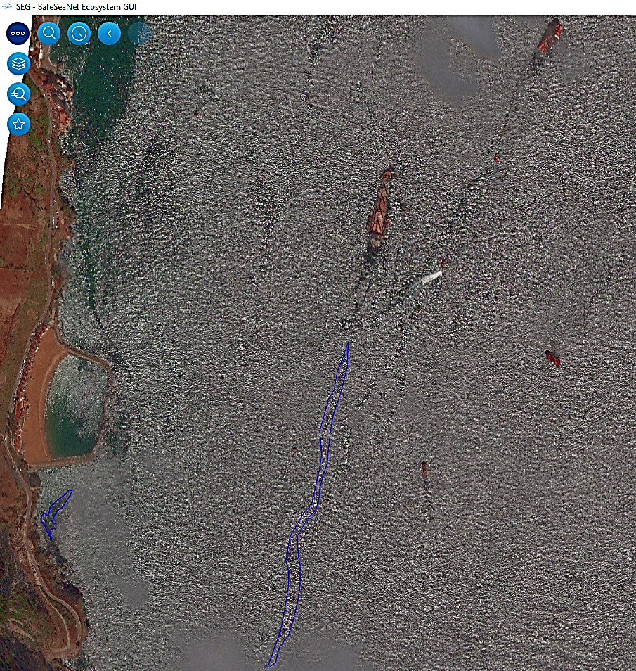
EMSA: EU’s eyes on the sea EO support to emergencies
EMSA EO support to Emergencies
    Use case: Oil spill, Gibraltar, Sep 2022
      SASEMAR requested satellite images for oil spill monitoring in Gibraltar
      After the collision between the Bulk Carrier OS 35 and the LNG tanker ADAM LNG and the subsequent grounding of the OS 35
Vessel OS 35 grounded after collision (Source: HM Government of Gibraltar 02/09/2022)
© EMSA, contains modified GE1 (bottom) and WV3 (top) data, 2022 © 2022 European Space Imaging / Maxar Technologies

Slide 13
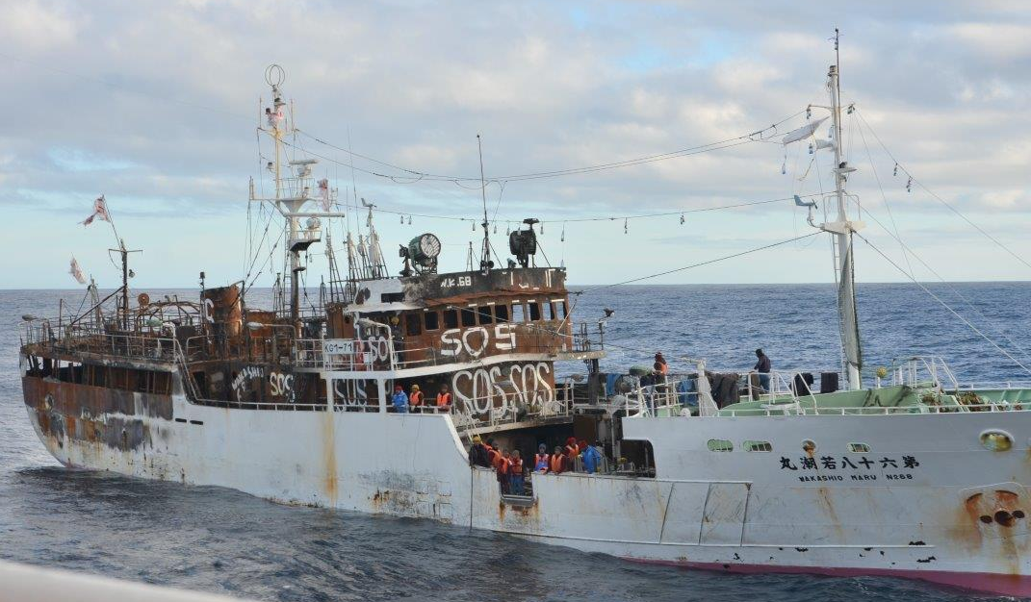
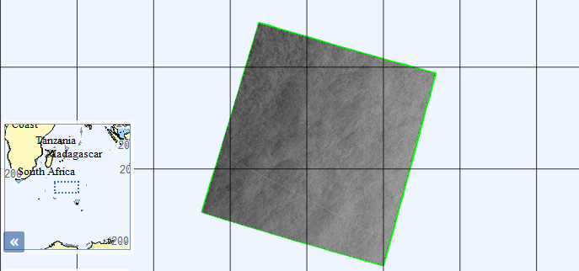
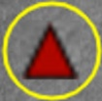
EMSA: EU’s eyes on the sea
EO support to emergencies
EMSA EO support to Emergencies
    Use case: SAR operation, Indian Ocean, May 2021
    Fishing vessel Wakashio Maru 68 lost communications after an explosion on board
    A satellite image, complemented by MRCC Reunion drift model results, was paramount in finding the stricken vessel and rescuing 24 crew members
    In the satellite image, a non-reporting vessel, corresponding to Wakashio Maru 68 was detected 300 NM from its last known position, after 7 days adrift
Missing vessel Wakashio Maru 68 © MRCC Reunion, 2021
Missing vessel Wakashio Maru 68
© EMSA 2021. All rights reserved. Certain parts are licensed under conditions to EMSA

Slide 14
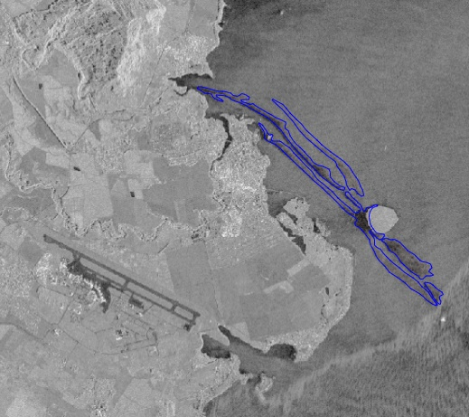
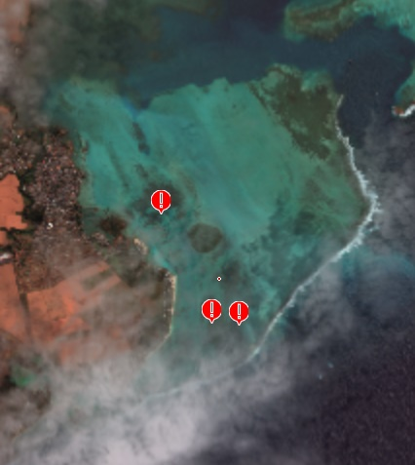
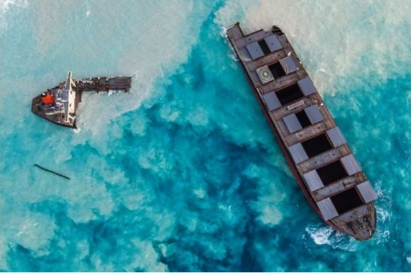
EMSA: EU’s eyes on the sea
EO support to emergencies
EMSA EO support to Emergencies
    Use case: Oil Spill, Indian Ocean, Jul 2020
    Bulk carrier M/V Wakashio grounded at the coast of Mauritius
    Oil spill caused by the incident reached nearby reefs and shore
    Optical and SAR images were requested and delivered assisting in following up the spill progress
Wakashio incident support in Mauritius © EMSA, 2020. All rights reserved. Certain parts are licenced under conditions to EMSA. © 2020 European Space Imaging/DigitalGlobe data, a MAXAR company © EMSA, 2022, contains modified "RADARSAT-2 Data and products. MacDONALD, DETTWILER AND ASSOCIATES LTD, 2020 All Rights Reserved. RADARSAT is an official mark of the Canadian Space Agency" data.
Notes:
Support requested by ERCC:
M/V Wakashio grounded close to Pointe D’Esny, SE of the island of Mauritius. The ship was carrying at that moment 3984 metric tons of Low sulphur fuel oil, 207 metric tons of diesel oil and 90 M/T of lubricants. A request for assistance was received from the Republic of Mauritius via ERCC and the EU Delegation following the detection of an oil spill from the bulk Carrier.
Further support requested by MRCC Reunion:
Further to the support provided in the scope of the Wakashio emergency, MRCC la Reunion requested imagery to anticipate potential adverse consequences of the sinking of the wreck offshore Mauritius.

