Slide 1
User Needs Assessment for Enhanced Disaster Risk Reduction
Annalisa Donati
Secretary General
Satellite-based applications for Disaster Risk Management Portugal national workshop
14/05/2024

Slide 3
Mission
Eurisy has been mandated by its Members to create networks to bridge space and society.

Slide 4
Agenda

Slide 5
Human cost of disasters: an overview of the last 20 years – UNDRR Report
Climate challenges
145
1389
44
263
1980
1999
1.63
trillion
163
2043
3254
552
338
238
2000
2019
2.97
trillion
47%
$1.39 trillion
22%
$651 billion
21%
$636 billion
4%
3%
$636 billion
$93 billion

Slide 6
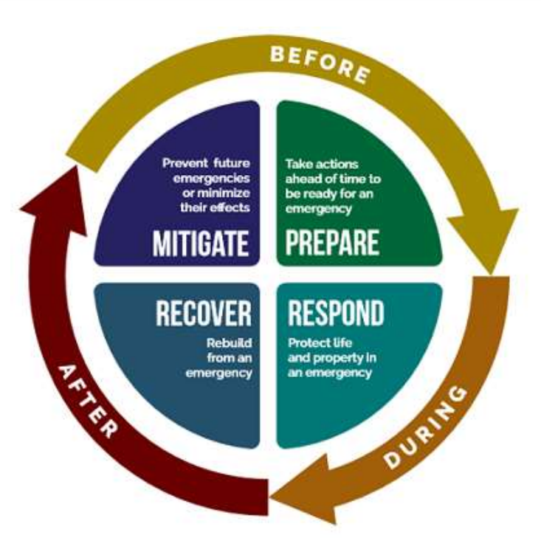
Disaster risk management
Key information & observation needs:
Hazards: Past events; adverse phenomena; geographic settings
Vulnerability: physical and socio-economic vulnerability assessment
Exposure: inventory of assets
Key information & observation needs:
Forecasts & early warnings: pre-disaster information
Need for assistance: post-disaster maps; human displacement
Prevent future emergencies or minimising the effects
PREVENTION
Take action ahead
of time to effectively manage a crisis
PREPARADNESS
RECOVERY
Restoring human activities and services
RESPONSE
Saving lives and minimizing losses
Key information & observation needs:
Losses and damages: post-disaster maps
Recovery and risk: changes of risks and hazards
Key information & observation needs:
→ Disaster scenarios: pre-disaster information

Slide 7
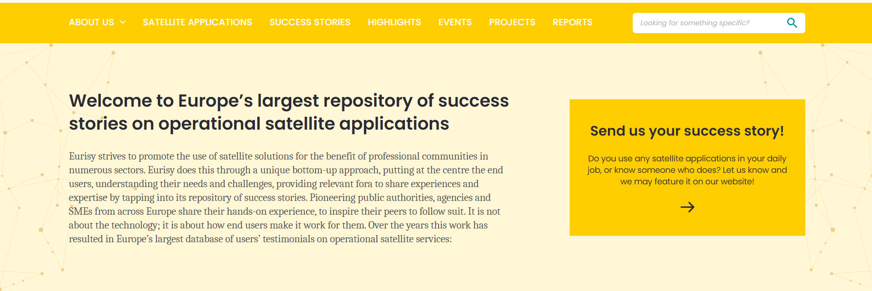
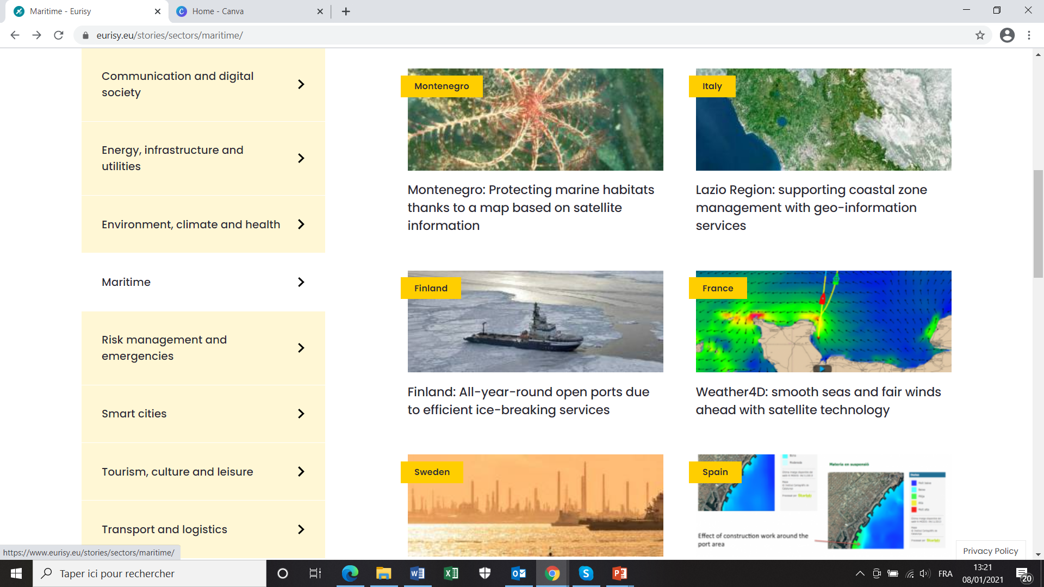
Success stories database
Success stories will favour the dissemination of case studies and help connecting service providers and end users.
The Success Stories aim at addressing communities outside the space sector to express their needs and to present their challenges.
Objective is to favour the integration of satellite-based solutions in their workflow.

Slide 8
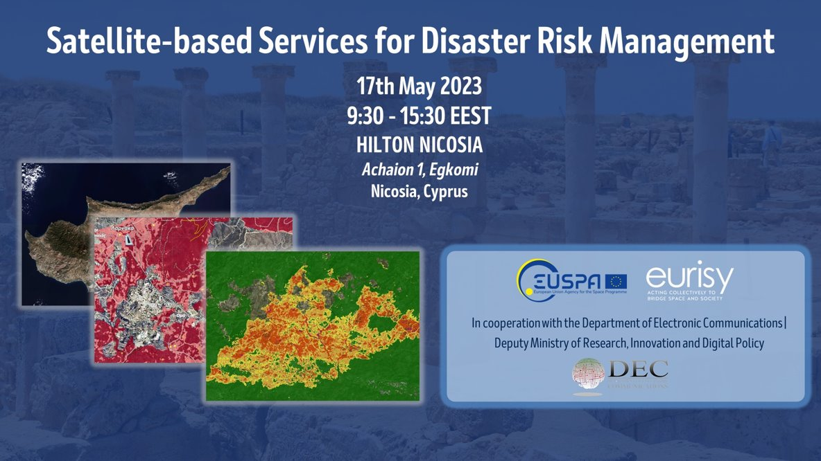
Satellite based services for DRM

Slide 9
Methodology
Questionnaire
Objectives
To get quantitative and comparable data
Allow for an easy sampling
In-depth interviews
Objectives
To get qualitative data from individual stakeholders/users
To specify the sampled categories
Tight cooperation with national authorities
Identification of current/interested/potential stakeholders

Slide 10
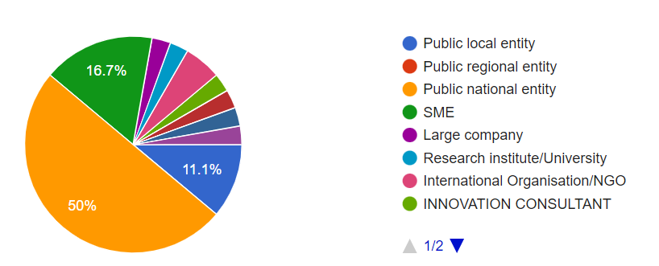
Local Users perspectives: sample
In what type of organisation do you work?
In which field do you work:
44.4% environmental protection
19.4% Buildings/Infrastructure
19.4% Climate energy
In which kind of data would you need to improve your daily work?
High resolution images
Near to real time
Environmental data/statistics

Slide 11
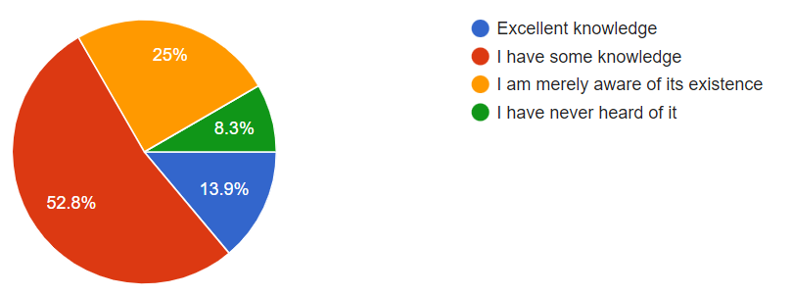
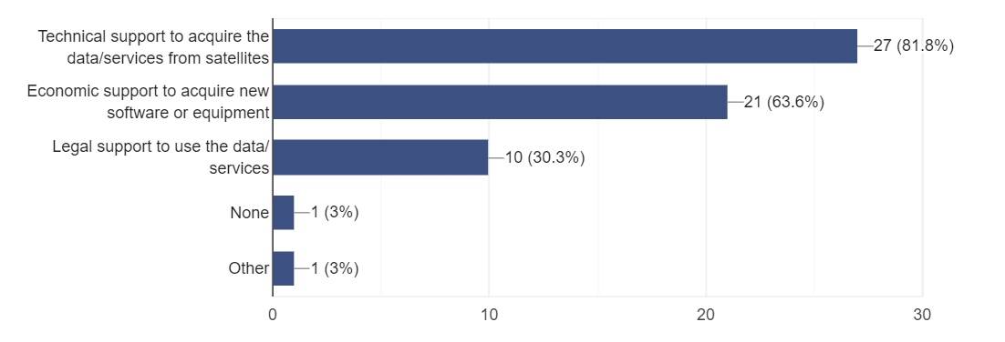
Local Users perspectives: sample
How familiar are you with Copernicus Emergency Management Service CEMS?
Which kind of support would you need to integrate satellite-based solutions?

Slide 12
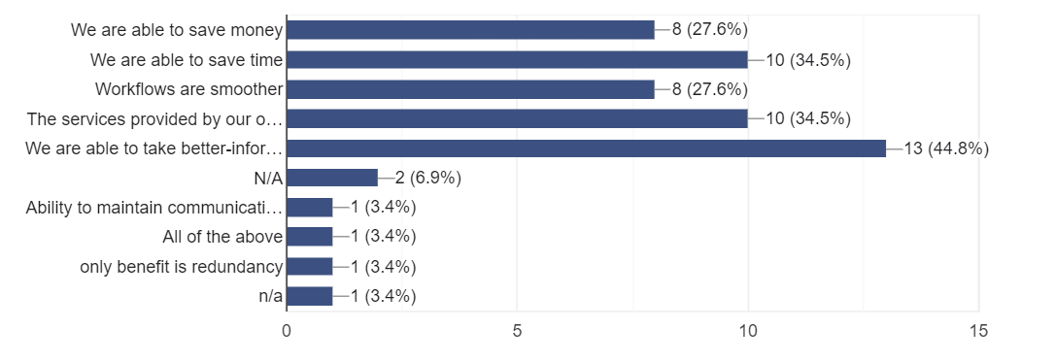
Local Users perspectives: sample
BENEFITS
CHALLENGES

Slide 13
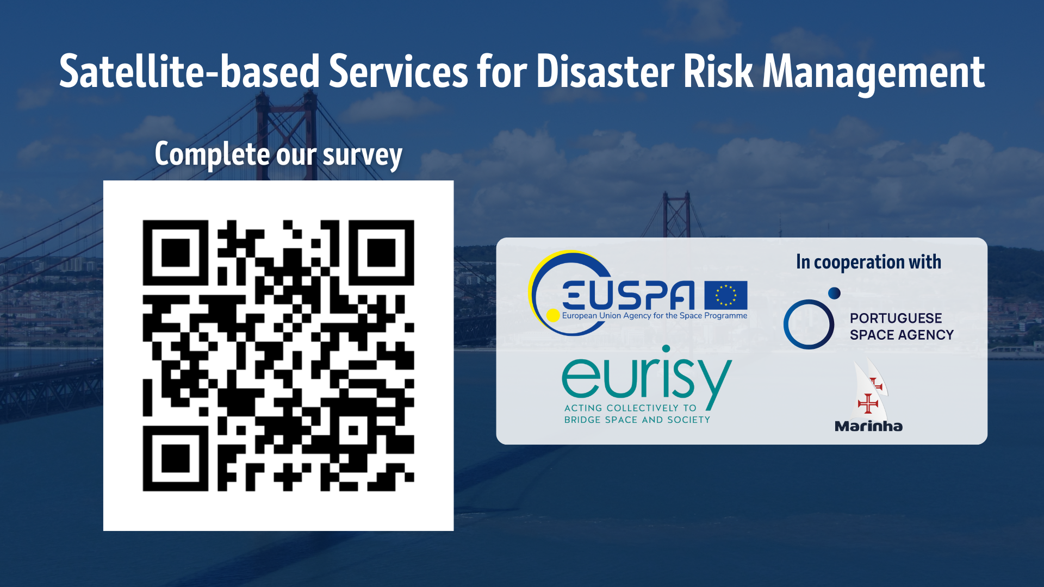

Slide 14
For more visit our website
Follow us:
Thank you!
QUESTIONS?
eurisy1
@Eurisy1
Eurisy

