Slide 1
From Data to Safety:
Mapping Landslide Risks with
Miguel Correia

Slide 3
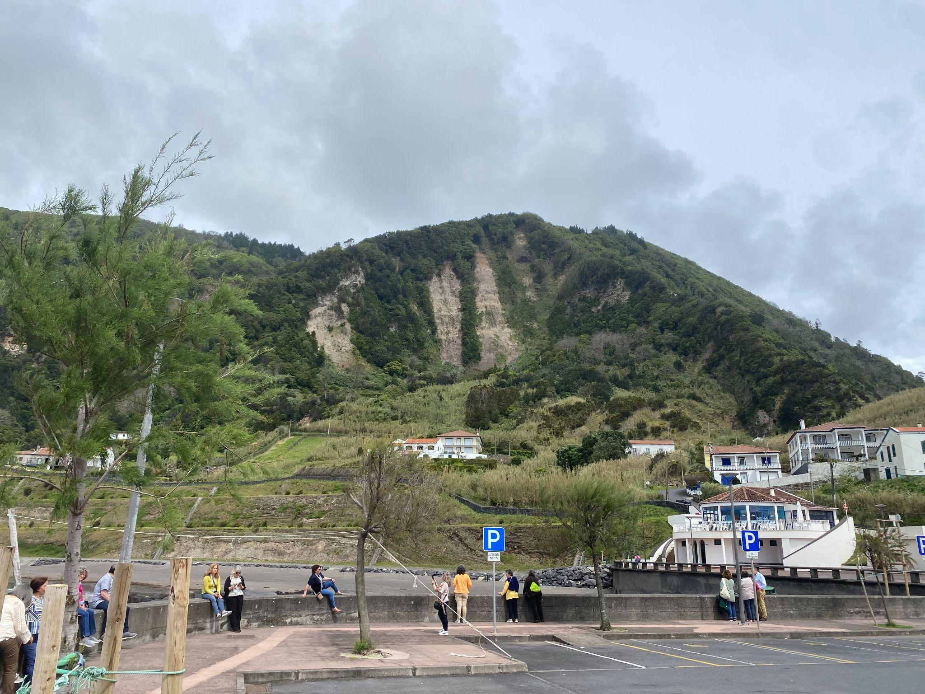

Slide 5
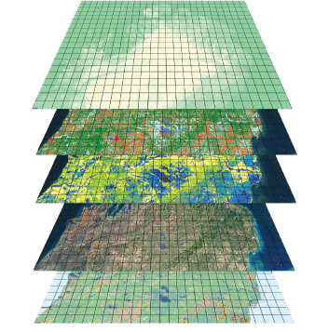
Landslide Susceptibility Map (LSM)
Algorithm Used
Random Forest
Accuracy Assessment
LSM

Slide 6
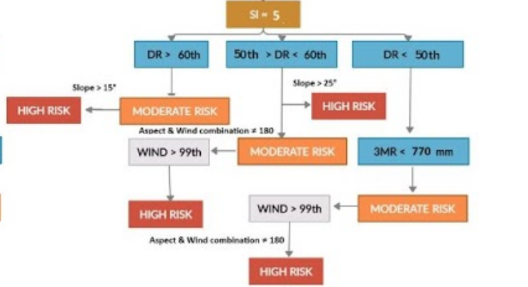
Early Warning System
Complex Decision Tree Based on a 3 Day Weather Forecast
Parameters:
Decision Tree (example for SI = 5) :
LSM Index (SI)
Daily Rain (DR)
Slope
3 Month Rain Accumulation
(3MR)
Wind Speed
Wind Alignment

Slide 7
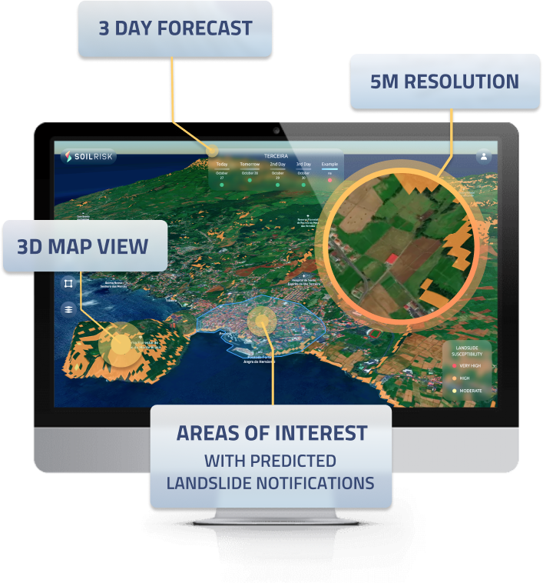
Web Application
Development of a Fully Automated Early Warning Application for Landslides
www.soilrisk.com

Slide 8
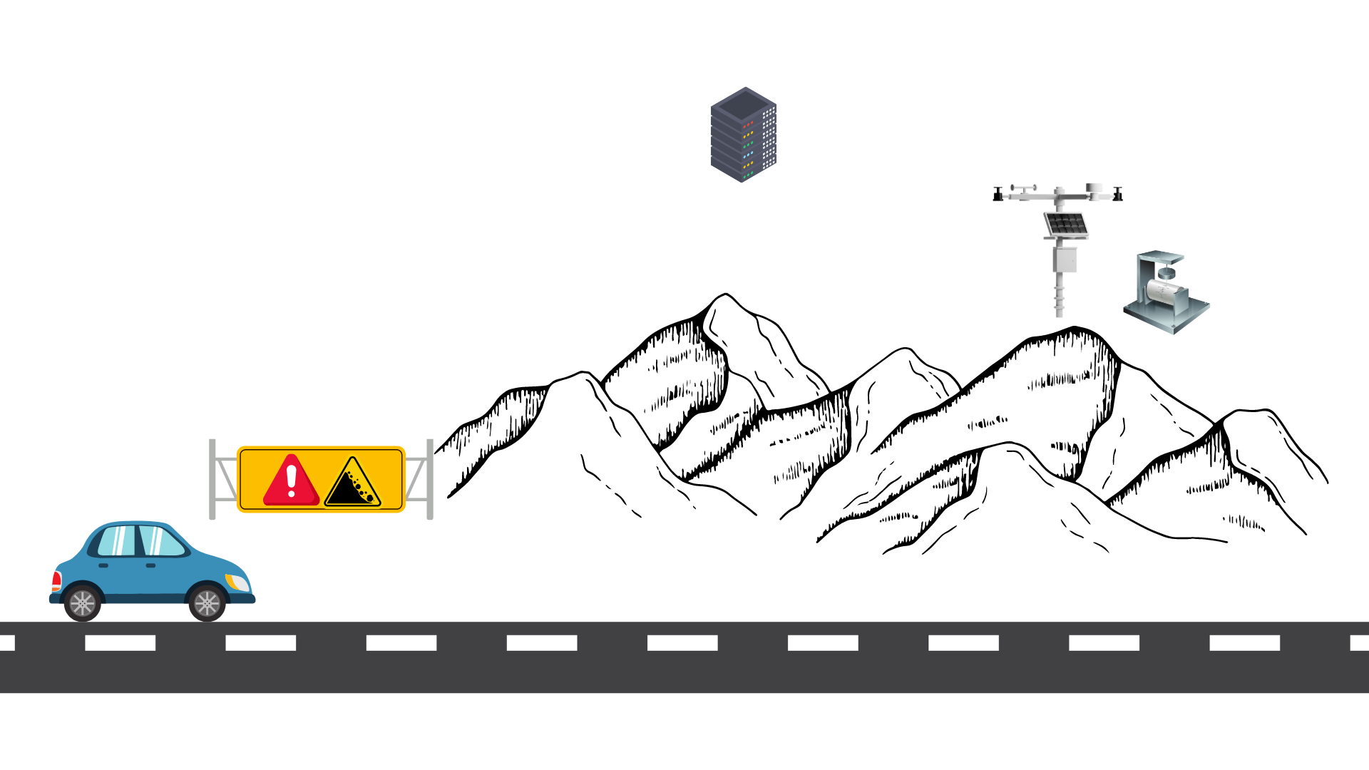

Slide 9
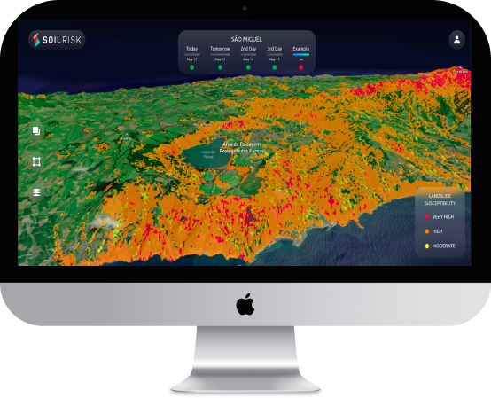

Slide 10
www.soilrisk.com
Eyecon Website
www.eyecon-group.com
Email
info@eyecon-group.com

