Slide 1
2023
Assessing Ground Surface Deformation Risk with SAR interferometry
Dr. Romy Schlögel, Earth Observation Deputy Manager

Slide 2
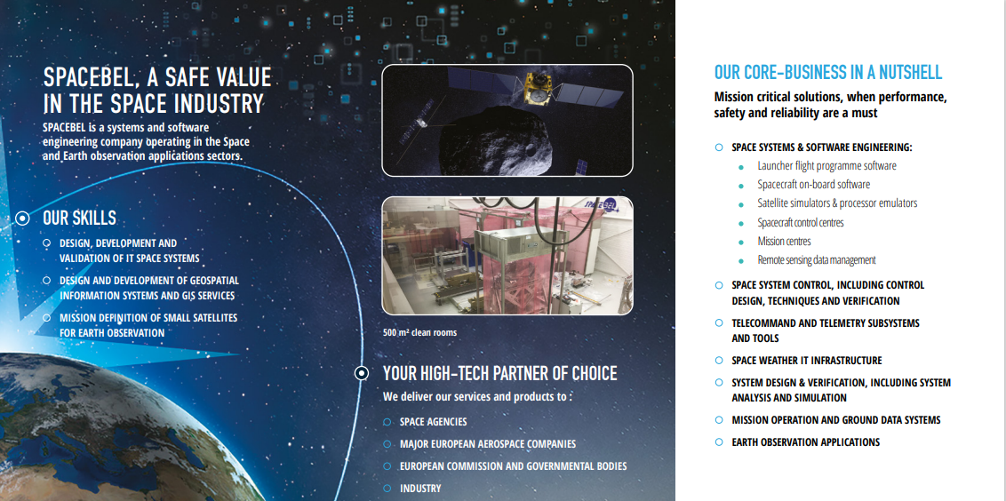
Notes:
Over the years, we have been able to develop Earth monitoring services tailored to users' needs, combining remote sensing data and field expertise through our many partnerships with universities, research centers, as well as stakeholders and end-users.

Slide 3
Services for disaster risks management
Air & soil pollution
(geomobile application, geolocation of odors, citizen science…)
Mine Life Cycle
(environmental footprints, tailing monitoring, ground stability…)
Coastal areas & flooding (regional model, local assessment, exposure, risk assessment, …)
Ground displacement
(detection, monitoring, time series analysis, triggering factors…)
Notes:
On top of services developed for natural resources management (such as protected areas, canopy mapping or forest characterization), natural and man-made disaster management services have also been set up to measure the impact of flooding, monitor air pollution, and detect ground movement analysis, among others.

Slide 4
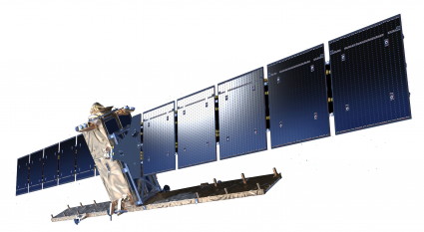
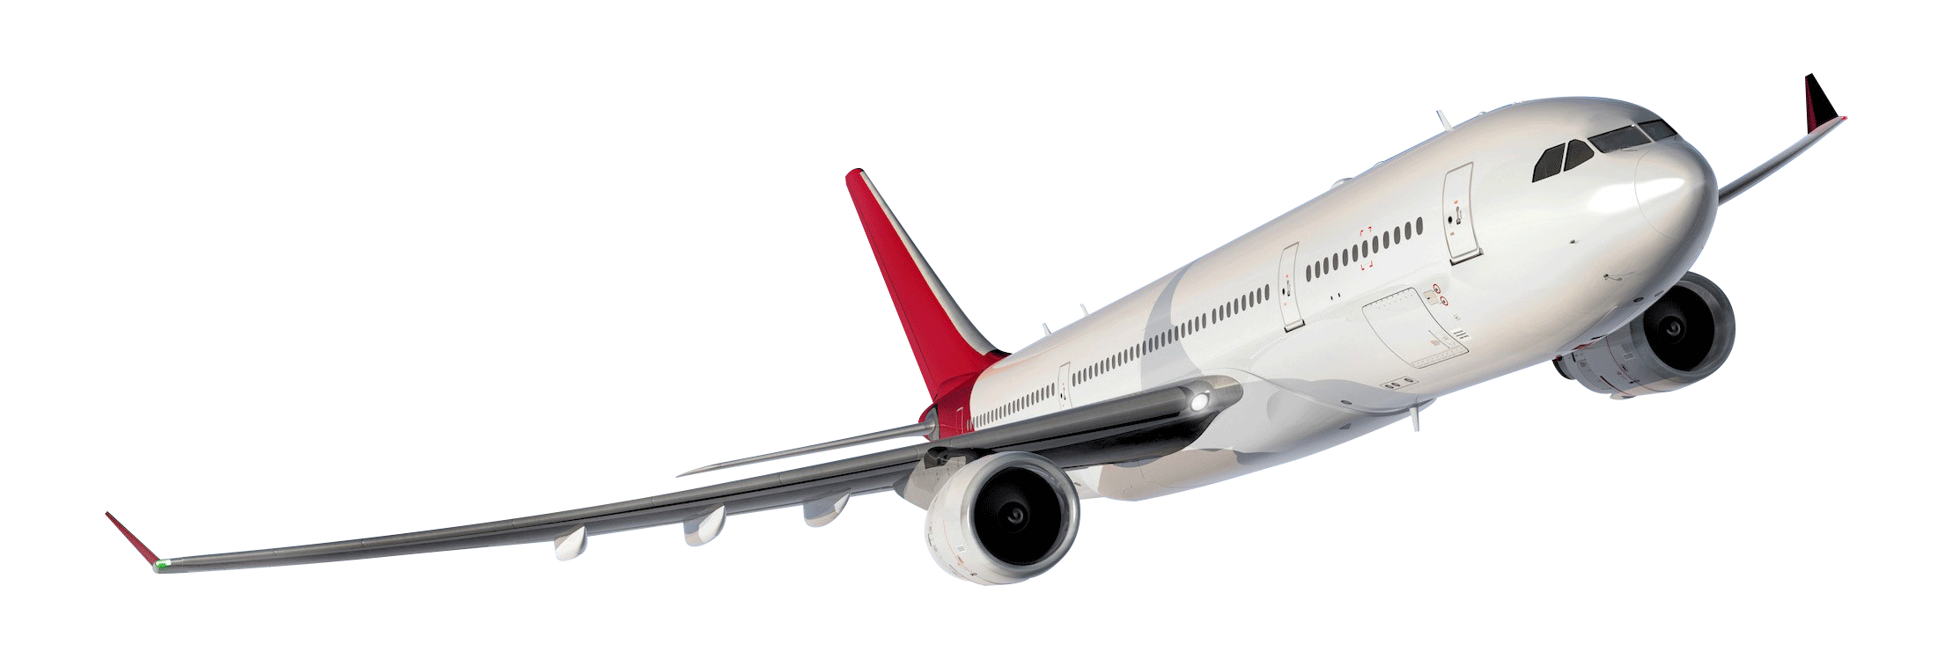
Earth Observation in the Humanitarian Programme Cycle

Slide 5
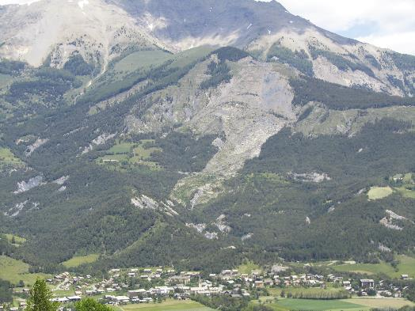
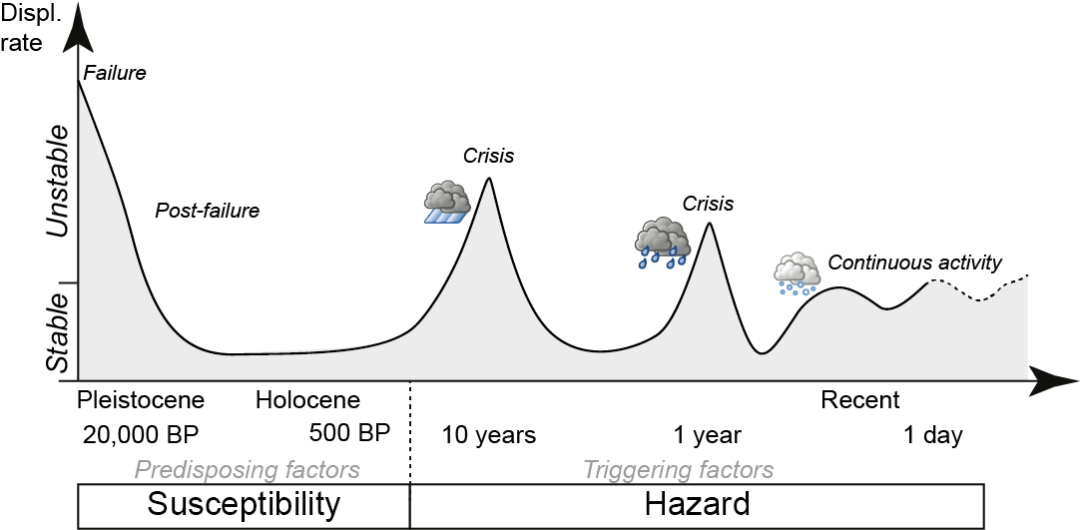
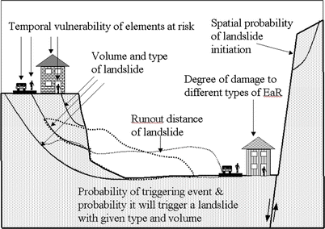
Risk assessment preparedness
WHERE ?
Disaster Risk
Hazard
Vulnerability
Exposure
with
H = Hazard = Spatial + temporal probability
• Basis of hazard and risk studies
• Basis for risk avoiding strategies
WHEN?
(van Westen et al., 2006)

Slide 6
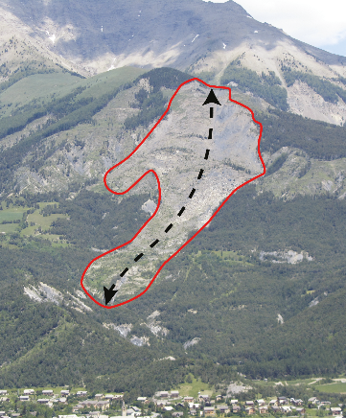
Why Landslide Mapping and Kinematic Evaluation are so important ?
• Methods for Disaster Risk prevention and reduction
Knowledge of ground deformation / landslide processes
Type
Magnitude
Evolution in time
Hazard assessment
HOW LARGE ?

Slide 7
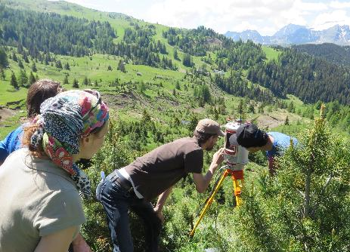
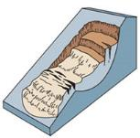
Methods for displacement measurements
• Point-based information: dGPS/GNSS, tacheometry…
Distributed information: remote sensing
- Terrestrial or proximal sensors; e.g. laser scanner, UAV
- Satellite sensors
→ Optical images correlation: not at regional scale, not adapted for slow motion
➔ Radar images ➔ Interferometry (InSAR):
powerful tool with large covered area, interesting for vertical displacements, centimetric precision and decametric resolution
Time
Money
Scale

Slide 8
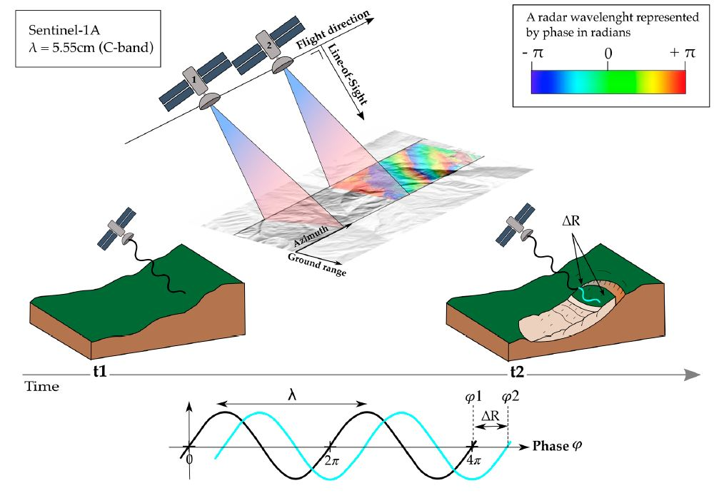
How does InSAR work?
ΔΦ*(λ/4Π) ≈ ΔR
λ: radar wavelength
ΔR: difference of satellite-ground distance between 2 images
Notes:
Phase difference due to the deformation
Estimate of the ground displacement [mm to cm]
along the Line of Sight (LOS) of the satellite

Slide 9
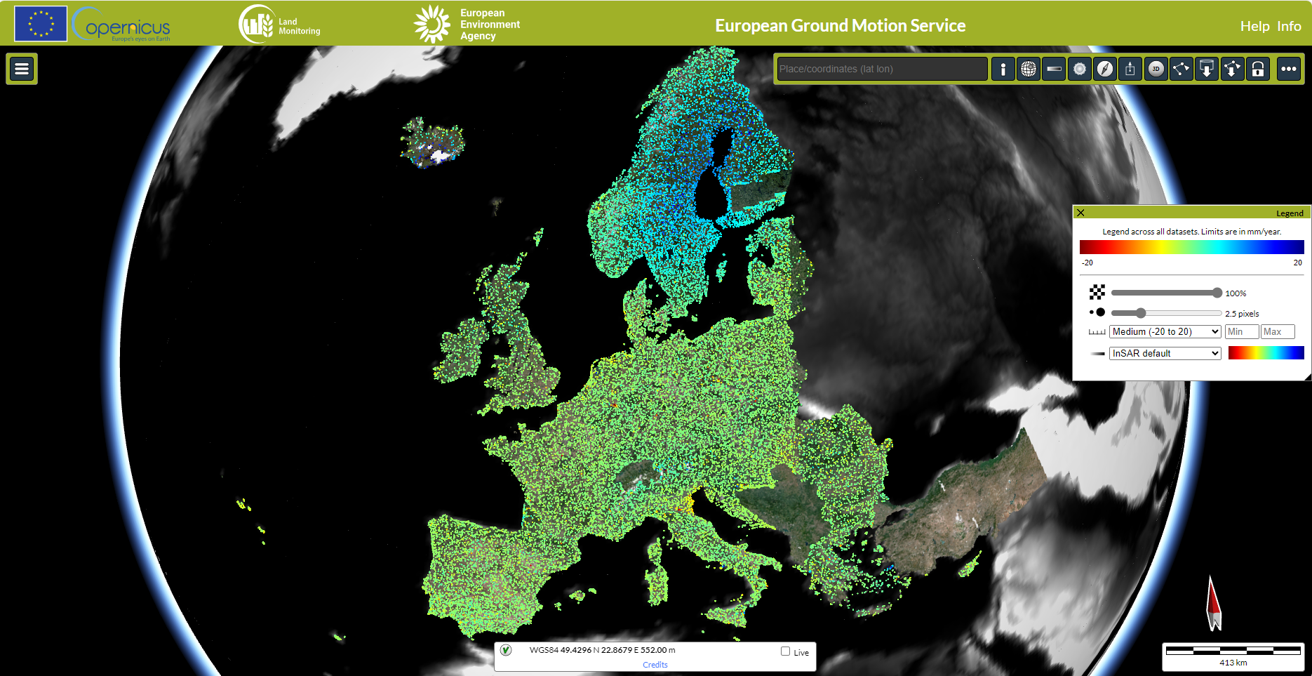
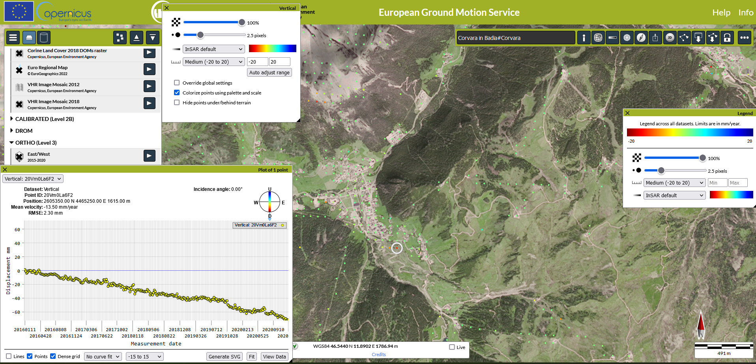

Slide 10
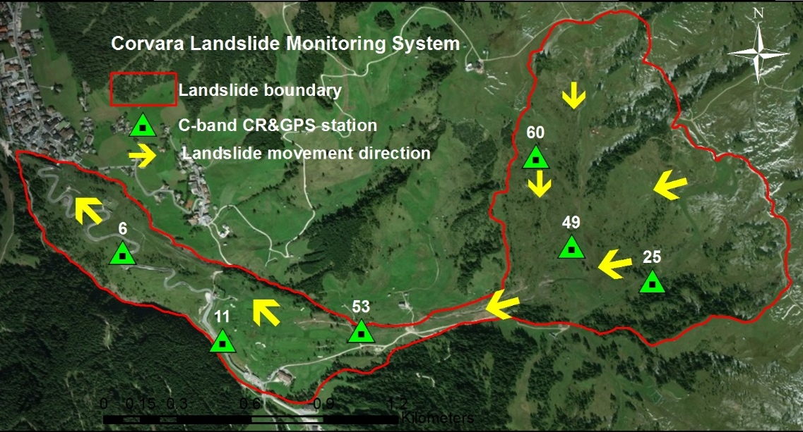
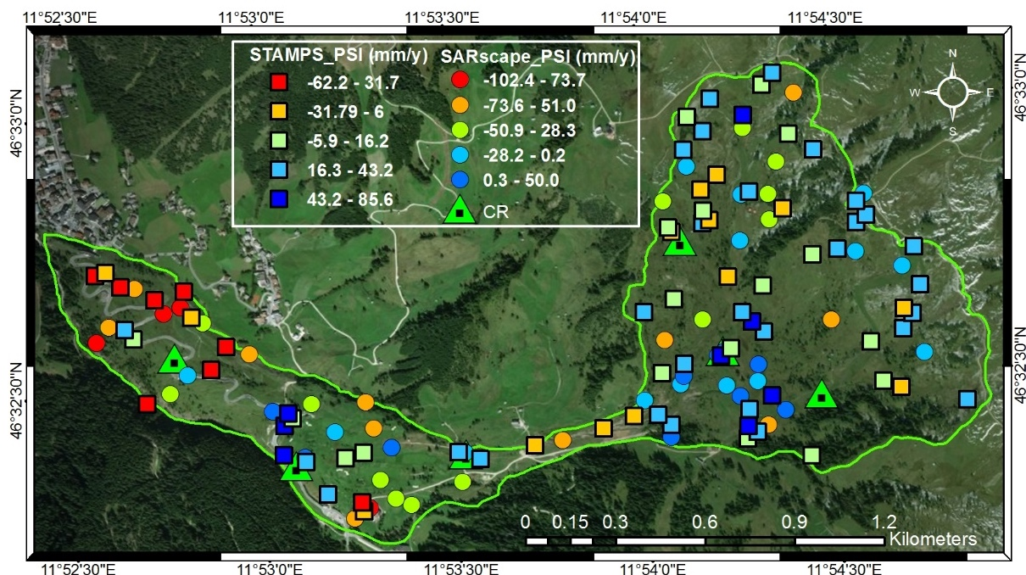
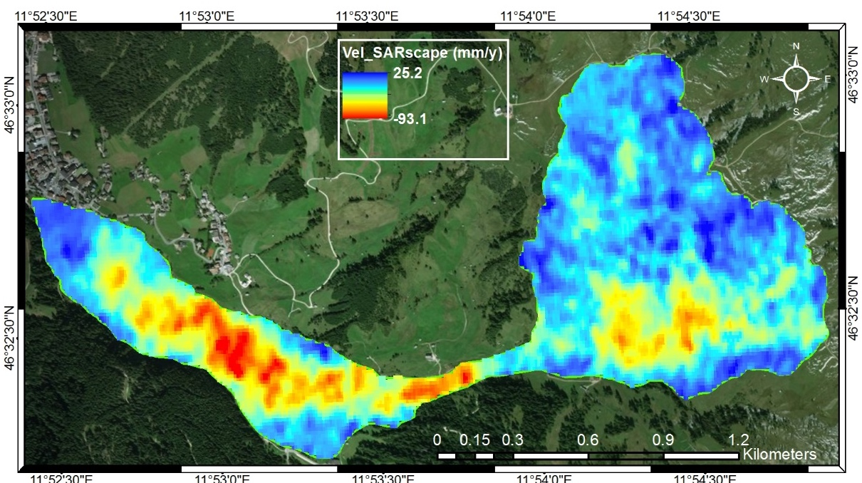
Situation maps
Deformation maps of the Corvara landslide (Italy) from multi-temporal InSAR techniques:
Persistent Scatterrer Interferometry (PSI)
Small Baseline Subset (SBAS)
Satellite path
LOS
LOS velocity derived from PSI (StaMPS & SARscape software)
LOS velocity derived from SBAS (SARscape)

Slide 11
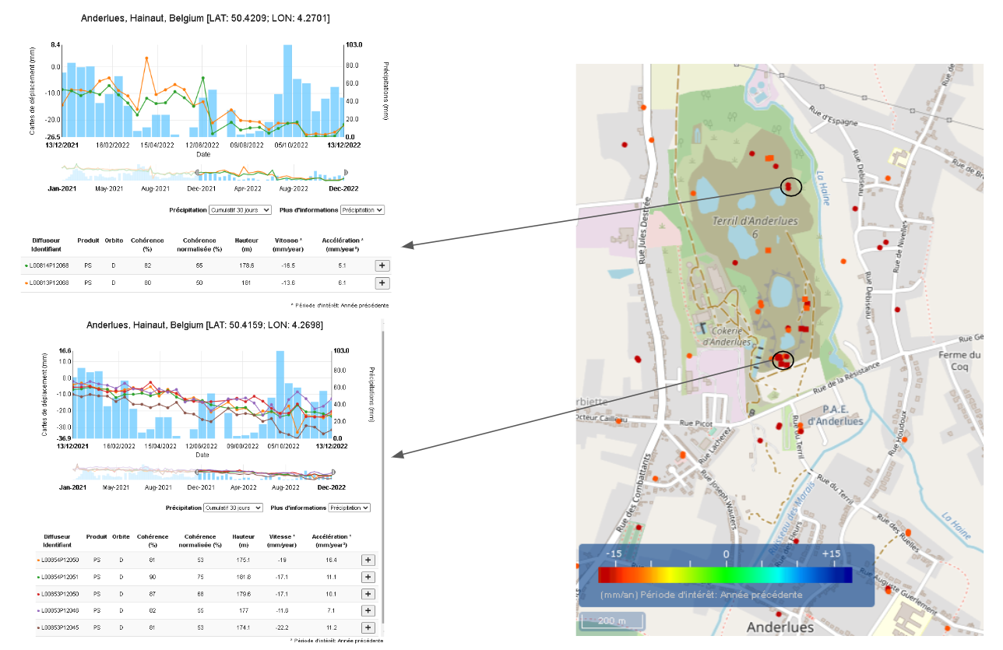
Assessment preparedness & risk analysis
Analysing deformation rate (subsidence)
Relationship with triggering factors
Precipitation
Seismo-tectonics
Snow melt – Temperature
Risk for the infrastructure
Cross with road/houses baselines
Impacting houses/industries
High added-value

Slide 12
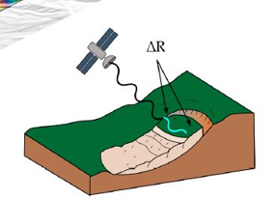
Conclusions
SPACEBEL mission is to provide adapted EO-based solutions to customers’ needs
Optical remote sensing
Quickly detect and monitor fast moving processes, disasters and impacted areas (e.g. mudflow, flood)
But also interesting to: recognize mass movement features and changing vegetation (NDVI)
Numerous high- and medium- resolution sensors, such as Pleiades (expensive) and Sentinel-2 (open access) to study HORIZONTAL displacement patterns and changes
SAR remote sensing
D-InSAR combined with an a priori knowledge of slope deformation processes (e.g. slow landslide, earthquake) is very promising to:
→ Detect, monitor, study (VERTICAL) displacement patterns and kinematic evolution of active and complex Earth surface deformation (also in mountainous conditions)
But also interesting to: detect unknown and slow moving mass movements
Added value for situation maps and risk assessment preparedness

Slide 13
Thanks for your attention!
Don’t hesitate to reach out ☺
eoservices@spacebel.be or romy.schlogel@spacebel.be
And visit: www.spacebel.com; http://eoregions.com/

