Slide 1
Synthetic Aperture Radar for hazard monitoring
CENTRE SPATIAL DE LIEGE
Serge Habraken
shabraken@uliege.be
Dominique Derauw
dderauw@uliege.be
dderauw@unrn.edu.ar
Anne Orban
aorban@uliege.be

Slide 2
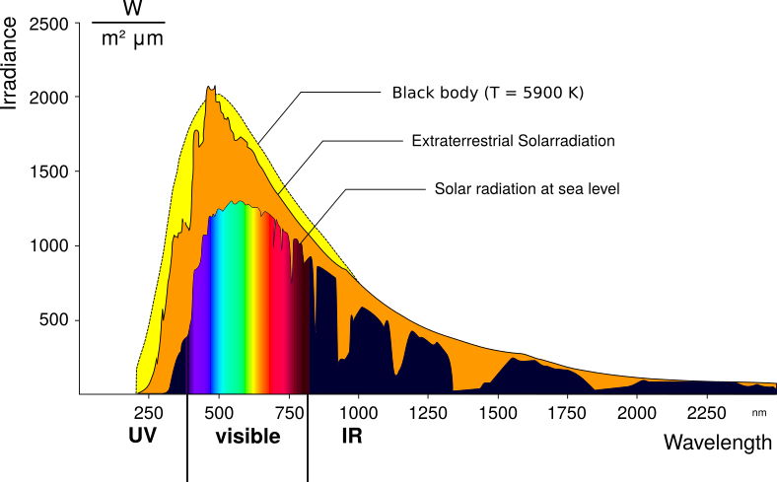
Earth Observation: Passive remote sensing
Passive observation
To observe self emitting objects
To observe diffuse reflection from the solar illumination
Allows a spectral analysis

Slide 3
Earth Observation: Active remote sensing
Active observation
The sensor is illuminating the scene with microwaves (Radar) or Laser (Lidar)
Allows day and night observations.
Very good atmosphere transparency ➔ all-weather observations.
Synthetic Aperture Radar: retrieve :
Topographic measurements
Displacement measurements.
Radar :

Slide 4
SAR remote sensing:
Numerous available sensors with large temporal archives:
Sentinel1 (EU), CosmoSkyMed (IT), SAOCOM 1 & 2 (AR), TerraSAR-X (D), TanDEM-X (D), ALOS2 (JP), RadarSAT (CA), PAZ (ES), KompSAT5(KP), ICEYE (FI), Capella (US), …
COPERNICUS Sentinel1 mission offers freely available observation every 12 days
Sentinel1A – February 21, 2021

Slide 5
SAR interferometry (InSAR)
SAR interferometry consists in:
Combining two SAR images to generate an interferogram.
In absence of perturbations, fringes are like contour lines.
Counting contour lines allows reconstructing / measuring the topography.
Coherence is an important quality indicator showing scene stability between acquisitions.

Slide 6
Coherence monitoring for wildfire delineation
Coherence losses indicate scene structure variation with time.
As such it is an indicator of:
Human activity,
Vegetation changes,
Wild fires,
Flooding,
…
Delineation of the Collon Curá de la Piedra wildfire,
Neuquen, Argentina – March 2019.
Coherence losses due to wildfire is shown in red

Slide 7
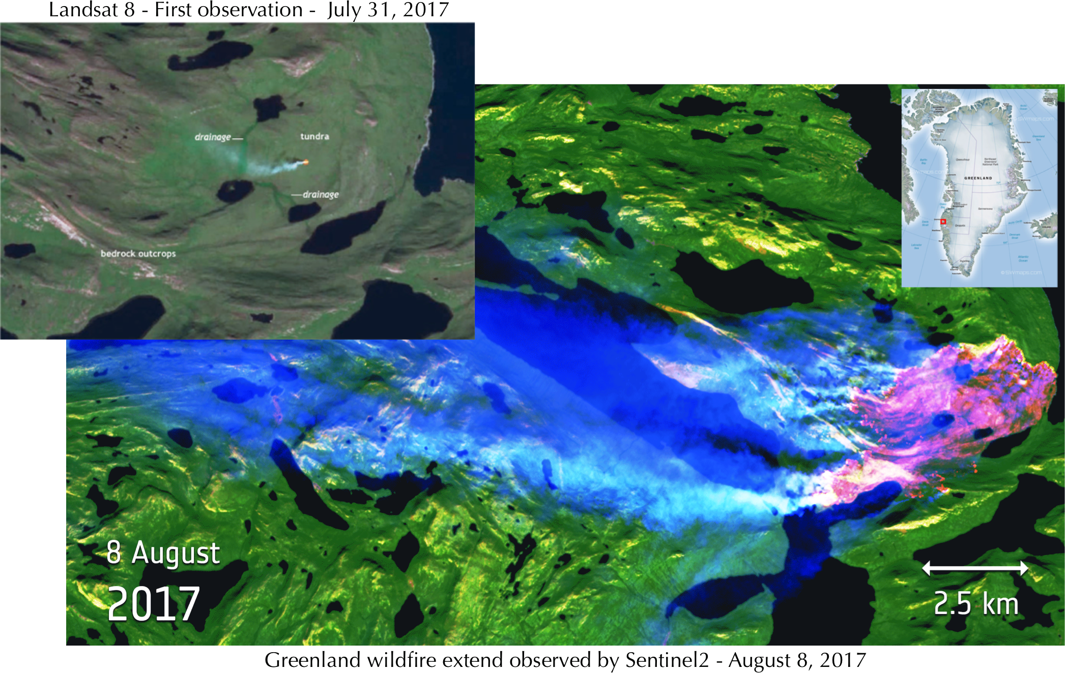
Dynamic coherence for wildfire monitoring
A peat wildfire started on July 31, 2017 in Greenland
Upper left insert shows wildfire as observed in infrared by Sentinel2 on August 8.
All available interferometric pairs were used to compute coherence (scene stability) between consecutive dates:
Burnt scare appears in red when only one acquisition observes a burnt area.
Nuuk peat wildfire monitoring
Greenland, August 2017
Coherence losses due to wildfire is shown in red

Slide 8
Flooding delineation
Combining SAR intensity images at different dates, one can delineate flooded areas.
Liege area, July 2021
Flooded areas appear in red

Slide 9
Glacier monitoring
Tracking coherence to optimize the interferometric signal on pixel-by-pixel basis allows getting a first approximation of on-ground displacements.
Right animation shows a 6-days displacements simulation of the Shirase glacier in Antarctica.
Results derived from an ERS tandem pair of 1996.

Slide 10
Glacier monitoring
Tracking coherence to optimize the interferometric signal allows getting bi-dimensional estimates of horizontal displacements
Right: Drauning Maud iceshelf monitoring based on Sentinel1 pair of images acquired in 2018.
Velocity measurements allows getting mass balance estimates.

Slide 11
Images time series for volcanic monitoring
Nowadays profusion of data allows monitoring area of interest:
Example: Observation with time of the lava lake level of the Nyiragongo volcano, Democratic Republic of Congo
Centre: high resolution CosmoSkyMed time series
Left and right, medium resolution ascending and descending Sentinel1 time series

Slide 12
SAR differential interferometry (DInSAR)
SAR differential interferometry consists in:
Combining two SAR images to generate an interferogram.
Perturbations are due to local displacements occurring between acquisition dates.
Removing the topographic component of the interferogram to keep only information due to perturbations.
Displacement can then be measured with millimetric precision
Displacement mapping allows studying and understanding geophysics process
Oaxaca, Mexico earthquake (7.4 Richter scale)
June 23, 2020
Each fringe corresponds to a ~4 cm vertical displacement.

Slide 13
SAR differential interferometry (DInSAR)
SAR differential interferometry consists in:
Combining two SAR images to generate an interferogram.
Perturbations are due to local displacements occurring between acquisition dates.
Removing the topographic component of the interferogram to keep only information due to perturbations.
Displacement can then be measured with millimetric precision
Displacement mapping allows studying and understanding geophysics process

Slide 14
Time series processing for displacement monitoring
Time series processing of the Laguna del Maule (Chile) and Domuyo (Argentina) volcanoes:
Allows following volcanic activity on a day by day basis.
Green curves show vertical displacements.
Blue curves show Eastward displacements.
The Laguna del Maule shows a continuous 25 cm per year inflation.
Domuyo followed same tendency up to 2020.
Results freely available at:
http://terra3.ecgs.lu/defo-domuyo

Slide 15
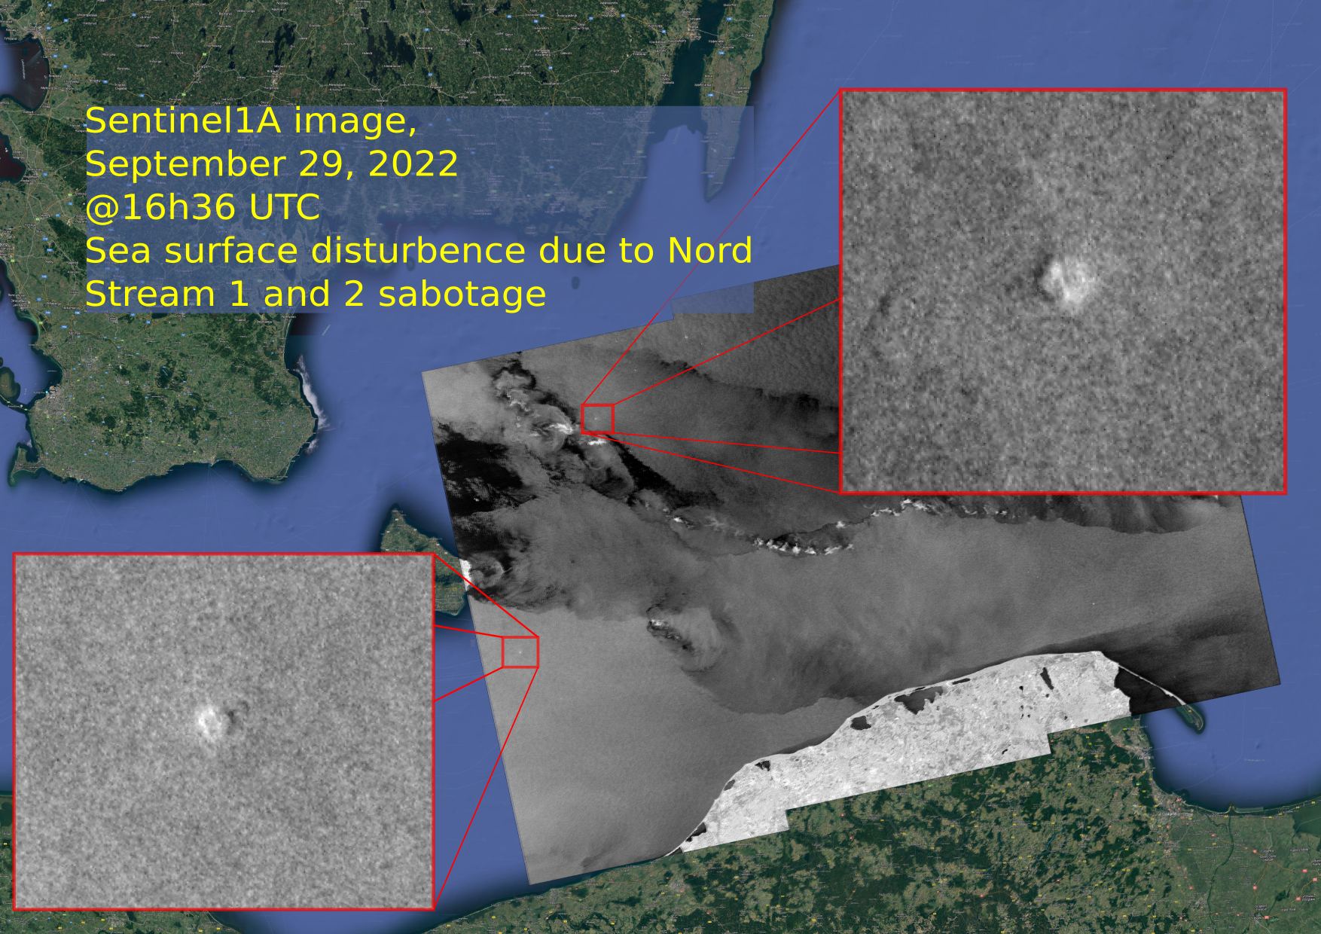
Human activity
SAR images are particularly prone to show see surface currents.
In some peculiar cases, other sea surface perturbations are observable.

Slide 16
Thank you! Questions?

